Slide 1
Revelation 15-16

Slide 2
The seven seals, trumpets and bowls of wrath
Repetitions (sea turns to blood, the heavenly bodies become dark)
Incongruities (sun is dark, stars have fallen and the sky has vanished in 6:12-17 yet they are darkened again in 8:12)
Differing responses to judgment
7 seals= the redeemed stand in God's presence
7 trumpets= people refuse to repent
7 bowls of wrath= God's adversaries intensify their rebellion and Babylon is finally judged

Slide 3
Why must God judge people anyway?

Slide 4
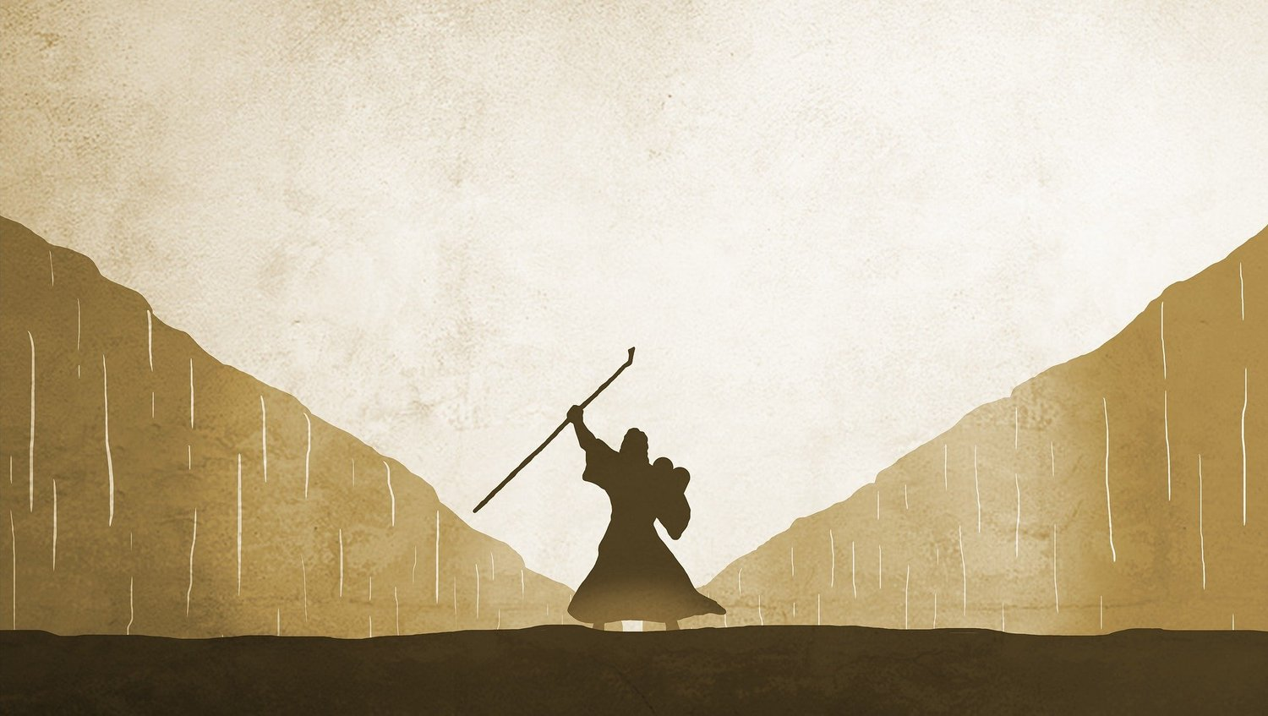
Typology in 15 and 16= Moses and the Ten Plagues
The conquerors of the beast sing the song of Moses and the lamb (15:5)
Sores, blood in water, darkness, and spirits like frogs (16)
The foreign oppressor of God's people will be defeated and it can only come about through his great power and judgment (15:3, 16:5-7)

Slide 5
The completion of God's wrath
Revelation 15:1 Then I saw another portent in heaven, great and amazing: seven angels with seven plagues, which are the last, for with them the wrath of God is ended.

Slide 6
The song of Moses and the Lamb
Revelation 15:2 And I saw what appeared to be a sea of glass mixed with fire, and those who had conquered the beast and its image and the number of its name standing beside the sea of glass with harps of God in their hands. ³ And they sing the song of Moses, the servant of God, and the song of the Lamb: ‘Great and amazing are your deeds, Lord God the Almighty! Just and true are your ways, King of the nations ⁴ Lord, who will not fear and glorify your name? For you alone are holy. All nations will come and worship before you, for your judgements have been revealed.’

Slide 7
The song of Moses?
Exodus 15:11-12 ‘Who is like you, O Lord, among the gods? Who is like you, majestic in holiness, awesome in splendour, doing wonders? 12 You stretched out your right hand, the earth swallowed them.
Deuteronomy 32:8 When the Most High apportioned the nations, when he divided humankind, he fixed the boundaries of the peoples according to the number of the gods; ⁹ the Lord’s own portion was his people, Jacob his allotted share.
3 songs are by or about Moses (Exodus 15; Deuteronomy 32; Psalm 90)
None are particularly close to Rev. 15:3-4.

Slide 8
Rabbinic tradition concerning Moses' future song
"It is not said that Moses sang (sar), but rather he will sing (yasir) in the Age to Come—In the Age to Come Israel will sing a song to the Lord," Tanhuma Exodus 30B.

Slide 9
The seven angels appear
Revelation 15:5 After this I looked, and the temple of the tent of witness in heaven was opened, ⁶ and out of the temple came the seven angels with the seven plagues, robed in pure bright linen, with golden sashes across their chests. ⁷ Then one of the four living creatures gave the seven angels seven golden bowls full of the wrath of God, who lives for ever and ever; ⁸ and the temple was filled with smoke from the glory of God and from his power, and no one could enter the temple until the seven plagues of the seven angels were ended.

Slide 10
The opening of the temple before war
"[Janus] also has a temple at Rome with double doors, which they call the gates of war; for it always stands open in time of war, but is closed when peace has come. The latter was a difficult matter, and it rarely happened, since the realm was always engaged in some war, as its increasing size brought it into collision with the barbarous nations which encompassed it round about. But in the time of Augustus it was closed, after he had overthrown Mark Antony; and before that, when Marcus Atilius and Titus Manlius were consuls, it was closed for a short time; then war broke out again at once, and it was opened," Plutarch, Life of Numa.

Slide 11
The seven angels appear
Revelation 15:5 After this I looked, and the temple of the tent of witness in heaven was opened, ⁶ and out of the temple came the seven angels with the seven plagues, robed in pure bright linen, with golden sashes across their chests. ⁷ Then one of the four living creatures gave the seven angels seven golden bowls full of the wrath of God, who lives for ever and ever; ⁸ and the temple was filled with smoke from the glory of God and from his power, and no one could enter the temple until the seven plagues of the seven angels were ended.

Slide 12
Bowls of wrath= libation bowls
In Greco-Roman religions, the bowls typically used as offerings to the gods.
It usually contained wine.
Thus the significance of the bowls has been changed from offering to judgment.

Slide 13
Libation bowls
Exodus 27:1 You shall make the altar of acacia wood, five cubits long and five cubits wide; the altar shall be square, and it shall be three cubits high. ² You shall make horns for it on its four corners; its horns shall be of one piece with it, and you shall overlay it with bronze. ³ You shall make pots for it to receive its ashes, and shovels and basins and forks and firepans; you shall make all its utensils of bronze
"This (ground) will one day provide you the strongest of vines, and rich flowing wine: from it come fruitful grapes, and the juice we offer in golden bowls," Vergil, Georgics 2.192.

Slide 14
No one could enter
Revelation 15:5 After this I looked, and the temple of the tent of witness in heaven was opened, ⁶ and out of the temple came the seven angels with the seven plagues, robed in pure bright linen, with golden sashes across their chests. ⁷ Then one of the four living creatures gave the seven angels seven golden bowls full of the wrath of God, who lives for ever and ever; ⁸ and the temple was filled with smoke from the glory of God and from his power, and no one could enter the temple until the seven plagues of the seven angels were ended.

Slide 15
Solomon's dedication of the temple
2 Chronicles 7:1 When Solomon had ended his prayer, fire came down from heaven and consumed the burnt-offering and the sacrifices; and the glory of the Lord filled the temple. ² The priests could not enter the house of the Lord, because the glory of the Lord filled the Lord’s house. ³ When all the people of Israel saw the fire come down and the glory of the Lord on the temple, they bowed down on the pavement with their faces to the ground, and worshipped and gave thanks to the Lord, saying, ‘For he is good, for his steadfast love endures for ever.’

Slide 16
The seven bowls of wrath

Slide 17
The pouring of the first three bowls
Revelation 16:1 Then I heard a loud voice from the temple telling the seven angels, ‘Go and pour out on the earth the seven bowls of the wrath of God.’ ² So the first angel went and poured his bowl on the earth, and a foul and painful sore came on those who had the mark of the beast and who worshipped its image.³ The second angel poured his bowl into the sea, and it became like the blood of a corpse, and every living thing in the sea died. ⁴ The third angel poured his bowl into the rivers and the springs of water, and they became blood. ⁵ And I heard the angel of the waters say, ‘You are just, O Holy One, who are and were, for you have judged these things; 6 because they shed the blood of saints and prophets, you have given them blood to drink. It is what they deserve!’

Slide 18
Pouring out of God's judgment
Jeremiah 7:20 Therefore thus says the Lord God: My anger and my wrath shall be poured out on this place, on human beings and animals, on the trees of the field and the fruit of the ground; it will burn and not be quenched.
Jeremiah 10:25 Pour out your wrath on the nations that do not know you, and on the peoples that do not call on your name; for they have devoured Jacob; they have devoured him and consumed him, and have laid waste his habitation.

Slide 19
The sun scorched people
Revelation 16:7 And I heard the altar respond, ‘Yes, O Lord God, the Almighty, your judgements are true and just!’ ⁸ The fourth angel poured his bowl on the sun, and it was allowed to scorch people with fire; ⁹ they were scorched by the fierce heat, but they cursed the name of God, who had authority over these plagues, and they did not repent and give him glory.

