Slide 1
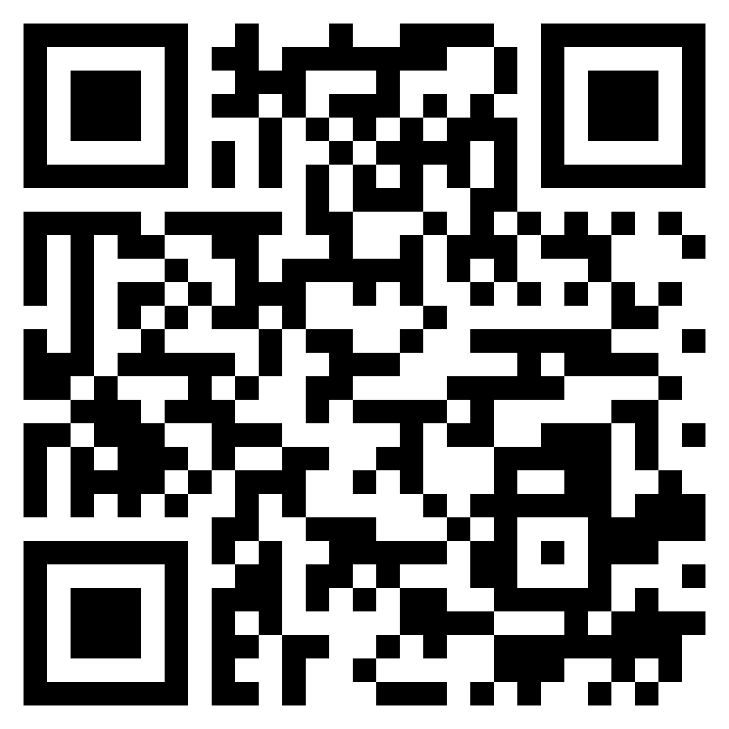
Paul’s letter
to the ROMANS

Slide 2
Romans 2:17 (ESV)
¹⁷ But if you call yourself a Jew and rely on the law and boast in God
problem with
the Law

Slide 3
covenant and
the Law

Slide 4
Covenant / Relationship with God
Grace / blessings come from relationship
Law = staying in covenant
covenant and
the Law

Slide 5
Mosaic covenant was a national covenant
Mosaic covenant was based on grace
Keeping the covenant / Law kept one in covenant with God
Forsaking the covenant / Law brought curses (i.e. out of relationship with God)
Law was important, not because it earned God’s blessings, but because it kept one in covenant
covenant and
the Law

Slide 6
legalism and
the Law

Slide 7
Covenant / Relationship with God
Grace / blessings come from relationship
Law = staying in covenant
legalism and
the Law

Slide 8
Covenant / Relationship with God
Grace / blessings come from relationship
Law = people of God
legalism and
the Law

Slide 9
Jews did not believe that they could earn salvation, but they did believe their salvation lay in the fact that they were God’s chosen people, with God’s Law.
Many (Pharisees in particular) viewed with contempt those who did not closely follow the Law.
Jews viewed with contempt the Gentiles who did not have the Law.
legalism and
the Law

Slide 10
Problem wasn’t with obedience! (Romans 1.5)
Jewish reliance on the Law hindered faith in Christ
Jewish reliance on the Law led to Jews binding the Law on their Gentile brethren
problem with
the Law

