Slide 2
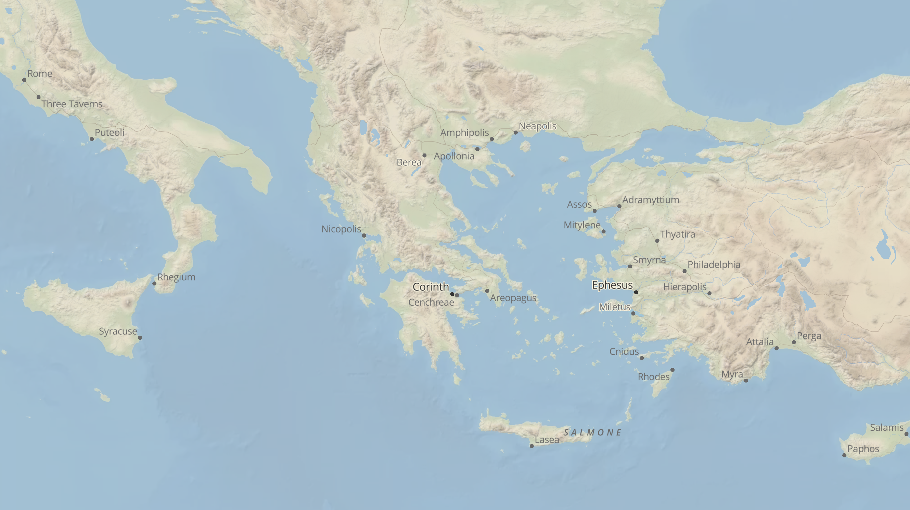

Slide 4
From Pontus to Rome (before 49AD)

Slide 5
From Pontus to Rome (before 49AD)
From Rome to Corinth (49AD)

Slide 6
From Pontus to Rome (before 49AD)
From Rome to Corinth (49AD)
From Corinth to Ephesus (54AD)

Slide 7
From Pontus to Rome (before 49AD)
From Rome to Corinth (49AD)
From Corinth to Ephesus (54AD)
From Ephesus to Rome (before 58AD)

Slide 8
From Pontus to Rome (before 49AD)
From Rome to Corinth (49AD)
From Corinth to Ephesus (54AD)
From Ephesus to Rome (before 58AD)
From Rome to Ephesus (before 65AD)

Slide 9
Aquila & Priscilla
A Leadership Team
a true team
a team who was willing to be influenced
a team who influenced

