Slide 1
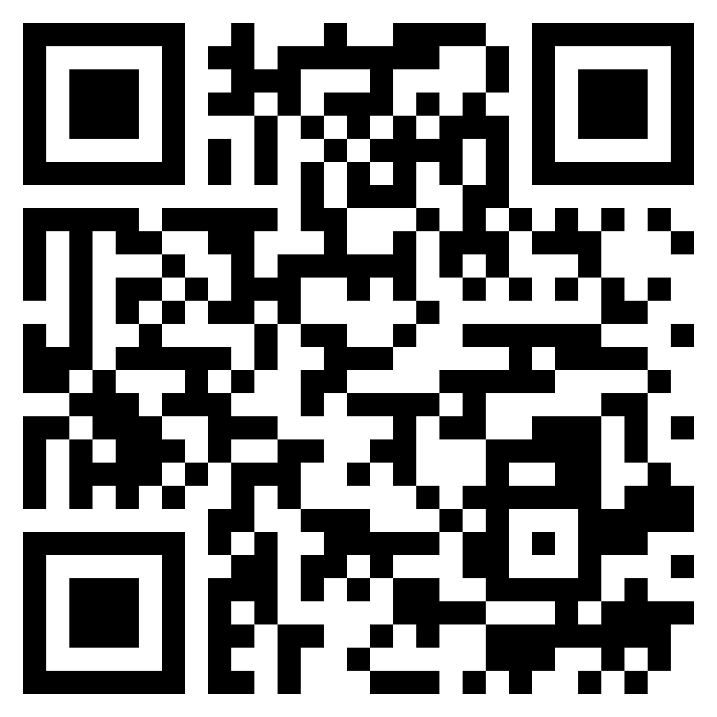
Paul’s letter
to the ROMANS

Slide 2
Romans 2:17–20 (ESV)
¹⁷ But if you call yourself a Jew and rely on the law and boast in God ¹⁸ and know his will and approve what is excellent, because you are instructed from the law; ¹⁹ and if you are sure that you yourself are a guide to the blind, a light to those who are in darkness, ²⁰ an instructor of the foolish, a teacher of children, having in the law the embodiment of knowledge and truth—
misplaced
boasting

Slide 3
Romans 2:21–24 (ESV)
²¹ you then who teach others, do you not teach yourself? While you preach against stealing, do you steal? ²² You who say that one must not commit adultery, do you commit adultery? You who abhor idols, do you rob temples? ²³ You who boast in the law dishonor God by breaking the law. ²⁴ For, as it is written, “The name of God is blasphemed among the Gentiles because of you.”
misplaced
boasting

Slide 4
Romans 2:25–29 (ESV)
²⁵ For circumcision indeed is of value if you obey the law, but if you break the law, your circumcision becomes uncircumcision. ²⁶ So, if a man who is uncircumcised keeps the precepts of the law, will not his uncircumcision be regarded as circumcision? ²⁷ Then he who is physically uncircumcised but keeps the law will condemn you who have the written code and circumcision but break the law. ²⁸ For no one is a Jew who is merely one outwardly, nor is circumcision outward and physical. ²⁹ But a Jew is one inwardly, and circumcision is a matter of the heart, by the Spirit, not by the letter. His praise is not from man but from God.
the true
circumcision

Slide 5
Romans 3:1–2 (ESV)
¹ Then what advantage has the Jew? Or what is the value of circumcision? ² Much in every way. To begin with, the Jews were entrusted with the oracles of God.
objections
answered

Slide 6
Romans 3:3–4 (ESV)
³ What if some were unfaithful? Does their faithlessness nullify the faithfulness of God? ⁴ By no means! Let God be true though every one were a liar, as it is written, “That you may be justified in your words, and prevail when you are judged.”
objections
answered

Slide 7
Romans 3:5–8 (ESV)
⁵ But if our unrighteousness serves to show the righteousness of God, what shall we say? That God is unrighteous to inflict wrath on us? (I speak in a human way.) ⁶ By no means! For then how could God judge the world? ⁷ But if through my lie God’s truth abounds to his glory, why am I still being condemned as a sinner? ⁸ And why not do evil that good may come?—as some people slanderously charge us with saying. Their condemnation is just.
objections
answered

