Slide 1
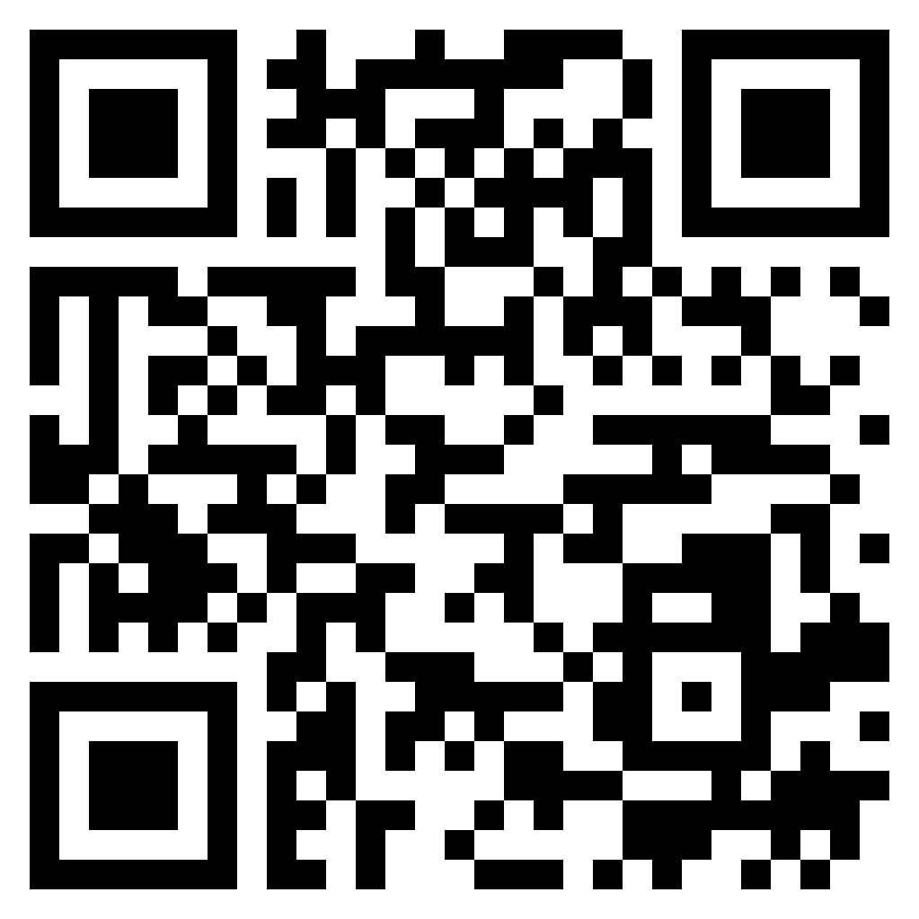
Paul’s letter
to the ROMANS

Slide 2
Romans 4:1-3 (ESV)
¹ What then shall we say was gained by Abraham, our forefather according to the flesh? ² For if Abraham was justified by works, he has something to boast about, but not before God. ³ For what does Scripture say? “Abraham believed God, and it was counted to him as righteousness.”
Abraham
Justified by FAITH

Slide 3
Romans 4:4-5 (ESV)
⁴ Now to the one who works, his wages are not counted as a gift but as his due. ⁵ And to the one who does not work but believes in him who justifies the ungodly, his faith is counted as righteousness,
Abraham
Justified by FAITH

Slide 4
Romans 4:6-8 (ESV)
⁶ just as David also speaks of the blessing of the one to whom God counts righteousness apart from the works:
^{7 “}Blessed are those whose lawless deeds are forgiven, and whose sins are covered;
⁸ blessed is the man against whom the Lord will not count as his sin.”
Abraham
Justified by FAITH

Slide 5
Romans 4:9-11 (ESV)
⁹ Is this blessing only for the circumcised, or also for the uncircumcised? For we say that faith was counted to Abraham as righteousness. ¹⁰ How then was it counted to him? Was it before or after he had been circumcised? it was not after, but before he was circumcised. ¹¹ He received the sign of circumcision as a seal of righteousness that he had by faith while he was still uncircumcised. The purpose was to make him the father of all who believed without being circumcised, so that righteousness would be counted to them as well,
Abraham
Justified by FAITH

Slide 6
Romans 4:12 (ESV)
¹² and to make him the father of the circumcised who are not merely circumcised but who also walk in the footsteps of the faith that our father Abraham had walked before he was circumcised.
Abraham
Justified by FAITH

Slide 7
Romans 4:13-15 (ESV)
¹³ For the promise to Abraham and his offspring that he would be heir of the world did not come through the law but through the righteousness of faith. ¹⁴ For if it is the adherents of the law who are to be heirs, faith is null and the promise is void. ¹⁵ For the law brings wrath, but where there is no law there is no transgression.
Promise
Realized Through FAITH

Slide 8
Romans 4:16-17 (ESV)
¹⁶ That is why it depends on faith, in order that the promise may rest on grace and be guaranteed to all his offspring – not only to the adherent of the law but also to the one who shares the faith of Abraham, who is the father of us all, ¹⁷ as it is written, “I have made you the father of many nations” – in the presence of God in whom he believed, who gives life to the dead and calls into existence the things that do not exist.
Promise
Realized Through FAITH

Slide 9
Romans 4:18-20 (ESV)
¹⁸ In hope he believed against hope, that he should become the father of many nations, as he had been told, “So shall your offspring be.” ¹⁹ He did not weaken in faith when he considered his own body, which was as good as dead (since he was about a hundred years old), or when he considered the barrenness of Sarah’s womb. ²⁰ No unbelief made him waver concerning the promise of God, but he grew strong in his faith as he gave glory to God,
Promise
Realized Through FAITH

Slide 10
Romans 4:21-25 (ESV)
²¹ fully convinced that God was able to do what he had promised.
²² That is why his faith was “counted to him as righteousness.” ²³ But the words “it was counted to him” were not written for his sake alone, ²⁴ but for ours also. It will be counted to us who believe in him who raised from the dead Jesus our Lord, ²⁵ who was delivered up for our trespasses and raised for our justification.
Promise
Realized Through FAITH

Slide 11
Primary reason is to exclude water baptism from salvation
Paul never says faith “alone”
Ignores obedience taught throughout all of Scripture
James 2:24
“Works” in Romans 4 are different than Colossians 2 or James 2
Paul speaks on “obedience of faith” (1:5), water baptism (Ch 6)- and confession (Ch 10) as being part of salvation
Faith
Not ONLY Faith

Slide 12
1 Peter 3:21 – Baptism, which corresponds to this, now saves you, not as a removal of dirt from the body but as an appeal to God for a good conscience, through the resurrection of Jesus Christ…
Faith
Not ONLY Faith

