Slide 1
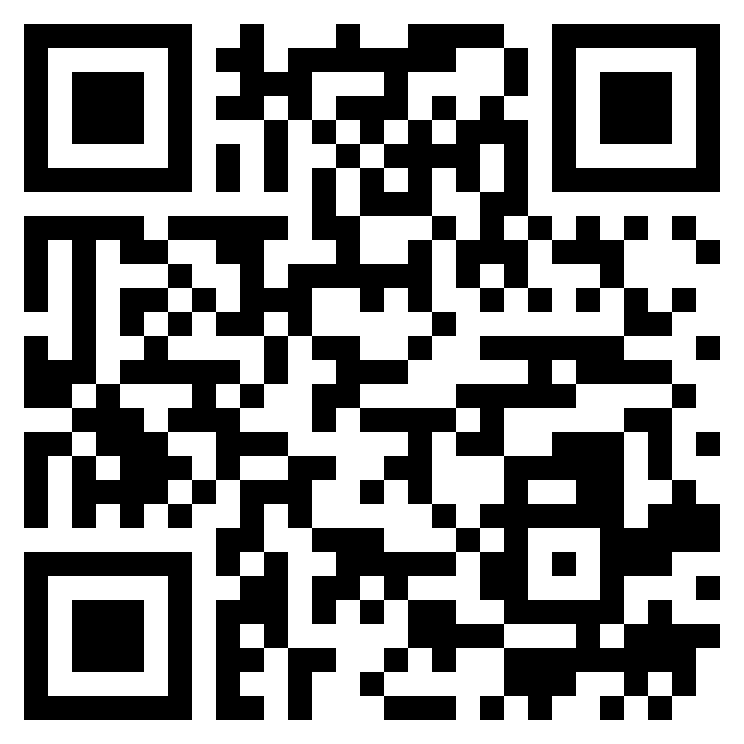
Paul’s letter
to the ROMANS

Slide 2
Ephesians 1:1–2 (ESV)
¹ Paul, an apostle of Christ Jesus by the will of God, To the saints who are in Ephesus, and are faithful in Christ Jesus: 2 Grace to you and peace from God our Father and the Lord Jesus Christ.
the gospel
Romans 1.1-17

Slide 3
Philippians 1:1–2 (ESV)
¹ Paul and Timothy, servants of Christ Jesus, To all the saints in Christ Jesus who are at Philippi, with the overseers and deacons: ² Grace to you and peace from God our Father and the Lord Jesus Christ.
the gospel
Romans 1.1-17

Slide 4
Colossians 1:1–2 (ESV)
¹ Paul, an apostle of Christ Jesus by the will of God, and Timothy our brother, ² To the saints and faithful brothers in Christ at Colossae: Grace to you and peace from God our Father.
the gospel
Romans 1.1-17

Slide 5
1 Thessalonians 1:1 (ESV)
¹ Paul, Silvanus, and Timothy, To the church of the Thessalonians in God the Father and the Lord Jesus Christ: Grace to you and peace.
the gospel
Romans 1.1-17

Slide 6
Romans 1:1–5 (ESV)
¹Paul, a servant of Christ Jesus, called to be an apostle, set apart for the gospel of God,
²which he promised beforehand through his prophets in the holy Scriptures,
³concerning his Son, who was descended from David according to the flesh
⁴and was declared to be the Son of God in power according to the Spirit of holiness by his resurrection from the dead, Jesus Christ our Lord,
⁵through whom we have received grace and apostleship to bring about the obedience of faith for the sake of his name among all the nations,
the gospel
Romans 1.1-17

Slide 7
Romans 1:1–5 (ESV)
¹Paul, a servant of Christ Jesus, called to be an apostle, set apart for the gospel of God,
²which he promised beforehand through his prophets in the holy Scriptures,
³concerning his Son, who was descended from David according to the flesh
⁴and was declared to be the Son of God in power according to the Spirit of holiness by his resurrection from the dead, Jesus Christ our Lord,
⁵through whom we have received grace and apostleship to bring about the obedience of faith for the sake of his name among all the nations,
the gospel
Romans 1.1-17

Slide 8
Romans 1:1–5 (ESV)
¹Paul, a servant of Christ Jesus, called to be an apostle, set apart for the gospel of God,
²which he promised beforehand through his prophets in the holy Scriptures,
³concerning his Son, who was descended from David according to the flesh
⁴and was declared to be the Son of God in power according to the Spirit of holiness by his resurrection from the dead, Jesus Christ our Lord,
⁵through whom we have received grace and apostleship to bring about the obedience of faith for the sake of his name among all the nations,
the gospel
Romans 1.1-17

Slide 9
Romans 1:1–5 (ESV)
¹Paul, a servant of Christ Jesus, called to be an apostle, set apart for the gospel of God,
²which he promised beforehand through his prophets in the holy Scriptures,
³concerning his Son, who was descended from David according to the flesh
⁴and was declared to be the Son of God in power according to the Spirit of holiness by his resurrection from the dead, Jesus Christ our Lord,
⁵through whom we have received grace and apostleship to bring about the obedience of faith for the sake of his name among all the nations,
the gospel
Romans 1.1-17

Slide 10
Romans 1:1–5 (ESV)
¹Paul, a servant of Christ Jesus, called to be an apostle, set apart for the gospel of God,
²which he promised beforehand through his prophets in the holy Scriptures,
³concerning his Son, who was descended from David according to the flesh
⁴and was declared to be the Son of God in power according to the Spirit of holiness by his resurrection from the dead, Jesus Christ our Lord,
⁵through whom we have received grace and apostleship to bring about the obedience of faith for the sake of his name among all the nations,
the gospel
Romans 1.1-17

Slide 11
Romans 1:1–5 (ESV)
¹Paul, a servant of Christ Jesus, called to be an apostle, set apart for the gospel of God,
²which he promised beforehand through his prophets in the holy Scriptures,
³concerning his Son, who was descended from David according to the flesh
⁴and was declared to be the Son of God in power according to the Spirit of holiness by his resurrection from the dead, Jesus Christ our Lord,
⁵through whom we have received grace and apostleship to bring about the obedience of faith for the sake of his name among all the nations,
the gospel
Romans 1.1-17

Slide 12
Romans 1:6–7 (ESV)
⁶including you who are called to belong to Jesus Christ,
⁷To all those in Rome who are loved by God and called to be saints: Grace to you and peace from God our Father and the Lord Jesus Christ.
the gospel
Romans 1.1-17

Slide 13
Romans 1:8–12 (ESV)
⁸First, I thank my God through Jesus Christ for all of you, because your faith is proclaimed in all the world.
⁹For God is my witness, whom I serve with my spirit in the gospel of his Son, that without ceasing I mention you
¹⁰always in my prayers, asking that somehow by God’s will I may now at last succeed in coming to you.
¹¹For I long to see you, that I may impart to you some spiritual gift to strengthen you—
¹²that is, that we may be mutually encouraged by each other’s faith, both yours and mine.
the gospel
Romans 1.1-17

Slide 14
Romans 1:8–12 (ESV)
⁸First, I thank my God through Jesus Christ for all of you, because your faith is proclaimed in all the world.
⁹For God is my witness, whom I serve with my spirit in the gospel of his Son, that without ceasing I mention you
¹⁰always in my prayers, asking that somehow by God’s will I may now at last succeed in coming to you.
¹¹For I long to see you, that I may impart to you some spiritual gift to strengthen you—
¹²that is, that we may be mutually encouraged by each other’s faith, both yours and mine.
the gospel
Romans 1.1-17

Slide 15
Romans 1:13–15 (ESV)
¹³I do not want you to be unaware, brothers, that I have often intended to come to you (but thus far have been prevented), in order that I may reap some harvest among you as well as among the rest of the Gentiles.
¹⁴I am under obligation both to Greeks and to barbarians, both to the wise and to the foolish.
¹⁵So I am eager to preach the gospel to you also who are in Rome.
the gospel
Romans 1.1-17

Slide 16
Romans 1:16–17 (ESV)
¹⁶For I am not ashamed of the gospel, for it is the power of God for salvation to everyone who believes, to the Jew first and also to the Greek.
¹⁷For in it the righteousness of God is revealed from faith for faith, as it is written, “The righteous shall live by faith.”
the gospel
Romans 1.1-17

Slide 17
Romans 1:16–17 (ESV)
¹⁶For I am not ashamed of the gospel, for it is the power of God for salvation to everyone who believes, to the Jew first and also to the Greek.
¹⁷For in it the righteousness of God is revealed from faith for faith, as it is written, “The righteous shall live by faith.”
the gospel
Romans 1.1-17

