Slide 1
Leading Godly in an Ungodly World

Slide 2
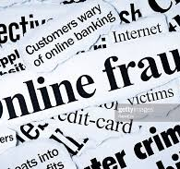
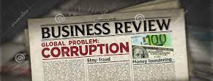
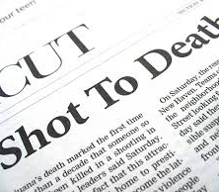
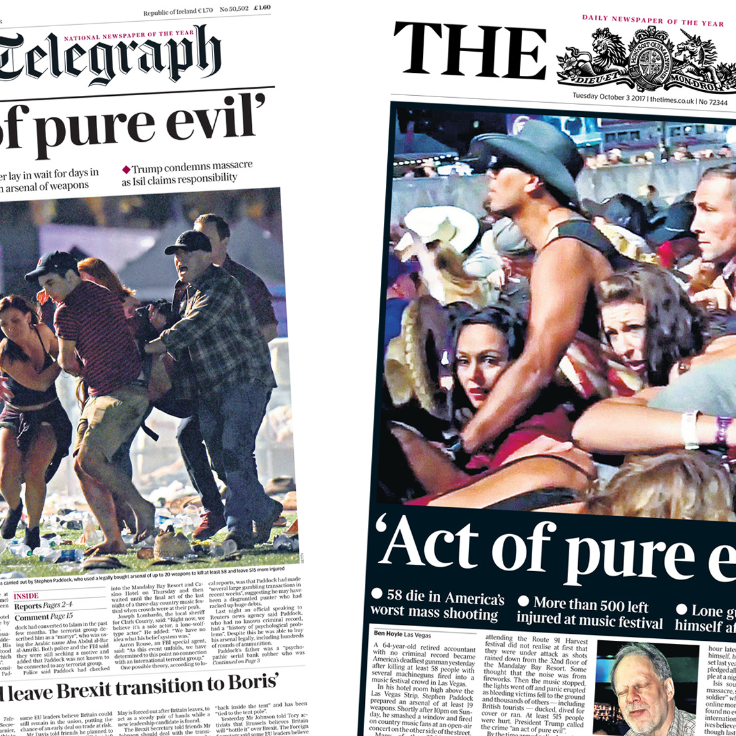
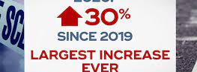

Slide 3
Does it really matter to anyone that I am trying to live righteously?
How are Christians going to prevail, in the country, in our workplaces, in our homes?

Slide 4
Crumbling Leadership in Our Nation
Crumbling Leadership in Our Homes
Crumbling Leadership in Our Churches
Crumbling Leadership in Our Work

Slide 5
“Celebrate What is Right With the World”

Slide 6
Believed the Warning
Served with Reverence
Acted with Purpose
Hebrews 11:7
7 By faith Noah, being warned by God concerning events as yet unseen, in reverent fear constructed an ark for the saving of his household. By this he condemned the world and became an heir of the righteousness that comes by faith. ESV
Leading Godly in an Ungodly World

Slide 7
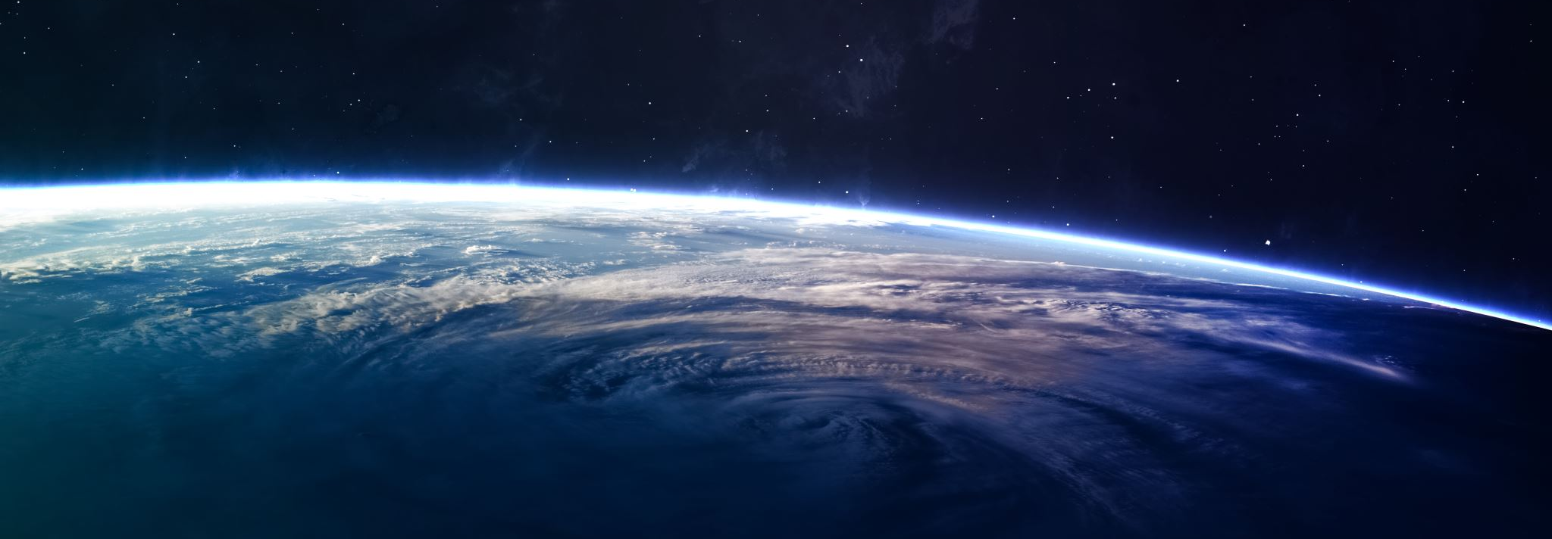
“By This, He Condemned The World”

Slide 8
Before He Could Lead, He Followed

Slide 9
Leading Godly in an Ungodly World

