Slide 1
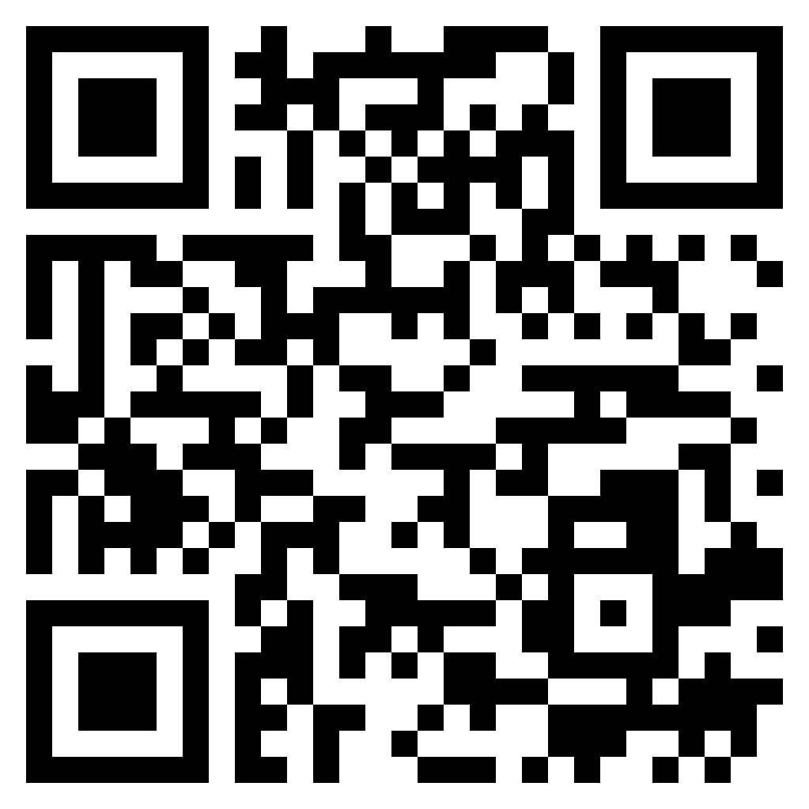
Paul’s letter
to the ROMANS

Slide 2
We have a new dominant principle in our lives (Romans 8.2)
there is now
no condemnation

Slide 3
Romans 8:1–2 (ESV)
¹ There is therefore now no condemnation for those who are in Christ Jesus. ² For the law of the Spirit of life has set you free in Christ Jesus from the law of sin and death.
there is now
no condemnation

Slide 4
We have a new dominant principle in our lives (Romans 8.2)
Jesus has fulfilled the righteous requirement of the Law (Romans 8.3-4)
there is now
no condemnation

Slide 5
Romans 8:3–4 (ESV)
³ For God has done what the law, weakened by the flesh, could not do. By sending his own Son in the likeness of sinful flesh and for sin, he condemned sin in the flesh, ⁴ in order that the righteous requirement of the law might be fulfilled in us, who walk not according to the flesh but according to the Spirit.
there is now
no condemnation

Slide 6
We have a new dominant principle in our lives (Romans 8.2)
Jesus has fulfilled the righteous requirement of the Law (Romans 8.3-4)
We now walk according to the Spirit and not according to the flesh (Romans 8.5-8)
there is now
no condemnation

Slide 7
Romans 8:5–8 (ESV)
⁵ For those who live according to the flesh set their minds on the things of the flesh, but those who live according to the Spirit set their minds on the things of the Spirit. ⁶ For to set the mind on the flesh is death, but to set the mind on the Spirit is life and peace. ⁷ For the mind that is set on the flesh is hostile to God, for it does not submit to God’s law; indeed, it cannot. ⁸ Those who are in the flesh cannot please God.
there is now
no condemnation

Slide 8
We have a new dominant principle in our lives (Romans 8.2)
Jesus has fulfilled the righteous requirement of the Law (Romans 8.3-4)
We now walk according to the Spirit and not according to the flesh (Romans 8.5-8)
God’s Spirit now dwells within us (Romans 8.9-11)
there is now
no condemnation

Slide 9
Romans 8:9–11 (ESV)
⁹ You, however, are not in the flesh but in the Spirit, if in fact the Spirit of God dwells in you. Anyone who does not have the Spirit of Christ does not belong to him. ¹⁰ But if Christ is in you, although the body is dead because of sin, the Spirit is life because of righteousness. ¹¹ If the Spirit of him who raised Jesus from the dead dwells in you, he who raised Christ Jesus from the dead will also give life to your mortal bodies through his Spirit who dwells in you.
there is now
no condemnation

Slide 10
We have a new dominant principle in our lives (Romans 8.2)
Jesus has fulfilled the righteous requirement of the Law (Romans 8.3-4)
We now walk according to the Spirit and not according to the flesh (Romans 8.5-8)
God’s Spirit now dwells within us (Romans 8.9-11)
Application: we are debtors to live by the Spirit and not the flesh (Romans 8.12-17)
there is now
no condemnation

