Slide 1
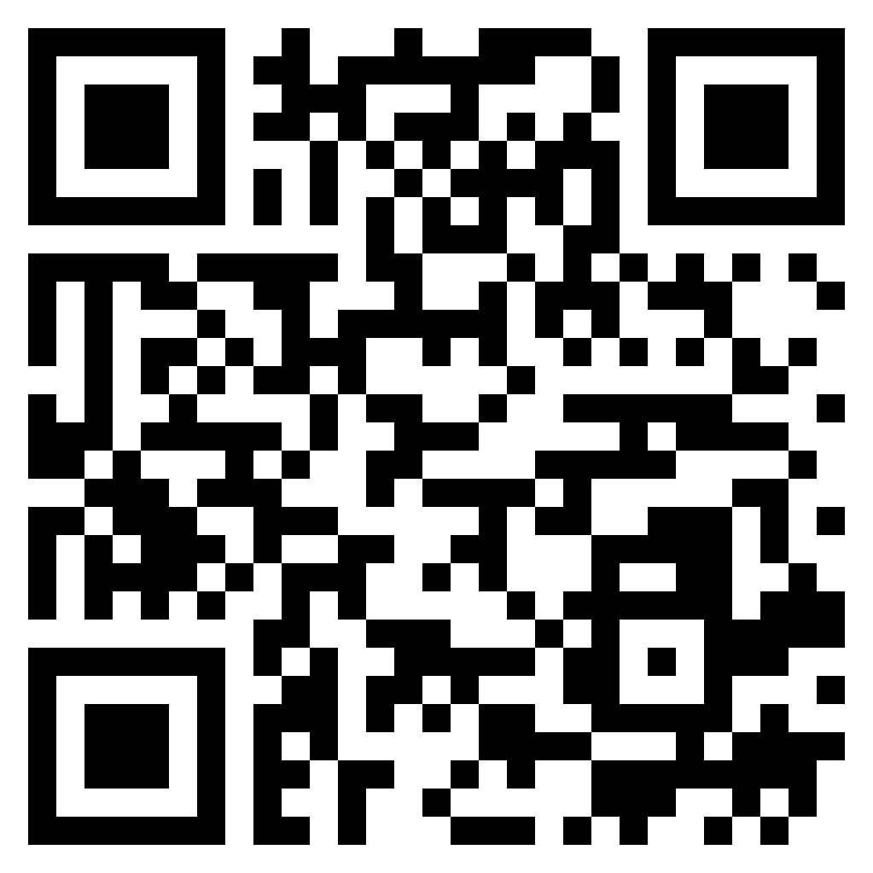
Paul’s letter
to the ROMANS

Slide 4
"Nothing in this world happens by chance. God is in back of everything. He decides and causes all things to happen that do happen. He is not sitting on the sidelines wondering and perhaps fearing what is going to happen next. No, He has foreordained everything 'after the counsel of his will' (Eph. 1.11): the moving of a finger, the beating of a heart, the laughter of a girl, the mistake of a typist - even sin."
(Palmer, Edwin H. The Five Points of Calvinism. P. 25)

Slide 5
"Total depravity means that natural man is never able to do any good that is fundamentally pleasing to God, and, in fact, does evil all the time." (Palmer 13)

Slide 7
Romans 9:1–5 (ESV)
¹ I am speaking the truth in Christ—I am not lying; my conscience bears me witness in the Holy Spirit— ² that I have great sorrow and unceasing anguish in my heart. ³ For I could wish that I myself were accursed and cut off from Christ for the sake of my brothers, my kinsmen according to the flesh. ⁴ They are Israelites, and to them belong the adoption, the glory, the covenants, the giving of the law, the worship, and the promises. ⁵ To them belong the patriarchs, and from their race, according to the flesh, is the Christ, who is God over all, blessed forever. Amen.
the doctrine
of election

Slide 8
Romans 9:6–10 (ESV)
⁶ But it is not as though the word of God has failed. For not all who are descended from Israel belong to Israel, ⁷ and not all are children of Abraham because they are his offspring, but “Through Isaac shall your offspring be named.” ⁸ This means that it is not the children of the flesh who are the children of God, but the children of the promise are counted as offspring. ⁹ For this is what the promise said: “About this time next year I will return, and Sarah shall have a son.” ¹⁰ And not only so, but also when Rebekah had conceived children by one man, our forefather Isaac,
the doctrine
of election

Slide 9
Romans 9:11–13 (ESV)
¹¹ though they were not yet born and had done nothing either good or bad—in order that God’s purpose of election might continue, not because of works but because of him who calls— ¹² she was told, “The older will serve the younger.” ¹³ As it is written, “Jacob I loved, but Esau I hated.”
the doctrine
of election

