Slide 1
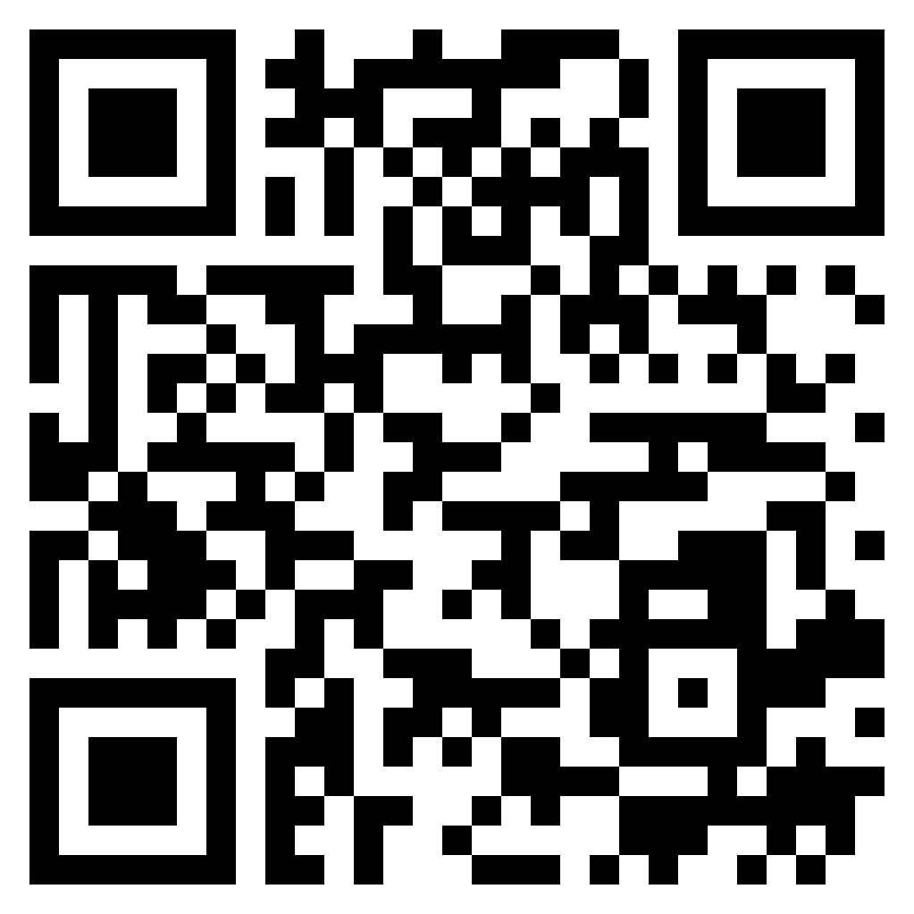
Paul’s letter
to the ROMANS

Slide 2
Salvation is achieved in Christ (Romans 5.1-11)
Sin reigned in Adam, but life reigns in Christ (Romans 5.12-21)
In light of what Christ has done, what should be our attitude toward sin? (Romans 6.1-23)
Our wretched condition under the Law (Romans 7.1-25)
Our blessed condition in Christ (Romans 8.1-39)
the object
of faith

Slide 3
Romans 5:1–5 (ESV)
¹ Therefore, since we have been justified by faith, we have peace with God through our Lord Jesus Christ. ² Through him we have also obtained access by faith into this grace in which we stand, and we rejoice in hope of the glory of God. ³ Not only that, but we rejoice in our sufferings, knowing that suffering produces endurance, ⁴ and endurance produces character, and character produces hope, 5 and hope does not put us to shame, because God’s love has been poured into our hearts through the Holy Spirit who has been given to us.
salvation
in Christ

Slide 4
Romans 5:1–5 (ESV)
¹ Therefore, since we have been justified by faith, we have peace with God through our Lord Jesus Christ. ² Through him we have also obtained access by faith into this grace in which we stand, and we rejoice in hope of the glory of God. ³ Not only that, but we rejoice in our sufferings, knowing that suffering produces endurance, ⁴ and endurance produces character, and character produces hope, 5 and hope does not put us to shame, because God’s love has been poured into our hearts through the Holy Spirit who has been given to us.
salvation
in Christ

Slide 5
Romans 5:1–5 (ESV)
¹ Therefore, since we have been justified by faith, we have peace with God through our Lord Jesus Christ. ² Through him we have also obtained access by faith into this grace in which we stand, and we rejoice in hope of the glory of God. ³ Not only that, but we rejoice in our sufferings, knowing that suffering produces endurance, ⁴ and endurance produces character, and character produces hope, 5 and hope does not put us to shame, because God’s love has been poured into our hearts through the Holy Spirit who has been given to us.
salvation
in Christ

Slide 6
Romans 5:1–5 (ESV)
¹ Therefore, since we have been justified by faith, we have peace with God through our Lord Jesus Christ. ² Through him we have also obtained access by faith into this grace in which we stand, and we rejoice in hope of the glory of God. ³ Not only that, but we rejoice in our sufferings, knowing that suffering produces endurance, ⁴ and endurance produces character, and character produces hope, 5 and hope does not put us to shame, because God’s love has been poured into our hearts through the Holy Spirit who has been given to us.
salvation
in Christ

Slide 7
Romans 5:1–5 (ESV)
¹ Therefore, since we have been justified by faith, we have peace with God through our Lord Jesus Christ. ² Through him we have also obtained access by faith into this grace in which we stand, and we rejoice in hope of the glory of God. ³ Not only that, but we rejoice in our sufferings, knowing that suffering produces endurance, ⁴ and endurance produces character, and character produces hope, 5 and hope does not put us to shame, because God’s love has been poured into our hearts through the Holy Spirit who has been given to us.
salvation
in Christ

Slide 8
Romans 5:1–5 (ESV)
¹ Therefore, since we have been justified by faith, we have peace with God through our Lord Jesus Christ. ² Through him we have also obtained access by faith into this grace in which we stand, and we rejoice in hope of the glory of God. ³ Not only that, but we rejoice in our sufferings, knowing that suffering produces endurance, ⁴ and endurance produces character, and character produces hope, 5 and hope does not put us to shame, because God’s love has been poured into our hearts through the Holy Spirit who has been given to us.
salvation
in Christ

Slide 9
Romans 5:6–11 (ESV)
⁶ For while we were still weak, at the right time Christ died for the ungodly. ⁷ For one will scarcely die for a righteous person—though perhaps for a good person one would dare even to die— ⁸ but God shows his love for us in that while we were still sinners, Christ died for us. 9 Since, therefore, we have now been justified by his blood, much more shall we be saved by him from the wrath of God. ¹⁰ For if while we were enemies we were reconciled to God by the death of his Son, much more, now that we are reconciled, shall we be saved by his life. ¹¹ More than that, we also rejoice in God through our Lord Jesus Christ, through whom we have now received reconciliation.
assurance of
salvation

Slide 10
Romans 5:6–11 (ESV)
⁶ For while we were still weak, at the right time Christ died for the ungodly. ⁷ For one will scarcely die for a righteous person—though perhaps for a good person one would dare even to die— ⁸ but God shows his love for us in that while we were still sinners, Christ died for us. 9 Since, therefore, we have now been justified by his blood, much more shall we be saved by him from the wrath of God. ¹⁰ For if while we were enemies we were reconciled to God by the death of his Son, much more, now that we are reconciled, shall we be saved by his life. ¹¹ More than that, we also rejoice in God through our Lord Jesus Christ, through whom we have now received reconciliation.
assurance of
salvation

Slide 11
Romans 5:6–11 (ESV)
⁶ For while we were still weak, at the right time Christ died for the ungodly. ⁷ For one will scarcely die for a righteous person—though perhaps for a good person one would dare even to die— ⁸ but God shows his love for us in that while we were still sinners, Christ died for us. 9 Since, therefore, we have now been justified by his blood, much more shall we be saved by him from the wrath of God. ¹⁰ For if while we were enemies we were reconciled to God by the death of his Son, much more, now that we are reconciled, shall we be saved by his life. ¹¹ More than that, we also rejoice in God through our Lord Jesus Christ, through whom we have now received reconciliation.
assurance of
salvation

