Slide 2
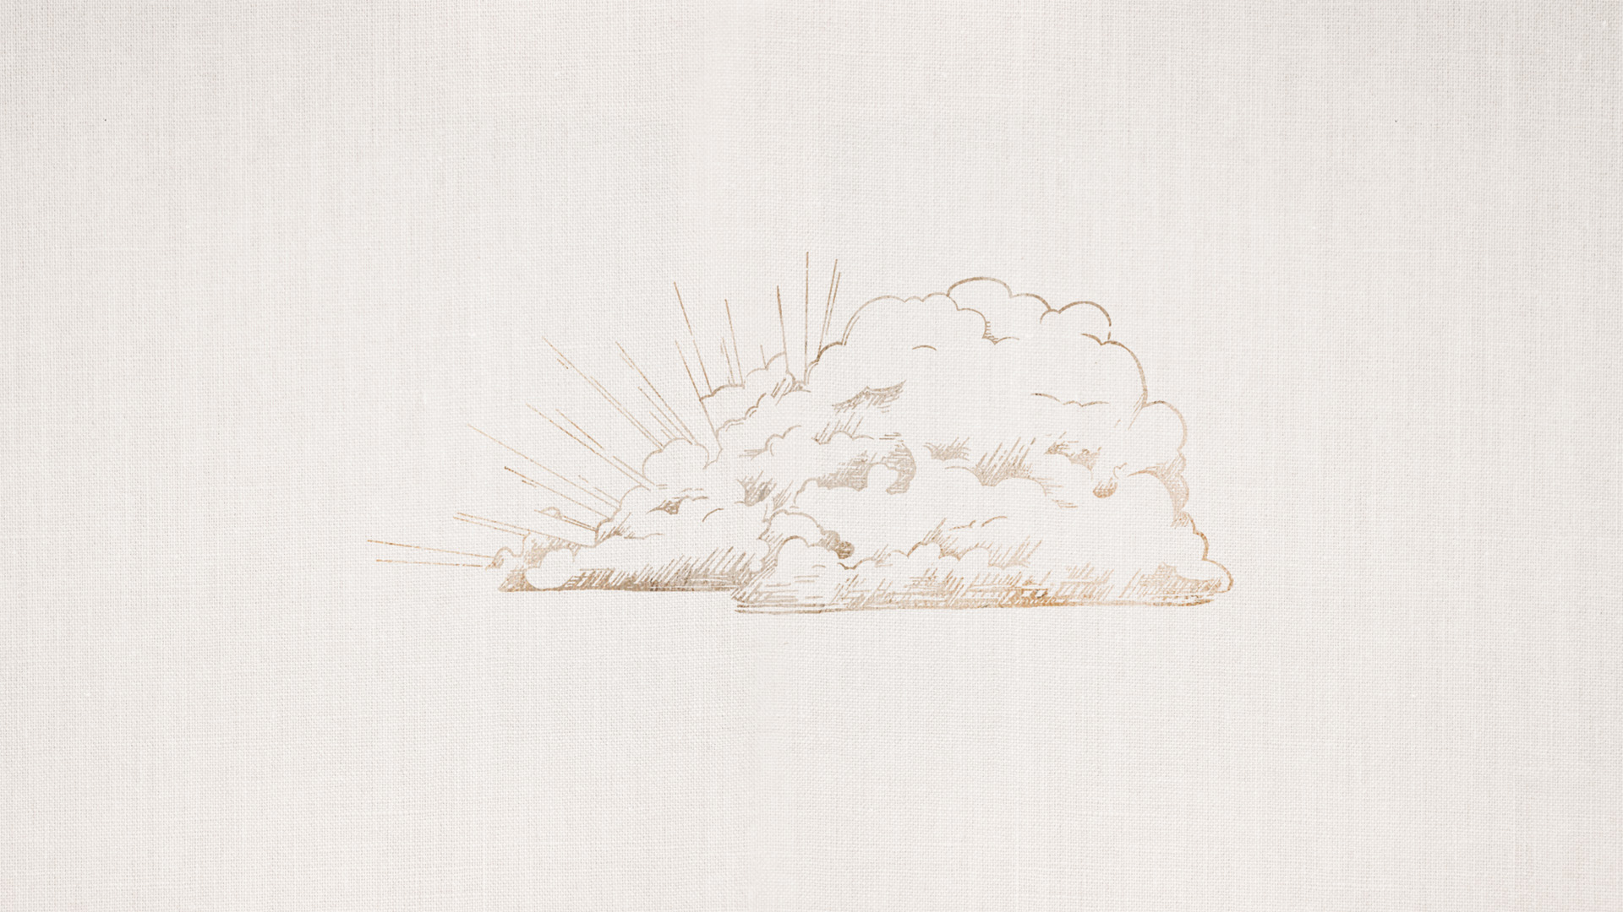
“In the world you will have tribulation. But take heart; I have overcome the world.”
-John 16.33

Slide 3
“In the world you will have tribulation. But take heart; I have overcome the world.”
-John 16.33

Slide 4
“In the world you will have tribulation. But take heart; I have overcome the world.”
-John 16.33

Slide 5
“In the world you will have tribulation. But take heart; I have overcome the world.”
-John 16.33

