Slide 1
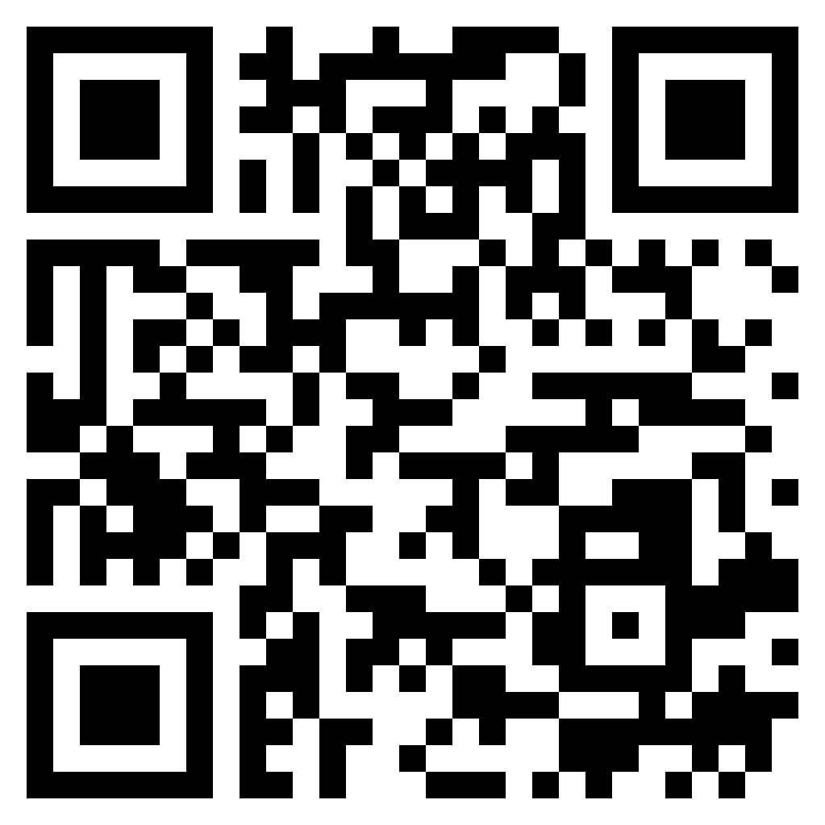
Paul’s letter
to the ROMANS

Slide 2
Romans 6:15-18 (ESV)
¹⁵ What then? Are we to sin because we are not under the law but under grace? By no means! ¹⁶ Do you not know that if you present yourselves to anyone as obedient slaves, you are slaves of the one whom you obey, either of sin, which leads to death, or of obedience, which leads to righteousness? ¹⁷ But thanks be to God, that you who were once slaves of sin have become obedient from the heart to the standard of teaching to which you were committed, ¹⁸ and, having been set free from sin, have become slaves of righteousness.
Slaves
Of righteousness

Slide 3
Romans 6:19-23 (ESV)
¹⁹ I am speaking in human terms, because of your natural limitations. For just as you once presented your members as slaves to impurity and to lawlessness leading to more lawlessness, so now present your members as slaves to righteousness leading to sanctification. ²⁰ For when you were slaves of sin, you were free in regard to righteousness. ²¹ But what fruit were you getting at that time from the things of which you are now ashamed? For the end of those things is death ²² But now that you have been set free from sin and have become slaves of God, the fruit you get leads to sanctification and its end, eternal life. ²³ For the wages of sin is death, but the free gift of God is eternal life in Christ Jesus our Lord.
Slaves
Of righteousness

Slide 4
Romans 7:1-3 (ESV)
¹ Or do you not know, brothers, - for I am speaking to those who know the law – that the law is binding on a person only as long as he lives?
² For a married woman is bound by law to her husband while he lives, but if her husband dies she is released from the law of marriage.
³ Accordingly, she will be called an adulteress if she lives with another man while her husband is alive. But if her husband dies, she is free from that law, and if she marries another man she is not an adulteress.
Slaves
Of righteousness

Slide 5
Romans 7:4-6 (ESV)
⁴ Likewise, my brothers, you also have died to the law through the body of Christ, so that you may belong to another, to Him who has been raised from the dead, in order that we may bear fruit for God.
⁵ For while we were living in the flesh, our sinful passions. Aroused by the law, were at work in our members to bear fruit for death. ⁶ But now we are released from the law, having died to that which held us captive, so that we serve in the new way of the Spirit and not the old way of the written code.
Slaves
Of righteousness

