Slide 1
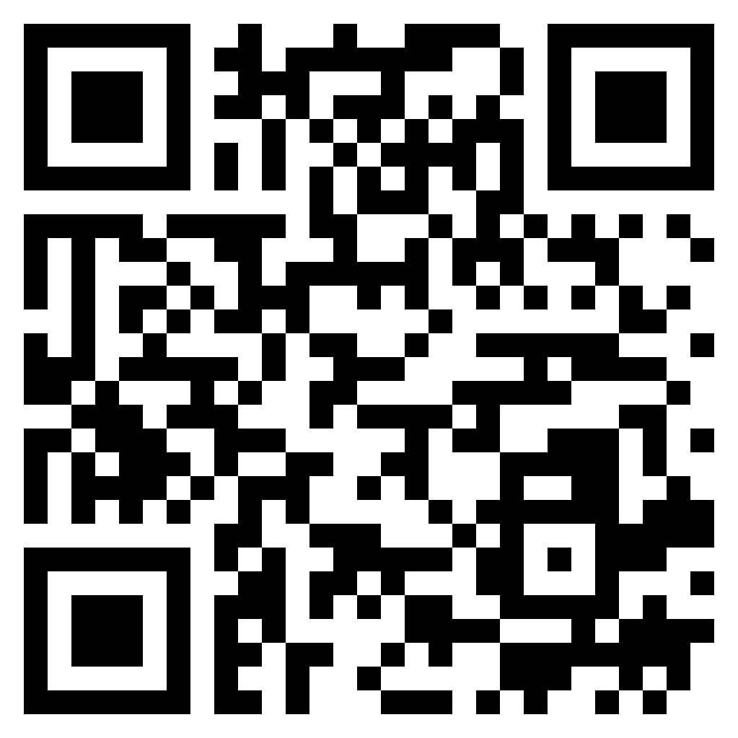
Paul’s letter
to the ROMANS

Slide 2
Romans 11:11-16 (ESV)
¹¹ So I ask, did they stumble in order that they might fall? By no means! Rather, through their trespass salvation has come to the Gentiles, so as to make Israel jealous. ¹² Now if their trespass means riches for the world, and if their failure means riches for the Gentiles, how much more will their full inclusion mean! ¹³ Now I am speaking to you Gentiles. Inasmuch then as I am an apostle to the Gentiles, I magnify my ministry ¹⁴ in order somehow to make my fellow Jews jealous, and thus save some of them. ¹⁵ For if their rejection means the reconciliation of the world, what will their acceptance mean but life from the dead? ¹⁶ If the dough offered as first fruits is holy, so is the whole lump, and if the root is holy, so are the branches.
Salvation
To the Gentiles

Slide 3
Romans 11:17-21 (ESV)
¹⁷ But if some of the branches were broken off, and you, although a wild olive shoot, were grafted in among the others and now share in the nourishing root of the olive tree, ¹⁸ do not be arrogant toward the branches. If you are, remember it is not you who support the root, but the root that supports you. ¹⁹ Then you will say, “Branches were broken off so that I might be grafted in.” ²⁰ That is true. They were broken off because of their unbelief, but you stand fast through faith. So do not become proud, but fear. ²¹ For if God did not spare the natural branches, neither will He spare you.
Wild
Olive Branches

Slide 4
Romans 11:22-24 (ESV)
²² Note then the kindness and the severity of God: severity toward those who have fallen, but God’s kindness to you, provided you continue in His kindness. Otherwise you too will be cut off. ²³ And even they, if they do not continue in their unbelief, will be grafted in for God has the power to graft them in again. ²⁴ For if you were cut from what is by nature a wild olive tree, and grafted, contrary to nature, into a cultivated olive tree, how much more will these, the natural branches, be grafted back into their own olive tree.
Kindness and
Severity of God

Slide 5
Romans 11:25-32 (ESV)
²⁵ Lest you be wise in your own sight, I do not want you to be unaware of this mystery, brothers: a partial hardening has come upon Israel, until the fullness of the Gentiles has come in. ²⁶ And in this way all Israel will be saved, as it is written, “The Deliverer will come from Zion, He will banish ungodliness from Jacob”; ²⁷ ”and this will be my covenant with them when I take away their sins.” ²⁸ As regards the gospel, they are enemies for your sake. But as regards election, they are beloved for the sake of their forefathers. ²⁹ For the gifts and the calling of God are irrevocable. ³⁰ For just as you were at one time disobedient to God but now have received mercy because of their disobedience, ³¹ so they too have now been disobedient in order that by the mercy shown to you they also may now receive mercy. ³² For God has consigned all to disobedience, that He may have mercy on all.
All Israel
Will Be Saved

Slide 6
Romans 11:33-36 (ESV)
³³ Oh, the depth of the riches and wisdom and knowledge of God! How unsearchable are His judgements and how inscrutable His ways! ³⁴ ”For who has known the mind of the Lord, or who has been His counselor?” ³⁵ ”Or who has given a gift to Him that He might be repaid?”. ³⁶ For from Him and through Him and to Him are all things. To Him be glory forever. Amen.
Glory to God
Forever

