Slide 1
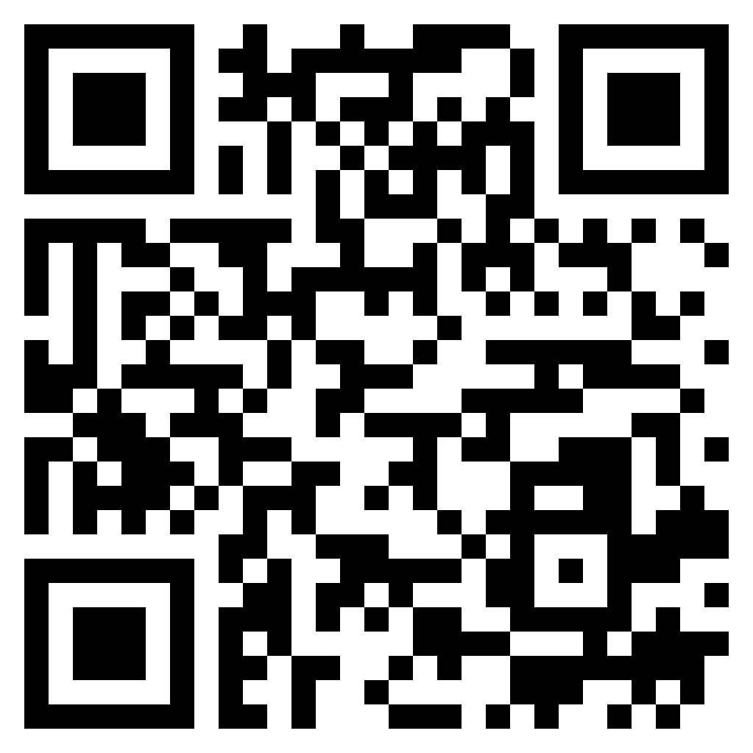
Paul’s letter
to the ROMANS

Slide 2
Romans 13:8–10 (ESV)
⁸ Owe no one anything, except to love each other, for the one who loves another has fulfilled the law. ⁹ For the commandments, “You shall not commit adultery, You shall not murder, You shall not steal, You shall not covet,” and any other commandment, are summed up in this word: “You shall love your neighbor as yourself.” ¹⁰ Love does no wrong to a neighbor; therefore love is the fulfilling of the law.
navigating
the world

Slide 3
Romans 13:11–14 (ESV) ¹¹ Besides this you know the time, that the hour has come for you to wake from sleep. For salvation is nearer to us now than when we first believed. ¹² The night is far gone; the day is at hand. So then let us cast off the works of darkness and put on the armor of light. ¹³ Let us walk properly as in the daytime, not in orgies and drunkenness, not in sexual immorality and sensuality, not in quarreling and jealousy. ¹⁴ But put on the Lord Jesus Christ, and make no provision for the flesh, to gratify its desires.
navigating
the world

Slide 4
What the OT revealed about the future:
Establishment of the Messianic Kingdom (Daniel 2.44-45)
Inclusion of the nations (Daniel 7.14)
Persecution by world powers (Daniel 9.24-27)
God’s judgment on world powers (Daniel 9.27)
The end (Daniel 12.1-4)
navigating
the world

Slide 5
What the OT revealed about the future:
Establishment of the Messianic Kingdom (Daniel 2.44-45)
Inclusion of the nations (Daniel 7.14)
Persecution by world powers (Daniel 9.24-27)
God’s judgment on world powers (Daniel 9.27)
The end (Daniel 12.1-4)
navigating
the world

Slide 6
What the OT revealed about the future:
Establishment of the Messianic Kingdom (Daniel 2.44-45)
Inclusion of the nations (Daniel 7.14)
Persecution by world powers (Daniel 9.24-27)
God’s judgment on world powers (Daniel 9.27)
The end (Daniel 12.1-4)
navigating
the world

Slide 7
Romans 13:11–14 (ESV) ¹¹ Besides this you know the time, that the hour has come for you to wake from sleep. For salvation is nearer to us now than when we first believed. ¹² The night is far gone; the day is at hand. So then let us cast off the works of darkness and put on the armor of light. ¹³ Let us walk properly as in the daytime, not in orgies and drunkenness, not in sexual immorality and sensuality, not in quarreling and jealousy. ¹⁴ But put on the Lord Jesus Christ, and make no provision for the flesh, to gratify its desires.
navigating
the world

Slide 8
Matthew 28:20 (ESV)
²⁰teaching them to observe all that I have commanded you. And behold, I am with you always, to the end of the age.”
welcome
one another

Slide 9
Romans 15:7–9 (ESV)
⁷ Therefore welcome one another as Christ has welcomed you, for the glory of God. ⁸ For I tell you that Christ became a servant to the circumcised to show God’s truthfulness, in order to confirm the promises given to the patriarchs, ⁹ and in order that the Gentiles might glorify God for his mercy. As it is written, “Therefore I will praise you among the Gentiles, and sing to your name.”
welcome
one another

Slide 10
The issues:
Eating of meats (vs. 2; Leviticus 11; Mark 7.19)
Observance of days (vs. 5; Colossians 2.14-17)
welcome
one another

Slide 11
The goal:
Not agreement
Not uniformity of practice
Welcome / acceptance of each other (14.1; 15.7)
welcome
one another

Slide 12
How to welcome / accept one another:
Refrain from judging (Romans 14.1-12)
Be sensitive to conscience (Romans 14.13-23)
Imitate Christ (Romans 15.1-13)
welcome
one another

