Slide 1
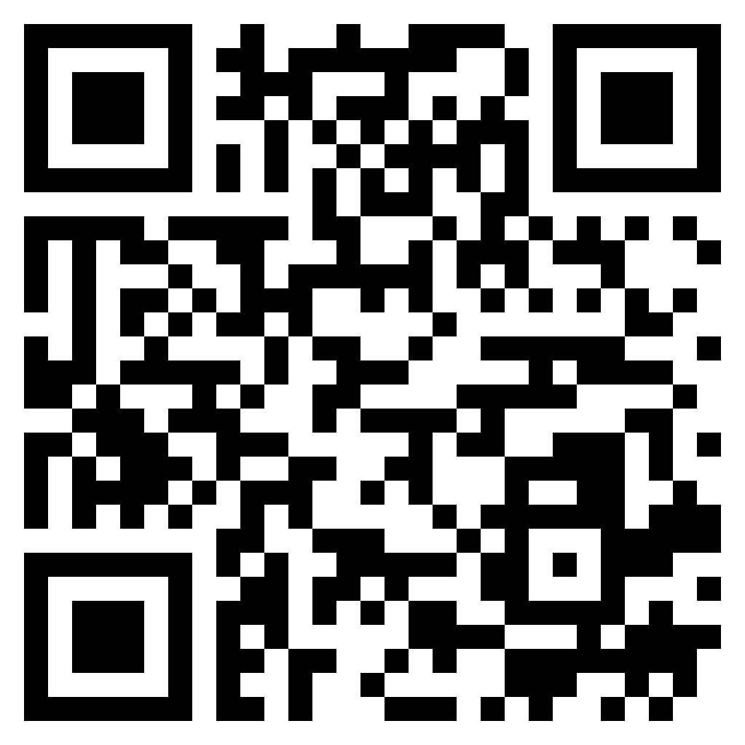
Paul’s letter
to the ROMANS

Slide 2
Matters of salvation and faith
Galatians 1:6-8 (ESV)
Galatians 2:5 (ESV)
Galatians 5:4-6 (ESV)
Galatians 4:9-11 (ESV)
Galatian
Differences

Slide 3
Eating of meats
Leviticus 11
1 Corinthians 8:1-8
Observance of days
Colossians 2:14-17
Rome’s
Differences

Slide 4
Do not judge a person God has accepted
Whatever you practice (in matters of liberty) do so with a clear conscience
Both the weak and strong were trying to please God
Romans 14
Takeaways

Slide 5
Romans 14:13-19 (ESV)
¹³ Therefore let us not pass judgment on one another any longer, but rather decide never to put a stumbling block or hindrance in the way of a brother. ¹⁴ I know and am persuaded in the Lord Jesus that nothing is unclean in itself, but it is unclean for anyone who thinks it is unclean. ¹⁵ For if your brother is grieved by what you eat, you are no longer walking in love. By what you eat, do not destroy the one for whom Christ died.¹⁶ So do not let what you regard as good be spoken of as evil. ¹⁷ For the kingdom of God is not a matter of eating and drinking but of righteousness and peace and joy in the Holy Spirit. ¹⁸ Whoever thus serves Christ is acceptable to God and approved by men. ¹⁹ So then let us pursue what makes for peace and for mutual upbuilding.
Do Not Cause
Others to Stumble

Slide 6
Romans 14:20-23 (ESV)
²⁰ Do not, for sake of food, destroy the work of God. Everything is indeed clean, but it is wrong for anyone to make another stumble by what he eats. ²¹ It is not good to eat meat or drink wine or do anything that causes your brother to stumble. ²² The faith that you have, keep between yourself and God. Blessed is the one who has no reason to pass judgement on himself for what he approves. ²³ But whoever has doubts is condemned if he eats, because the eating is not from faith. For whatever does not proceed from faith is sin.
Do Not Cause
Others to Stumble

Slide 7
I can be mistaken
My conscience is not the basis for everyone else’s actions
Scriptures allow for differences
Before liberty may be claimed for practice, it must first be authorized
Romans 14
Applications

Slide 8
Romans 15:1-7 (ESV)
¹ We who are strong have an obligation to bear with the failings of the weak, and not please ourselves. ² Let each of us please his neighbor for his good, to build him up. ³ For Christ did not please himself, but as it is written, “The reproaches of those who reproached you fell on me.” ⁴ For whatever was written in former days was written for our instruction, that through endurance and through the encouragement of the Scriptures we might have hope. ⁵ May the God of endurance and encouragement grant you to live in such harmony with one another, in accord with Christ Jesus, ⁶ that together you may with one voice glorify the God and Father of our Lord Jesus Christ. ⁷ Therefore welcome one another as Christ has welcomed you, for the glory of God.
Examples
Of Christ

Slide 9
Romans 15:8-13 (ESV)
⁸ For I tell you that Christ became a servant to the circumcised to show God’s truthfulness, in order to confirm the promises given to the patriarchs, ⁹ and in order that the Gentiles might glorify God for His mercy. As it is written, “Therefore I will praise you among the Gentiles, and sing to your name.” ¹⁰ And again it is said. “Rejoice, O Gentiles, with his people.” ¹¹ And again, “Praise the Lord, all you Gentiles, and let all the peoples extol Him.” ¹² And again Isaiah says, “The root of Jesse will come, even he who arises to rule the Gentiles; in Him will the Gentiles hope.” ¹³ May the God of hope fill you with all joy and peace in believing, so that by the power of the Holy Spirit you may abound in hope.
Hope
In Christ

Slide 10
Romans 15:13 (ESV)
¹³ May the God of hope fill you with all joy and peace in believing, so that by the power of the Holy Spirit you may abound in hope.
Blessing
In Christ

