Slide 1
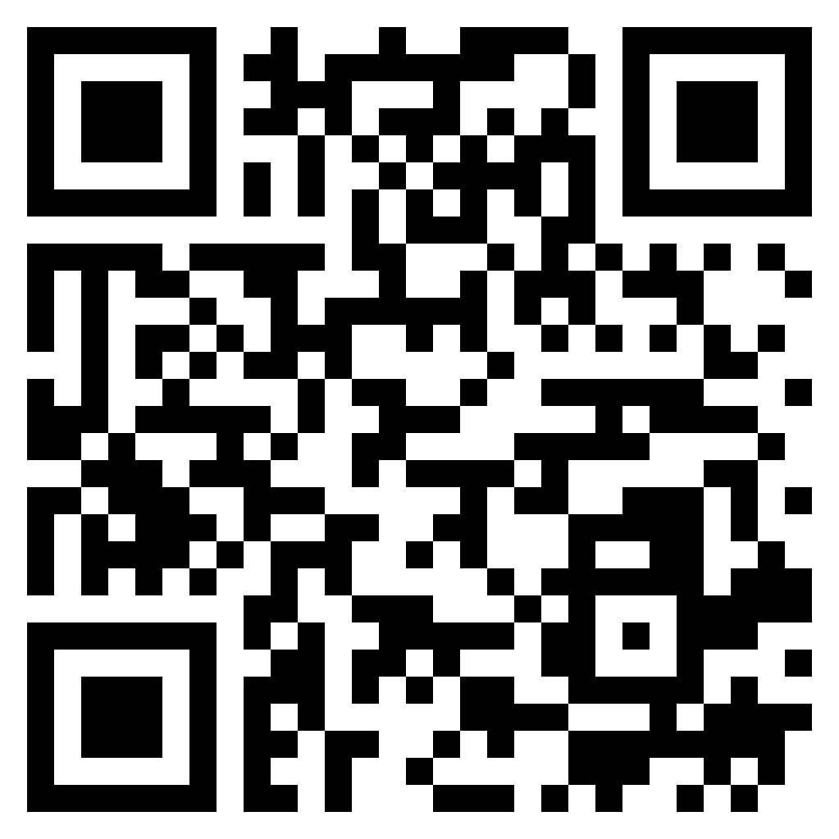
Paul’s letter
to the ROMANS

Slide 2
“It is only a slight exaggeration to say that the history of the interpretation of Rom. 13:1–7 is the history of attempts to avoid what seems to be its plain meaning.” (Douglas Moo, New International Commentary on the New Testament)
navigating
the world

Slide 3
Why these instructions?
Gospel redefined the people of God (Romans 1.16-17)
Potential misunderstanding of “not being conformed to this world” (Romans 12.2)
Preparing the brethren for difficult days (Romans 12.14)
Simply because it’s a matter of God’s will (Matthew 22.21; 1Peter 2.13-15; Titus 3.1; 1Timothy 2.1-2)
navigating
the world

Slide 4
Romans 13:1–5 (ESV) ¹ Let every person be subject to the governing authorities. For there is no authority except from God, and those that exist have been instituted by God. ² Therefore whoever resists the authorities resists what God has appointed, and those who resist will incur judgment. ³ For rulers are not a terror to good conduct, but to bad. Would you have no fear of the one who is in authority? Then do what is good, and you will receive his approval, ⁴ for he is God’s servant for your good. But if you do wrong, be afraid, for he does not bear the sword in vain. For he is the servant of God, an avenger who carries out God’s wrath on the wrongdoer. ⁵ Therefore one must be in subjection, not only to avoid God’s wrath but also for the sake of conscience.
navigating
the world

Slide 5
Romans 13:1–5 (ESV) ¹ Let every person be subject to the governing authorities. For there is no authority except from God, and those that exist have been instituted by God. ² Therefore whoever resists the authorities resists what God has appointed, and those who resist will incur judgment. ³ For rulers are not a terror to good conduct, but to bad. Would you have no fear of the one who is in authority? Then do what is good, and you will receive his approval, ⁴ for he is God’s servant for your good. But if you do wrong, be afraid, for he does not bear the sword in vain. For he is the servant of God, an avenger who carries out God’s wrath on the wrongdoer. ⁵ Therefore one must be in subjection, not only to avoid God’s wrath but also for the sake of conscience.
navigating
the world

Slide 6
Romans 13:6–7 (ESV)
⁶ For because of this you also pay taxes, for the authorities are ministers of God, attending to this very thing. ⁷ Pay to all what is owed to them: taxes to whom taxes are owed, revenue to whom revenue is owed, respect to whom respect is owed, honor to whom honor is owed.
navigating
the world

Slide 7
What if the government is wicked / abusive?
Don’t be surprised (Romans 13.1; 8.31-39)
Don’t take God’s prerogative into your own hands (Romans 12.19-21)
Remember that the gospel is the most important thing (Romans 12.18; 1Timothy 2.1-7)
Submit to the government, unless submission requires disobedience to Christ (Acts 5.29)
navigating
the world

Slide 8
Romans 13:8–10 (ESV)
⁸ Owe no one anything, except to love each other, for the one who loves another has fulfilled the law. ⁹ For the commandments, “You shall not commit adultery, You shall not murder, You shall not steal, You shall not covet,” and any other commandment, are summed up in this word: “You shall love your neighbor as yourself.” ¹⁰ Love does no wrong to a neighbor; therefore love is the fulfilling of the law.
navigating
the world

Slide 9
Romans 13:11–14 (ESV) ¹¹ Besides this you know the time, that the hour has come for you to wake from sleep. For salvation is nearer to us now than when we first believed. ¹² The night is far gone; the day is at hand. So then let us cast off the works of darkness and put on the armor of light. ¹³ Let us walk properly as in the daytime, not in orgies and drunkenness, not in sexual immorality and sensuality, not in quarreling and jealousy. ¹⁴ But put on the Lord Jesus Christ, and make no provision for the flesh, to gratify its desires.
navigating
the world

Slide 10
What the OT revealed about the future:
Establishment of the Messianic Kingdom (Daniel 2.44-45)
Inclusion of the nations (Daniel 7.14)
Persecution by world powers (Daniel 9.24-27)
God’s judgment on world powers (Daniel 9.27)
The end (Daniel 12.1-4)
navigating
the world

Slide 11
What the OT revealed about the future:
Establishment of the Messianic Kingdom (Daniel 2.44-45)
Inclusion of the nations (Daniel 7.14)
Persecution by world powers (Daniel 9.24-27)
God’s judgment on world powers (Daniel 9.27)
The end (Daniel 12.1-4)
navigating
the world

Slide 12
What the OT revealed about the future:
Establishment of the Messianic Kingdom (Daniel 2.44-45)
Inclusion of the nations (Daniel 7.14)
Persecution by world powers (Daniel 9.24-27)
God’s judgment on world powers (Daniel 9.27)
The end (Daniel 12.1-4)
navigating
the world

Slide 13
Romans 13:11–14 (ESV) ¹¹ Besides this you know the time, that the hour has come for you to wake from sleep. For salvation is nearer to us now than when we first believed. ¹² The night is far gone; the day is at hand. So then let us cast off the works of darkness and put on the armor of light. ¹³ Let us walk properly as in the daytime, not in orgies and drunkenness, not in sexual immorality and sensuality, not in quarreling and jealousy. ¹⁴ But put on the Lord Jesus Christ, and make no provision for the flesh, to gratify its desires.
navigating
the world

