Slide 1
Hebrews 11:32-34 - And what more shall I say? For time would fail me to tell of Gideon, Barak, Samson, Jephthah, of David and Samuel and the prophets— 33 who through faith conquered kingdoms, enforced justice, obtained promises, stopped the mouths of lions, 34 quenched the power of fire, escaped the edge of the sword, were made strong out of weakness, became mighty in war, put foreign armies to flight.

Slide 2
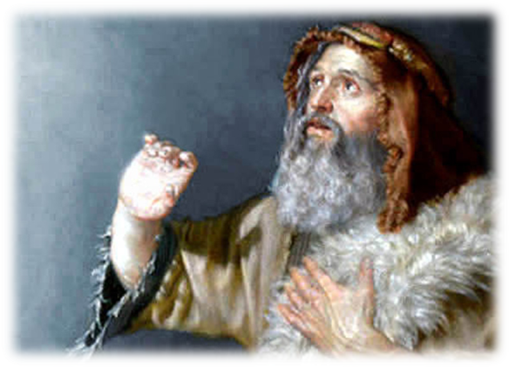
Gideon Flawed; Not Failed
Judges 6-7

Slide 3
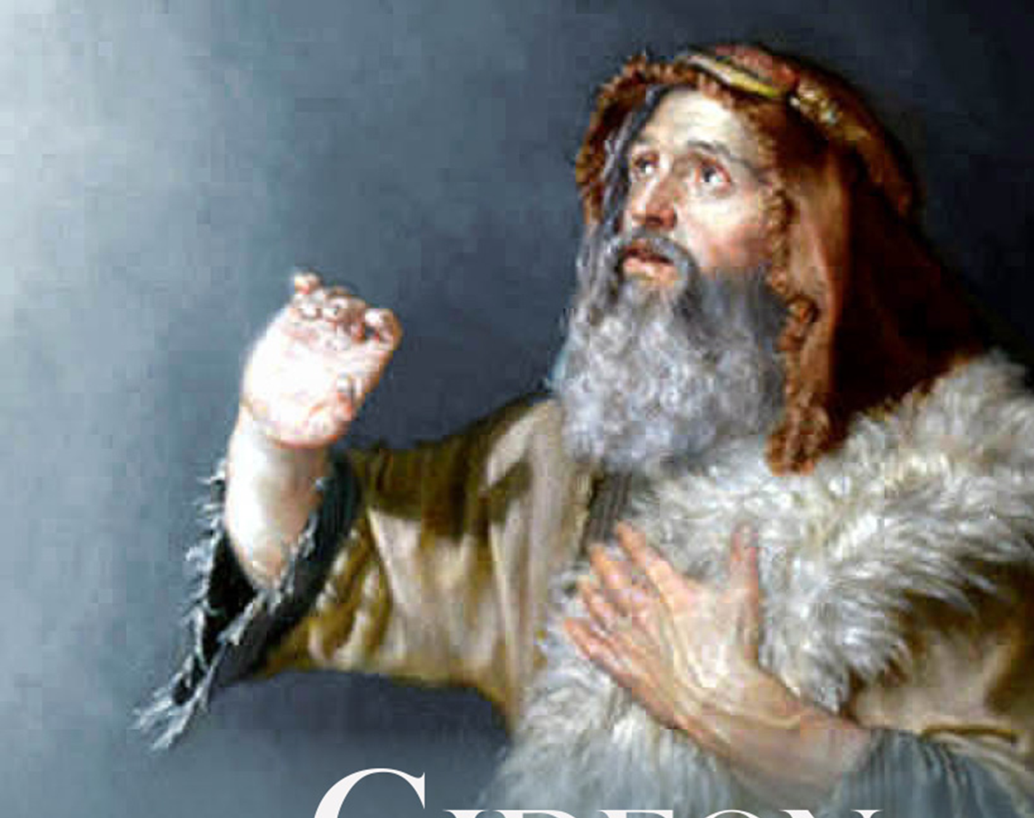
Gideon
Judges 6-7
6:1-6 - Israel was brought very low…
…and the people of Israel cried out for help to the Lord.
6:8-10 - "Thus says the Lord, the God of Israel: I led you up from Egypt and brought you out of the house of bondage. 9 And I delivered you from the hand of the Egyptians and from the hand of all who oppressed you, and drove them out before you and gave you their land. 10 And I said to you, 'I am the Lord your God; you shall not fear the gods of the Amorites in whose land you dwell.' But you have not obeyed my voice."

Slide 4
Gideon
Judges 6-7
The Call of Gideon (6:11-24)
v. 12 - “The Lord is with you, O mighty man of valor.”
v. 13 - “If the Lord is with us, why then has all this happened to us? And where are all his wonderful deeds that our fathers recounted to us…? But now the Lord has forsaken us and given us into the hand of Midian.”
v. 14 - "Go in this might of yours and save Israel… do not I send you?"
v. 16 - “I will be with you.”
v. 17 - “show me a sign that it is you who speaks with me.”

Slide 5
Gideon
Judges 6-7
Gideon’s First Assignment (6:25-32)
v. 25-27 - “…pull down the altar of Baal that your father has, and cut down the Asherah that is beside it and build an altar to the Lord your God on the top of the stronghold here… Then take the second bull and offer it as a burnt offering with the wood of the Asherah that you shall cut down." 27 So Gideon took ten men of his servants and did as the Lord had told him. But because he was too afraid of his family and the men of the town to do it by day, he did it by night.
Start at home
Do it afraid

Slide 6
Gideon
Judges 6-7
Gideon’s Incredible Victory (6:34 - 7:23)
But the Spirit of the Lord clothed Gideon, and he sounded the trumpet, and the Abiezrites were called out to follow him. 35 And he sent messengers throughout all Manasseh, and they too were called out to follow him. And he sent messengers to Asher, Zebulun, and Naphtali, and they went up to meet them.

Slide 7
Gideon
Judges 6-7
Gideon’s Incredible Victory (6:34 - 7:23)
6:36-40 - A Faith-Confirming Fleece
7:2-8 - A Faith-Testing Drink of Water
7:9-14 - If you are afraid…
7:15-25 - Trumpets, Torches and Empty Jars
The key to Gideon’s success was his willingness to obey God.
Gideon went to God for a stronger faith.
God is exalted through human weakness.

