Slide 1
“Flawed, Not Failed”
Joseph of Arimathea

Slide 2
A unique challenge…
Not much is known about him
His actions are his legacy
Hard to understand more without context
Disclaimers and “Beware of rabbit holes!”
Notes:
I was honored to be asked to do this – and just kinda wondering, “What were they thinking asking me?”
My next thought was then, “How am I gonna get enough together about Joseph of Arimathea?” “What was I thinking when I picked it?” But there are many who are mentioned in scripture with far fewer than 22 or 23 verses. So, OK, here we go!
What I learned first off – this is going to be hard to understand better without understanding the context of his life and of these events.
More familiarity with the accounts and the events just following Jesus’ death
Understand Jewish hours, days, and customs
4. Disclaimers -- I’m going to try to stay focused here → there’s a LOT of interesting detail, and this could really easily become a different kind of study. So, I’m going to include important points about Jesus’ burial, but I’ll try not to get sidetracked. And, though I’m trying to represent events as factually and accurately as I can, every possibility exists there are some timeline mistakes. And I will be asking some speculative questions in an effort to understand our subject better.
Rabbit Holes -- Now, I LOVE TRIVIA, and it can also be easy to indulge in too much conjecture. And here’s where I ended up down a really deep rabbit hole. Because, you see, there is some debate out there about the order of events during the last week of Jesus’s life and a few different arguments for why some events happened on different days than what most people think. And maybe smarter people than I am really don’t get pulled down those rabbit holes. It was VERY interesting, but I ended up spending wayyy too much time thinking about that and how it factors into to my understanding, and thinking about what I might share. And then I realized it was a fool’s errand and really not that important.
Also, there are many apocryphal accounts of Joseph after his recorded actions, from the plausible to the fantastical, with lines getting somewhat blurry.
So, let’s focus mostly on what we know and what we can safely infer, and better yet, what is pertinent. (phew!) But, maybe we can do a little “collateral learning” together.
https://www.biblestudytools.com/bible-study/topical-studies/why-is-joseph-of-arimathea-included-in-the-easter-story.html

Slide 3
1st Day
Triumphal Entry
2nd Day Cleanses Temple
Curses Fig
Olivet Discourse
Last Supper
Judas Agrees to Betray
Prepare Upper Room
Temple Debates
12 AM
12 AM
12 AM
12 AM
Tuesday
Wednesday
Thursday
6 AM
6 AM
6 AM
6 PM
6 PM
6 PM
6 PM
Sunset
Sunset
Sunset
Sunset
3rd Day
4th Day
5th Day
(Preparation for Passover)

Slide 4
Appears to Disciples
Garden Prayers
Trials / Disciples Flee
Road to Emmaus
Last Supper
Jesus Arrested
Appears to Mary M.
12 AM
12 AM
12 AM
12 AM
Friday
Saturday
Sunday
6 AM
6 AM
6 AM
6 PM
6 PM
6 PM
Resurrection
6 PM
Tomb sealed
Empty Tomb
Burial
Cross
Sunset
Sunset
Sunset
Sunset
6th Day
(Passover / Preparation for Sabbath)
7th Day (Sabbath)
1st Day

Slide 5
What do we know?
Many details are recorded by only one or two gospel writers
Pilate’s frustration
Jesus’s garments divided
“It is finished”
Jesus offered sour wine
Veil of the temple torn in two
Pilate & Herod become friends
Pilate grants a guard the next morning at the Jews’ request
Naming of various women disciples in attendance
Simon the Cyrenian
Notes:
Even more details are mentioned by 3 of the 4 gospels: the crown of thorn, mock coronation, passers-by wagging their heads and insulting Him, the 3 hours of darkness, the centurion’s belief,

Slide 6
What do we know?
Not everything mentioned in all 4 gospels
Some details are in all 4 gospels
Pilate’s judgment
Jesus died by crucifixion
An inscription above the cross
Jesus was wrapped in linen
Placed in a tomb
Mary and others came to the tomb on the first day of the week
Notes:
Reading these accounts and studying them side by side was very interesting!
Matthew doesn’t even mention Joseph’s Council position – only calls him a “rich man from Arimathea”

Slide 7
What do we know?
Joseph is mentioned in all 4 gospels:
Matthew – 4 verses (27:57-60)
Mark – 6 verses (15:42-47)
Luke – 7 verses (23:50-52)
John – 5 verses (19:38-42)
Also mentioned indirectly in Isaiah
Isaiah 53:9 – His grave was assigned to be with wicked men, Yet with a rich man in His death.
Notes:
I think this is one of the first facts that lend significance to the account of Joseph!

Slide 8
Who is Joseph of Arimathea?
Arimathea is believed to have been about 20-25 miles northwest of Jerusalem
Eusebius identifies it as the place of Samuel’s birth
Ramah Naioth or Ramathaim-Zophim
Notes:
Historians have disagreed about where this really was, and, like many such details, are beautifully obscure now.

Slide 9
Who is Joseph of Arimathea?
Luke
- member of the Council
- good and righteous
- had not consented to their plan and action
- from Arimathea, a city of the Jews
- waiting for the kingdom of God
Each gospel writer describes him differently
Matthew
- rich man from Arimathea
- had also become a disciple
Mark
- prominent member of the Council
- waiting for the kingdom of God
- “gathered up his courage”
John
- Joseph of Arimathea
- disciple of Jesus, but secret
- fear of the Jews
Notes:
Matthew – I think this is so interesting because what Matthew (the former tax collector) first notes is his wealth is his wealth; he may even recognize something familiar in Joseph – a wealthy man “also” becoming a disciple
Mark – gives us a hint that Joseph was not a naturally bold or brash individual – and this may make sense as to why he was a respected member of the Council; but notes he was “waiting for the kingdom of God” – so he’s looking for the Messiah and would be very knowledgeable about the prophetic scriptures pointing to Jesus
Luke – has a lot to say! Seems to want to defend Joseph, possibly out of admiration, and gives a very positive picture of him
John – clear and matter-of-fact – and here we get probably the most clear-eyed assessment of any character flaws that Joseph possessed – He feared the Jews. This seems to corroborate what Mark hints at, and gives us insight to his nature, and ultimately what would be seen as his biggest fault, from what we know of him. He feared the Jews. He kept his faith in Jesus hidden. There was a lot at stake, and because of his position, prominence, and wealth, he did not share openly what he believed in his heart.

Slide 10
Mt 27:57-60 | Mk 15:42-47 | Lk 23:50-56 | Jno 19:38-42
at evening | evening had already come | -- | after these things had taken place…
rich man from Arimathea named Joseph | Joseph of Arimathea, a prominent member of the Council | man named Joseph who was a member of the Council, a good and righteous man, had not consented to their plan & action | Joseph of Arimathea
had become a disciple himself | was himself waiting for the kingdom of God | man from Arimathea, a city of the Jews, who was waiting for the kingdom of God | being a disciple, but a secret one for fear of the Jews
went to Pilate and asked for the body of Jesus | gathered up his courage & went in before Pilate and asked for the body of Jesus | -- | asked Pilate that he might take away the body
Joseph took the body | Pilate questioned whether He was already dead; granted the body; Joseph bought a linen cloth, took Him down | he took it down | Pilate granted permission, so he came and took away His body
wrapped it in a clean linen cloth | wrapped Him in the linen cloth | wrapped it in a linen cloth | Nicodemus also came bringing a mixture of myrrh & aloes, about 100 pounds; they took the body of Jesus and bound it in linen wrappings with the spices

Slide 11
Mt 27:57-60 | Mk 15:42-47 | Lk 23:50-56 | Jno 19:38-42
laid it in his own new tomb hewn out of the rock; rolled a large stone against the entrance of the tomb | laid Him in a tomb which had been hewn out in the rock; rolled a stone against the entrance of the tomb | laid Him in a tomb cut into the rock where no one had ever been lain | in the place where He was crucified there was a garden; and in the garden a new tomb, in which no one had been laid; on account of the preparation day, because the tomb was nearby, they laid Jesus there
Mary Magdalene was there and the other Mary sitting opposite the grave | Mary Magdalene and Mary, the mother of Joses were looking on to see where He was laid | the women of Galilee followed there and saw the tomb and how the body was laid and returned and prepared spices | --

Slide 12
Who is Joseph of Arimathea?
Other details of interest…
John omits several details included by the others:
The centurion’s reaction
The insults & Elijah references
The veil
Darkness
John gives the most details - Jesus’ words with Pilate, utterances on the way to the cross and on the cross
He was likely with Jesus when the others weren’t
Notes:
John resonates with me because he has a heart and a warmth for people that you don’t hear from the other writers. He describes details about people in a very observant way, but still factual. He was the only one to call Joseph “a secret disciple”.
John offers more interpersonal details than the other apostles’ accounts

Slide 13
Who is Joseph of Arimathea?
…a picture emerges
Mt. 27 – a rich man, disciple of Jesus
Mk. 15 – respected member of the Council (Sanhedrin) and looking for the kingdom of God
A Sadducee?
Lk. 23 – he had not consented to the council’s decision
Jno. 19 – secret disciple, asked Pilate for Jesus’ body; purchased a linen shroud, took the body of Jesus down from the cross with Nicodemus’ help

Slide 14
What was his ‘flaw’?
…did not consent to their plan
Was he flawed because he was unable to sway the council?
No.

Slide 15
What was his ‘flaw’?
…a secret disciple
Something prevented him from living his faith out loud
What was he afraid of?
Loss of influence?
Loss of respect?
Loss of position?
Loss of livelihood / security?

Slide 16
What was his ‘flaw’?
…a secret disciple
Why?
He could never live his life in secret
Wealthy, well-regarded public figure
Responsibilities and position of influence
Are we reading it correctly?
Mindfulness, not “fear”?
Notes:
He would’ve been instantly recognized wherever he went
His movements and actions would have been the topic of conversation and discussion
He also knew the kind of men he served with
Perhaps his fear was less personal failing and more an awareness, a matter of practicality?
We can understand that, but it only reinforces the basic concern – he was a “secret disciple”, not an open one. This is a dangerous place to walk spiritually. And I think most every person here can understand that in a very personal way, because from time to time we have probably each had moments (or continue to have moments) in which we’d have to classify ourselves as “secret disciples” – and it’s a shameful feeling, isn’t it? Many of us can really understand the position that Joseph was in.

Slide 17
What was his ‘flaw’?
…a secret disciple
The only basis for criticism
The only “failure or flaw” we know about
“…for fear of the Jews”

Slide 18
What was his ‘flaw’?
He was like you and me.
Lack of vision
What makes it possible to see beyond the present?
Hebrews 11:1
Assurance & conviction – NASB
Substance & evidence – KJV
He had a faith problem
→ FAITH
Notes:
- Joseph was like us. He was just a man, not a perfect man. He had strengths and he had weaknesses. He had virtues and he had private struggles. He was a child of God.
He couldn’t see how things would turn out.
None of us can see the future – what moves us to make difficult decisions, decisions that defy man’s understanding and wisdom?
Heb. 11:1
KJV for the win, here – I love the connotation of these words – with faith, it’s REAL. It is REAL. The promises are REAL. Heaven is REAL. Our salvation is REAL.
Joseph had a chance to stand with Jesus’s followers and be publicly counted among them, to follow Jesus, to help spread his message, to learn from his teachings, but he found himself unable to take that step.
He had a FAITH problem. And so his fear prevented him from acting.
“A willingness to risk our reputation is that which differentiates a follower from a mere admirer.” (Goswami, Premier Christianity Magazine, April 2021)

Slide 19
Why was he afraid?
He was like you and me
He had a faith problem
“A willingness to risk our reputation
is that which differentiates
a follower from a mere admirer.”
(Goswami, Premier Christianity Magazine, April 2021)
Notes:
Joseph was like us.
He had a faith problem. And so his fear prevented him from acting.
“A willingness to risk our reputation is that which differentiates a follower from a mere admirer.” (Goswami, Premier Christianity Magazine, April 2021)

Slide 20
Notes:
Stop at 2:15
-- The more we see these events and these people as real, living, breathing, men and women, with complex personalities and lives like we have, #1 – the more real it becomes to us, but #2 – the more we can truly be affected by it. And that’s an important thing.
-- I’m going to admit – I’ve watched The Chosen – and while I know it’s not intended to be a purely factual depiction of the gospel accounts, I find it very powerful. I knew I needed to watch it when I saw a clip on Facebook – of the woman with the flow of blood being healed – and it wrecked me.

Slide 21
What can flawed people do?
Make a better choice. Speak up for what is right!
“Joseph, this secret disciple, outs himself and argues against the council’s decision to condemn Jesus. He breaks rank and speaks up against the charges of blasphemy.”
“The council overrules him.” (Costa)
Notes:
Joseph’s fear may have prevented him from acting, but only up to a point. Because what can flawed people do? They can make a good decision. They can make a better choice. They can go a different way.
It is now late in the night hours of the Passover night, and Jesus the Nazarene teacher has been arrested in the night with the help of Judas who was paid to betray him. Joseph may or may not be fully aware of all these arrangements, but he is present when Jesus is brought before the High Priest and the whole Council and accused of blasphemy. People are giving false testimony but the accused doesn’t say anything. Finally, Jesus answers a question that the increasingly enraged Caiaphas, the High Priest puts to Him, saying “I Am the Christ, and you shall see the Son of Man sitting at the right hand of power, and coming with the clouds of heaven.” And Caiaphas tears his clothing and claims that this is blasphemy from the mouth of the accused in their own hearing, and the assembly spit at Him, blindfold, and begin beating and taunting Him. And Joseph is there witnessing all of this. And as the assembly becomes increasingly chaotic, somewhere outside, the sound of a rooster crowing goes unnoticed by the assembly, but seems to draw the blindfolded Teacher’s attention for a few moments.
In the early morning hours, the Sanhedrin are summoned together, and Jesus the Nazarene teacher is awaiting their judgment. It likely at this time, having seen the escalation of the Council’s evil intentions toward Jesus, and being a “good and righteous man” according to Luke, that “Joseph, this secret disciple, outs himself and argues against the council’s decision to condemn Jesus. He breaks rank and speaks up against the charges of blasphemy. He may have been the only one to dissent, we don’t know.
It makes no difference. The energy is out of control, the hatred is palpable. The council overrules him. And Joseph knows they will stop at nothing to try to eradicate the memory of this man who had threatened to topple their world.
And now, if they had no suspicions about Joseph before now, some of his fellow Council members may be wondering where Joseph’s allegiances lie. But the Council orders Jesus to be bound and led away to Pilate, and from there, the Sandhedrin use every bit of their influence and power to sway the growing riotous crowd to calling for Jesus’s crucifixion.
And Joseph, realizing what will happen, perhaps incredulous at what he has just seen that night and morning, may be experiencing a strengthened resolve, and a determination to start down a different path than he has been travelling up to this point in his life.

Slide 22
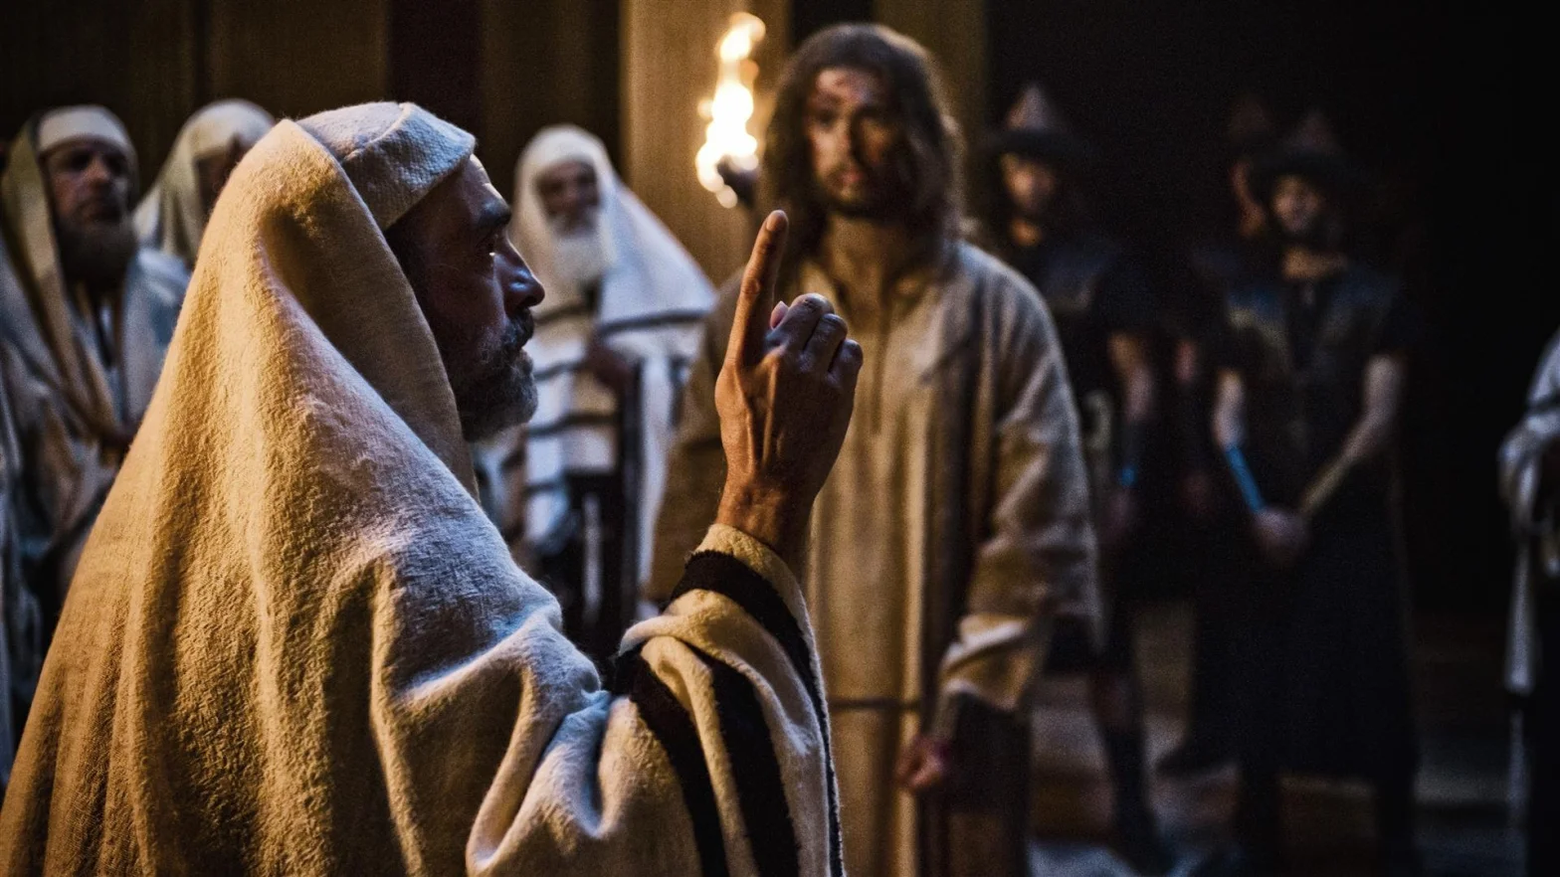
What can flawed people do?
The crowd is out of control.
It can’t be stopped now.
What can he do?
Notes:
He couldn’t sway the Council. No one is listening to reason.
The crowd is out of control.
It can’t be stopped now. They’re out for blood.
Even the Roman authorities realize what is going on, and they are powerless to subdue the riot.
The Teacher is taken away by the soldiers, severely beaten, mocked, and tied to a cross and made to drag it out of the city toward Golgotha.
Joseph doubtless knows what is going to happen now. He can do little else but observe.
And as he does, I wonder if it all becomes clearer and clearer to him – Joseph, this learned man, well aware of the scriptures and “awaiting the kingdom of God”
Does his mind go to the Man of Sorrows passage from the scroll of Isaiah? He certainly would know it very well.
The darkness, earthquakes, and reports of tombs being opened would certainly confirm for him that something truly unusual and significant is taking place.
And is this when it all becomes clear that there is something else he can do?
He is a rich man.
He owns a new grave cut out of rock, and it’s nearby.
This is going to potentially drag on for a while, but he knows that because the Sabbath begins in a few hours that the Romans will be asked to hasten the deaths of those hanging, agonizing to breathe as the spectacle goes into the afternoon hours.
He knows what needs to happen and that he is the best one (if not the only one) to do something about it.

Slide 23
What can flawed people do?
Set fear aside.
Choose to act.
Notes:
He is going to need to act pretty quickly, but he can anticipate what will need to happen shortly. There’s going to be a body. There’s going to need to be a burial, and there’s not going to be much time. And some more difficult decisions.
Joseph goes and buys a linen cloth – (according to Mark 15:46, he bought a linen sheet) - the word for which is “sindon” (a sheet) – which is a different word than that used of the traditional burial wrappings which were strips of cloth wound around the body after it had been covered with spices. And this may offer an interesting clue about something else that would happen later.
Who can he trust? Who will help him? He’s going to need some help and someone who understands the circumstances. Nicodemus. They are of the same mind, he knows Nicodemus has been asking the same questions as he has, so he finds him and quickly tells him his plan. Nicodemus quickly makes arrangements for perfumes and spices to be prepared.
“He and Nicodemus do the one thing they can: ensure a fitting burial for Christ, in Joseph’s own tomb. Was this a partnership of disappointed disciples?” asks Ken Costa, author of Joseph of Arimathea: The Extraordinary Calling of Ordinary People (as quoted the article in Premier Christianity). Perhaps the shame they both carried from their lack of open witness to Jesus? We don’t know…”

Slide 24
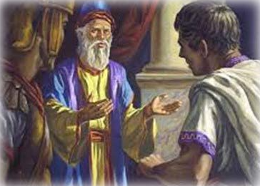
What can flawed people do?
Set fear aside.
Choose to act.
…and he gathered
up his courage and went in before Pilate, and asked for the
body of Jesus.
- Mk 15:43b
Notes:
It is the ninth hour of the day, (about 3 in the afternoon). Jesus has expired and the crowd is dissipating. The sun is shining again, almost like nothing happened, and things are growing quieter already. There are reports that the temple veil was torn from top to bottom – who can imagine that?? What could it mean?
Mark 15:43 – and he gathered up his courage and went in before Pilate, and asked for the body of Jesus.
He likely did this as privately as he could, to avoid any debate about what would be done with the body. He had to get there first. So he prudently does what needs to be done.
In Mt. 27:58, the word “asked” means to boldly implore. Joseph appearing before Pilate was not insignificant in another way –
As a Jew, entering the court of a Gentile would’ve made Jospeh ceremonially unclean for the Sabbath, but he knows that this is nothing compared to what he will do soon.
“An emboldened Joseph approaches Pilate without regard to his reputation and requests the body. How extraordinary that he would do this publicly after Jesus was dead. He had nothing (earthly) to gain and so much to lose,” says Costa.
But he’s not acting from fear now. Joseph may have regrets, but he’s determined to do the right thing now, no matter the cost to him. He’s following his faith now.

Slide 25
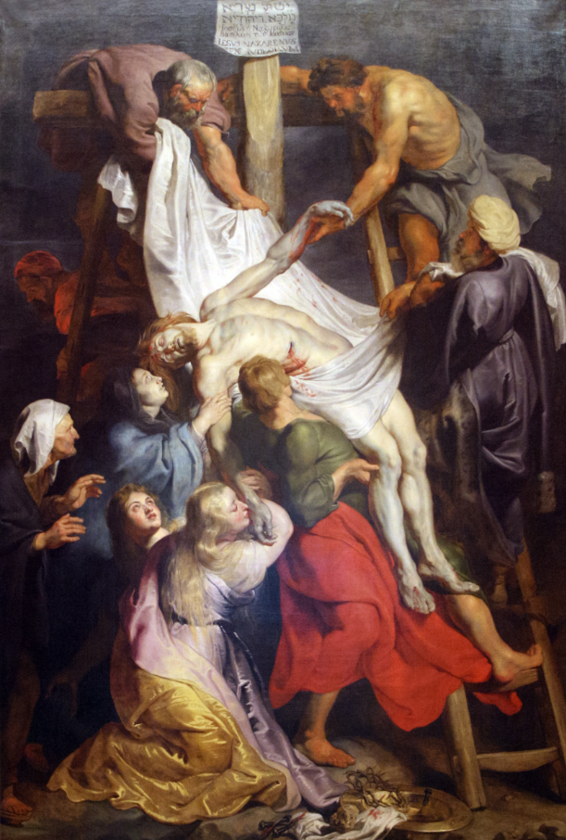
What can flawed people do?
Do difficult things.
Risk position & welfare
Defy corruption
Bear ultimate impurity
Make spiritual sacrifices
Notes:
Flawed people can do difficult things.
Joseph has been granted custody of Jesus’ body by Pilate. Time is getting short. He knows that his colleagues on the Sanhedrin want only to erase Jesus and his memory. So he defies them. He steps out and leaves his fear behind.
With the help of Nicodemus and perhaps a few others, they lower Jesus’s lifeless body down from the cross, probably by laying it down on the ground to remove the nails. And they carry him away to the nearby garden tomb, and quickly clean Him up and prepare His body.
And in so doing, Joseph and anyone else who touched His body became ritually unclean. According to Numbers 31:19, corpse uncleanness resulted from physical contact with a corpse and required not just a ritual mikveh bath, it required a 7-day purification process.
It was a the highest grade of uncleanness, the ULTIMATE impurity.
And, anyone with corpse uncleanness would pass on their uncleanness to anyone they touched until they are ceremonially clean again.
So to handle Jesus’s body and prepare it for burial would’ve been a huge commitment for a Jew, particularly of his position.
It’s a spiritual sacrifice that shows his compassion and sense of right, and perhaps even his faith and recognition of his Messiah.
But he was already unclean after visiting Pilate. He’s committed now. He will miss the Sabbath meal and temple worship this week. He’ll think about that later.

Slide 26
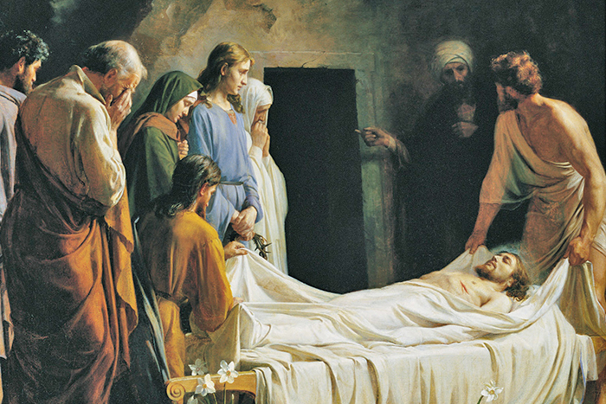
What can flawed people do?
Do what needs to be done.
Notes:
Joseph moves Jesus’s body the short distance to the garden nearby, where he owns a new tomb where no one has yet been buried.
Nicodemus bring myrrh and aloes, fragrant ointment to apply to the body. And if my calculations are right, he brings a lot. My Bible says it’s 100 12-oz. pounds, which would be about 75 pounds. And if this was in any way similar to what Mary used to anoint Jesus’s feet, (which was 1 pound and worth 300 denarii), then what Nicodemus brings was of tremendous cost, even if it was only worth half the price per pound.
The Preparation Day is drawing to a close and it will soon be the Sabbath. They have to finish quickly. They place Jesus into the tomb and roll the stone across the entrance. They return to their homes to absorb and process the events of this remarkable day, one of the four or five most important in all of history.

Slide 27
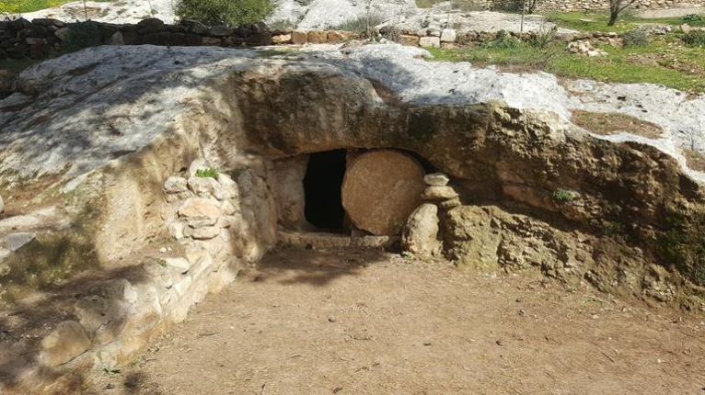
What can flawed people do?
Recognize real priorities
Provide for others
Establish the faith of others
Encourage others
Notes:
Flawed people can establish the faith of others.
If the Council had their way, they would’ve wanted Jesus and the crucifixion and His fame all to go away quickly.
Criminals who were shamefully executed by crucifixion, typically the lowest classes of people and destitute, would be buried in the public graveyard in an unmarked grave.
Maybe something tells Joseph that this can’t be allowed to happen. So, he acted.
Have you ever considered the significance that if Jesus were buried in an obscure place, it would have made it almost impossible for there to be any witness that he had risen from the grave? Jesus would’ve still been resurrected if He had not been buried in the stone tomb, but the witness of the empty tomb would’ve been lost.
According to Matthew 27:62-66 – Now on the next day, which is the one after the preparation (so it’s the morning of the Sabbath), the chief priests and the Pharisees gathered together with Pilate, and said, “Sir, we remember that when He was still alive that deceiver said, ‘After three days I am to rise again.’ “Therefore, give orders for the grave to be made secure until the third day, lest the disciples come and steal Him away and say to the people, ‘He has risen from the dead,’ and the last deception will be worse than the first.” Pilate said to them, “You have a guard; go, make it as secure as you know how.” And they went and made the grave secure, and along with the guard they set a seal on the stone.
This couldn’t have happened had Jesus been buried in an unmarked common pit of a grave. And so, what the Council meant as a measure to prevent Jesus’ reputation actually ensured that there would be an extra layer of proof of his resurrection.
It’s also significant that after the crucifixion, Joseph didn’t disappear. Jesus’s companions watched from a distance. Later, the women did come and sat opposite the tomb, and observed how and where they buried Him. But Joseph knew that Jesus was innocent, and he did the respectful and generous thing by ensuring He was buried properly. And it was a very honorable burial place.
It may be interesting that the women, possibly because they saw that Jesus wasn’t embalmed as thoroughly as He should’ve been be or they’d like Him to be, as He was just wrapped in a linen cloth. There just hadn’t been time. And not anticipating His resurrection, they prepared spices after they returned home either that night or the following at dark when the Sabbath had passed. And these they brought back to the tomb early on the 1st day just as the Sabbath was ending and the first day of the week with the intent to finish the task properly. But then and there they realized that Jesus had risen from the dead.
By the way, as the women gather at the empty tomb, not only has Jesus been raised from the dead, but some of the dead whose tombs were opened during the crucifixion are now reportedly being seen alive in the city.

Slide 28
One more thing…
The meaning of his name just might have a coincidental significance…
Joseph
“may God add”
Genesis 30:22-24 – God remembers Rachel – “may the Lord add to me another son”
Notes:
That just struck me as an interesting coincidence.

Slide 30
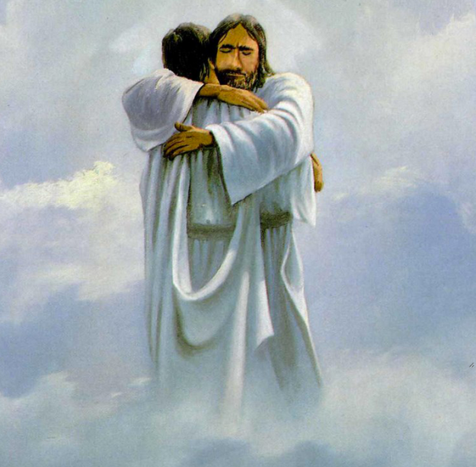
Faith Wins Out
Notes:
What about you? Are you flawed? Yeah, me too. But we don’t have to be failed. You can’t keep a foot in two worlds.
How would you live your life of faith if it weren’t for other people? Does it make a difference in your life? Are you ashamed of it? If he could’ve gone back and made his choices again but with the benefit of what he came to know later, how do you think Joseph would’ve lived? Would he have been a secret disciple? Would he have “feared the Jews?” Would he have tried to keep a foot in two different worlds? Or would he have fully committed, openly, without shame, placing himself among the followers, the visibly faithful, potentially persecuted, but knowing his reward was to come and not to be found in the security and safety of his earthly life, wealth, and position? Perhaps. The important part of his legacy is that he did make the right choice, he did live out his faith, and he was no longer a secret disciple after the events on the crucifixion day. How he lived after that, we will find out some day. But HIS ACTIONS are HIS LEGACY!
Joseph was flawed. And guess what? So were a few others. Let’s look at Hebrews 11 for a moment. Hebrews 11:6 – and it goes on to talk about Abraham (liar), Sarah (laughed at God), Jacob (deceiver), and his sons (sold Joseph into slavery and lied about it, letting their father believe he was dead), Moses (let his anger get the best of him, and was also at times fearful and reluctant), Rahab (no comment needed); these were all ‘flawed’ individuals. And yet the Hebrew writer goes on (in verse 38) to call them “men of whom the world was not worthy). They were not failed individuals. If it were up to me, I’d include Joseph in this category and among the “heroes of faith.” Verses 39 and 40: And all these, having gained approval through their FAITH, did not receive what was promised, because God had provided something better for us, so that apart from us they should not be made perfect.
Except, I’d like to think that Joseph, in the weeks and months following his actions after the crucifixion, was baptized into Christ and became a Christian. Personally, I believe he did. And so, hopefully he did receive what was promised.
“One man, with strengths and weaknesses like all men, a man whose heart was no doubt pounding like a piston as he approached Pilate’s palace, but a man who kept going because he loved Jesus and believed that He was who He said He was. One man who stayed, even when many of the disciples closest to Jesus had left.”
Costa also wrote, “In life, we must steward both our affluence and our influence.” Good stewardship of wealth – our generosity – is well understood. But good stewardship of our influence is often much harder. “Perhaps it is a willingness to risk our reputation with men which differentiates a follower of Jesus from a mere admirer.”
What part of Joseph’s story stands out to you? He got a “do-over”. He got the chance to make a better choice. And you have that opportunity right now. But you may not have it tomorrow. Don’t be a secret disciple. Live your faith out loud. Joseph may have been flawed, but ultimately, Joseph was not failed. Faith wins out! Will faith win out for you? I hope it will. Let us know how we can help you now…

