Slide 1
Jesus to Weak & Outcasts

Slide 2
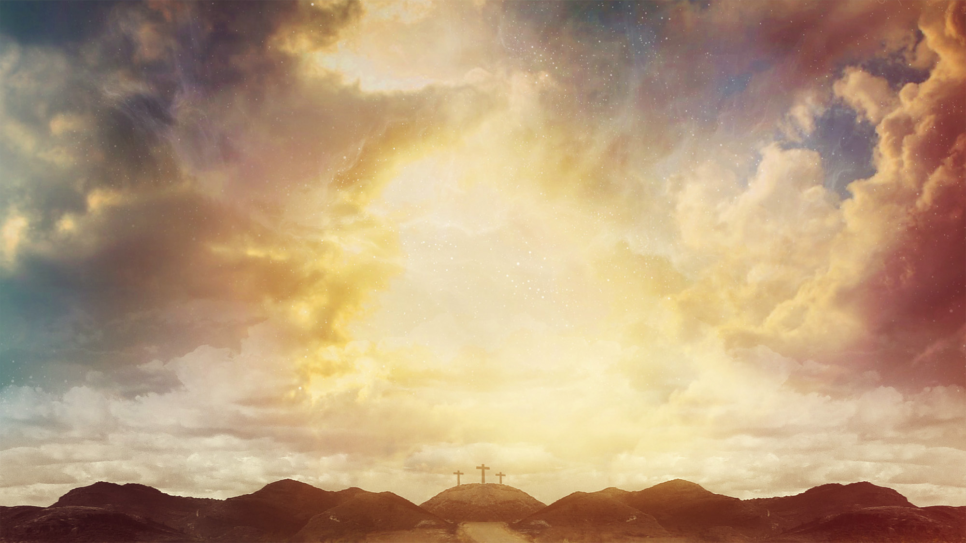
Luke 5:12-16
The Leper and the Paralytic
¹² While He was in one of the cities, behold, there was a man covered with leprosy; and when he saw Jesus, he fell on his face and implored Him, saying, “Lord, if You are willing, You can make me clean.” ¹³ And He stretched out His hand and touched him, saying, “I am willing; be cleansed.” And immediately the leprosy left him. ¹⁴ And He ordered him to tell no one, “But go and show yourself to the priest and make an offering for your cleansing, just as Moses commanded, as a testimony to them.” ¹⁵ But the news about Him was spreading even farther, and large crowds were gathering to hear Him and to be healed of their sicknesses. ¹⁶ But Jesus Himself would often slip away to the wilderness and pray.

Slide 3
Luke 5:17-26
¹⁷ One day He was teaching; and there were some Pharisees and teachers of the law sitting there, who had come from every village of Galilee and Judea and from Jerusalem; and the power of the Lord was present for Him to perform healing. ¹⁸ And some men were carrying on a bed a man who was paralyzed; and they were trying to bring him in and to set him down in front of Him. ¹⁹ But not finding any way to bring him in because of the crowd, they went up on the roof and let him down through the tiles with his stretcher, into the middle of the crowd, in front of Jesus. ²⁰ Seeing their faith, He said, “Friend, your sins are forgiven you.” ²¹ The scribes and the Pharisees began to reason, saying, “Who is this man who speaks blasphemies? Who can forgive sins, but God alone?” ²² But Jesus, aware of their reasonings, answered and said to them, “Why are you reasoning in your hearts? ²³ Which is easier, to say, ‘Your sins have been forgiven you,’ or to say, ‘Get up and walk’? ²⁴ But, so that you may know that the Son of Man has authority on earth to forgive sins,”—He said to the paralytic—“I say to you, get up, and pick up your stretcher and go home.” ²⁵ Immediately he got up before them, and picked up what he had been lying on, and went home glorifying God. ²⁶ They were all struck with astonishment and began glorifying God; and they were filled with fear, saying, “We have seen remarkable things today.”

Slide 4
Luke 5:27-32
²⁷ After that He went out and noticed a tax collector named Levi sitting in the tax booth, and He said to him, “Follow Me.” ²⁸ And he left everything behind, and got up and began to follow Him.
²⁹ And Levi gave a big reception for Him in his house; and there was a great crowd of tax collectors and other people who were reclining at the table with them. ³⁰ The Pharisees and their scribes began grumbling at His disciples, saying, “Why do you eat and drink with the tax collectors and sinners?” ³¹ And Jesus answered and said to them, “It is not those who are well who need a physician, but those who are sick. ³² I have not come to call the righteous but sinners to repentance.”

Slide 5
Luke 7:1-10
Jesus Heals a Centurion’s Servant
7 When He had completed all His discourse in the hearing of the people, He went to Capernaum.
² And a centurion’s slave, who was highly regarded by him, was sick and about to die. ³ When he heard about Jesus, he sent some Jewish elders asking Him to come and save the life of his slave. ⁴ When they came to Jesus, they earnestly implored Him, saying, “He is worthy for You to grant this to him; ⁵ for he loves our nation and it was he who built us our synagogue.” ⁶ Now Jesus started on His way with them; and when He was not far from the house, the centurion sent friends, saying to Him, “Lord, do not trouble Yourself further, for I am not worthy for You to come under my roof; ⁷ for this reason I did not even consider myself worthy to come to You, but just say the word, and my servant will be healed. ⁸ For I also am a man placed under authority, with soldiers under me; and I say to this one, ‘Go!’ and he goes, and to another, ‘Come!’ and he comes, and to my slave, ‘Do this!’ and he does it.” ⁹ Now when Jesus heard this, He marveled at him, and turned and said to the crowd that was following Him, “I say to you, not even in Israel have I found such great faith.” ¹⁰ When those who had been sent returned to the house, they found the slave in good health.

Slide 6
Luke 7:11-17
¹¹ Soon afterwards He went to a city called Nain; and His disciples were going along with Him, accompanied by a large crowd. ¹² Now as He approached the gate of the city, a dead man was being carried out, the only son of his mother, and she was a widow; and a sizeable crowd from the city was with her. ¹³ When the Lord saw her, He felt compassion for her, and said to her, “Do not weep.” ¹⁴ And He came up and touched the coffin; and the bearers came to a halt. And He said, “Young man, I say to you, arise!” ¹⁵ The dead man sat up and began to speak. And Jesus gave him back to his mother. ¹⁶ Fear gripped them all, and they began glorifying God, saying, “A great prophet has arisen among us!” and, “God has ^{[l]}visited His people!” ¹⁷ This report concerning Him went out all over Judea and in all the surrounding district.

Slide 7
Some observations
Jesus was accessible & approachable
Jesus was compassionate
Jesus broke the social norms
Jesus had a non-judgmental attitude
Jesus taught simple truths
Jesus recognized faith

Slide 8
How do we relate & respond?
Imitate Christs compassion
Break down the social barriers
Offer Practical Help
Work with a non-judgmental attitude
Share the Gospel

