Slide 2
Luke 11:1-13 and Luke 12:13-48
These questions and answers provide a starting point for reflection on the teachings of Jesus in these passages. They encourage us to consider our attitudes towards prayer, wealth, materialism, and our readiness for Christ's return.

Slide 3
Trusting and Fully Depending on God
Luke 11:1-13
Luke 12:13-48

Slide 4
Luke Chapter 11:1-13
What does the Lord's Prayer (Luke 11:2-4) teach us about the priorities and attitudes we should have in our prayers?
emphasizes a focus on God's will, daily needs, forgiveness, and seeking His guidance in our prayers.

Slide 5
Luke 11:5-8:
Why does Jesus use the parable of the persistent friend to teach about prayer?
What does it reveal about our persistence in seeking God?

Slide 6
The importance of persistence in prayer, highlighting that God responds to our persistent requests. The story of the friend at midnight shows the value of continual asking. We need a LONGER-TERM view of prayer. We cannot nag God into submission, but persistence is a sign that we trust He hears and that we need His help.

Slide 7
Luke 11:9-13: The Loving God who gives
How does Jesus' comparison between earthly fathers giving good gifts to their children and God giving the Holy Spirit to those who ask deepen our understanding of God's generosity and love?

Slide 8
It begins with ASK which should tell us that God is approachable.
The idea of SEEK involves a focus on pursuing knowledge and a relationship with Him
KNOCK is an appeal to be continual or being persistent…Luke 18:1 “men always ought to pray and not lose heart”

Slide 9
In verse 12 Would God give something harmful to His child who has pled for something necessary to life?
Vs 13 God gives good gifts…we sometimes focus on God’s power and forget the personal love and care He offers with His presence in our lives..He is accessible through prayer, but not only that but He responds to our prayers

Slide 10
“It's easy to ask, "Why me?" But I'm determined to ask another question: "Why not me?" Since I believe that the Lord knows what He's doing, and I believe that He can use weaknesses in people to glorify Him and serve others, then I am willing to go down this road as He wills. It's a thorn, but I can accept what the Lord told Paul:
"My grace is sufficient for you, for my power is made perfect in weakness."” (2 Cor 12.9-10)
~Doy Moyer

Slide 11
Luke Chapter 12
In Luke 12 much of the teaching of Jesus is directed to his disciples in the presence of the multitude.
Christ Warns About Hypocrisy
Christ tells the crowd to “Beware of the leaven of the Parisees.

Slide 12
Luke Chapter 12
12: 13-21 Parable of the Rich Fool
12:22-34 Seek The Kingdom of God
12: 35-48 Parable ot the Expectant Steward
12: 41-48 Parable of the Faithful Steward

Slide 13
In the parable of the rich fool (Luke 12:13-21), what is the warning Jesus gives about the dangers of greed and materialism?
-Warns against prioritizing wealth and material possessions over a relationship with God, as it can lead to spiritual emptiness.
-Beware and be on guard for every form of greed
-It’s a warning about self reliance as opposed to reliance on God
-Those devoted to securing earthly wealth and who forget God, are not rich toward God. Spiritual treasures are not determined by the amount of things one has on earth

Slide 14
Greed is an intense and selfish desire for something, especially wealth or possession.
Other types of greed include:
• Financial greed
• Power greed
• Greed for fame
• Greed for attention
• Greed for compliments
• Greed for gifts
• Greed for another person's time

Slide 15
What measures can we take to guard against greed in our lives today?
–Prayer
–Study God’s word
–Serve others
–Give to others

Slide 16
Luke 12:22-34
In our lives today, if we take a look around us, what are some things that we value?
Our children homes jobs
our marriage friends success
Integrity health relationship with God
a Cause/Organization of some kind
our church family

Slide 17
In terms of earthly things, what does God appear to value most according to Luke 12:24?
YOU!!!

Slide 18
We live out what we truly believe, aka, your belief system. If we truly believe what God says about our value to Him, it will alter how we live our lives……..
1) It frees us from hypocrisy
2) It frees us from unnecessary fear vs 4- “I tell you, my friends, do not be afraid of those who kill the body and after that can do nothing more.”
3) It frees us from the need for riches vs. 33 “sell your possessions and give to the poor”

Slide 19
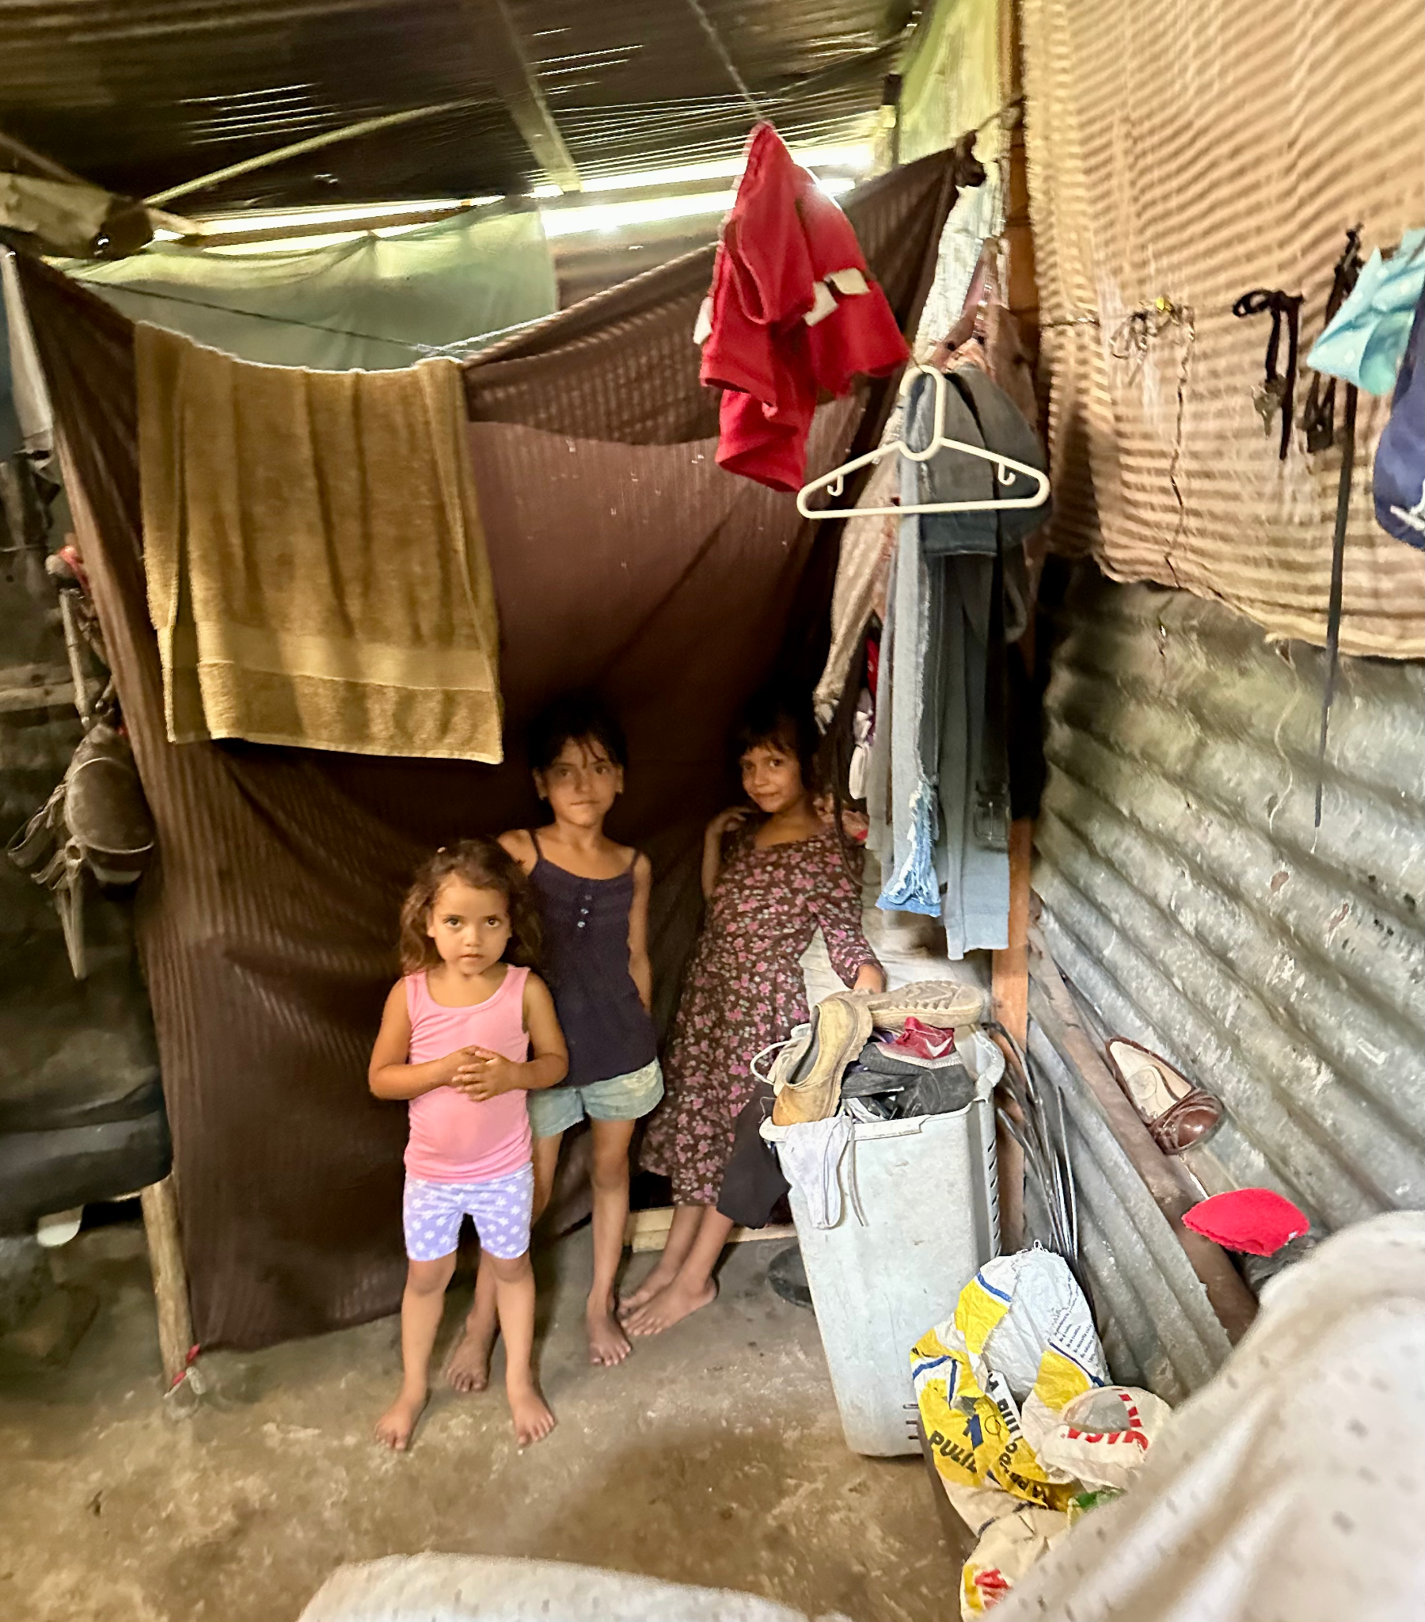
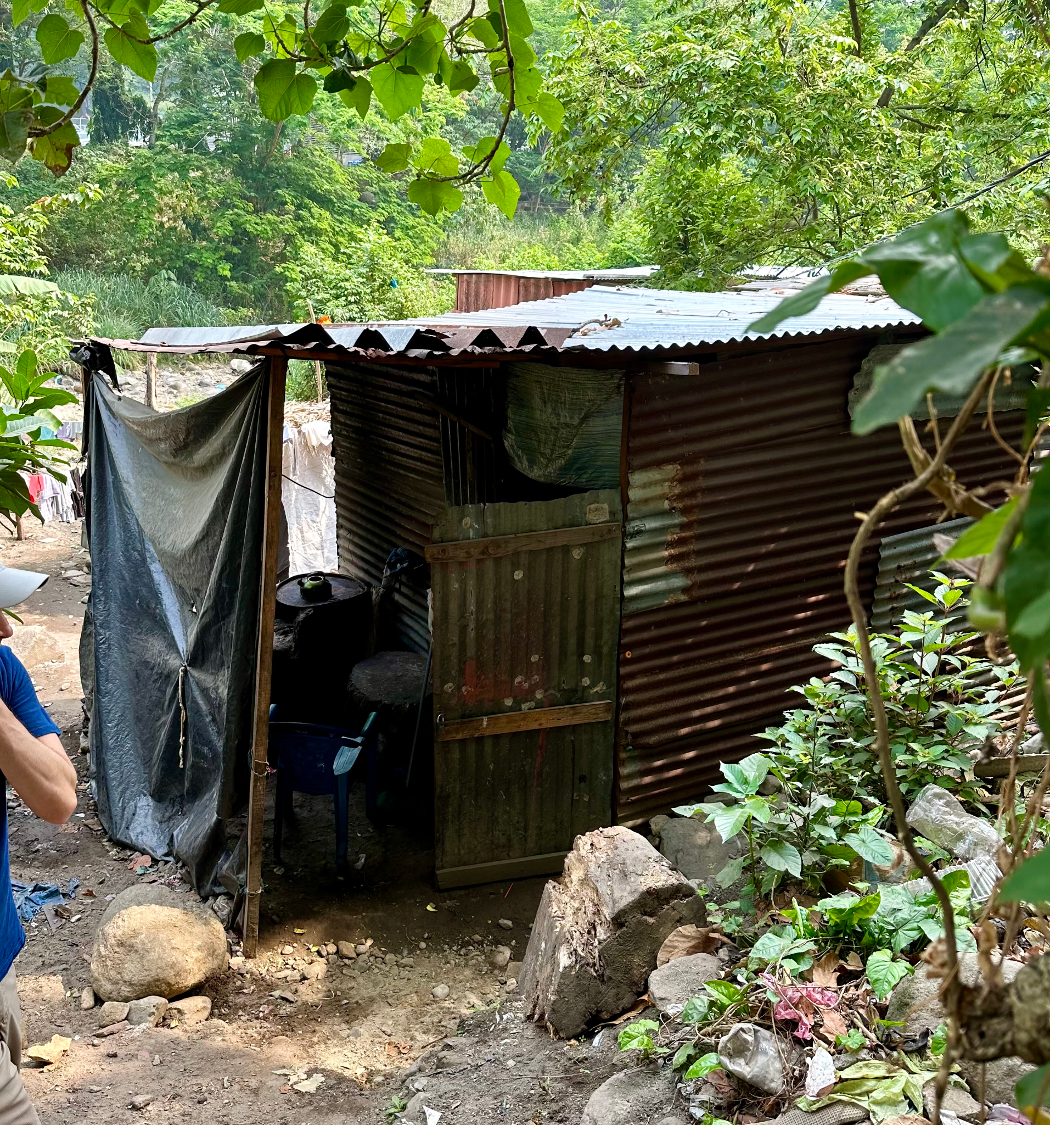

Slide 20
4) It frees us from worry- vs. 25 “Can any of you add one moment of his life span by worrying?”
Why do we find it so difficult to not worry and what is the remedy?

Slide 21
Luke 12:35-40 Be Ready for the Master’s Return
Who is the Master? Jesus
Do you think his Disciples knew what He meant when He said that the Son of Man is coming at an hour you do not expect?

Slide 22
END

Slide 27
These questions and answers provide a starting point for reflection on the teachings of Jesus in these passages. They encourage us to consider our attitudes towards prayer, wealth, materialism, and our readiness for Christ's return.

Slide 28
In these passages, Jesus engages with people who hold various forms of power and authority, be it religious, financial, or social. He often challenges their misuse of power, calls for humility and authenticity, and emphasizes the importance of prioritizing God’s kingdom over wordly status. His interactions with those considered “more powerful” serve as a reminder of the higher moral standards expected of those in influential positions and the need for a humble and righteous approach to authority and wealth.

Slide 32
Chapter 2

