Slide 2
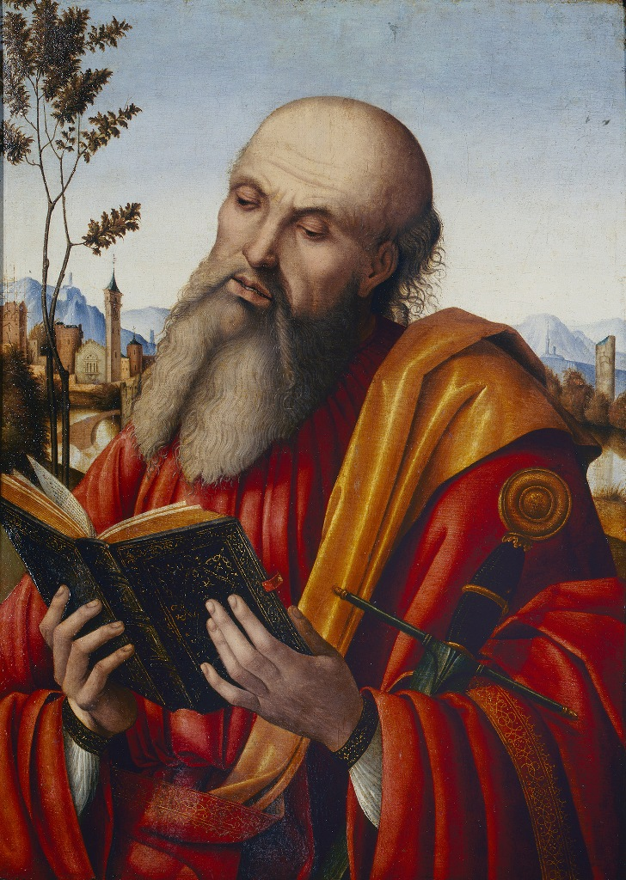
Apollos
1 minute ago
I get tired of some people thinking they know it all
😑

Slide 3
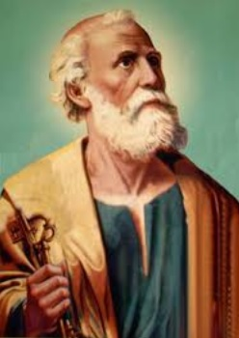
Peter
Yesterday at 6:05 PM
Who do some people think they are? They need to take care of their own baggage instead of lecturing others! 😡

Slide 4
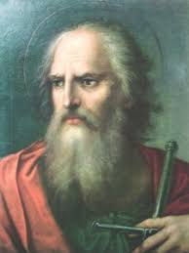
Corinthian brother
Sunday at 12:01 PM
My church is so judgmental 😫

Slide 5
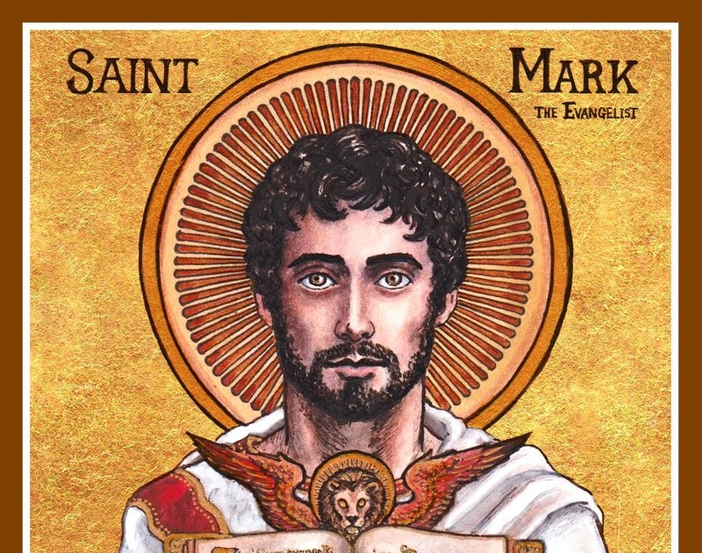
John Mark
13 minutes ago
I wish older Christians would try to understand younger Christians rather than judging us #ThanksGrandpa

Slide 6
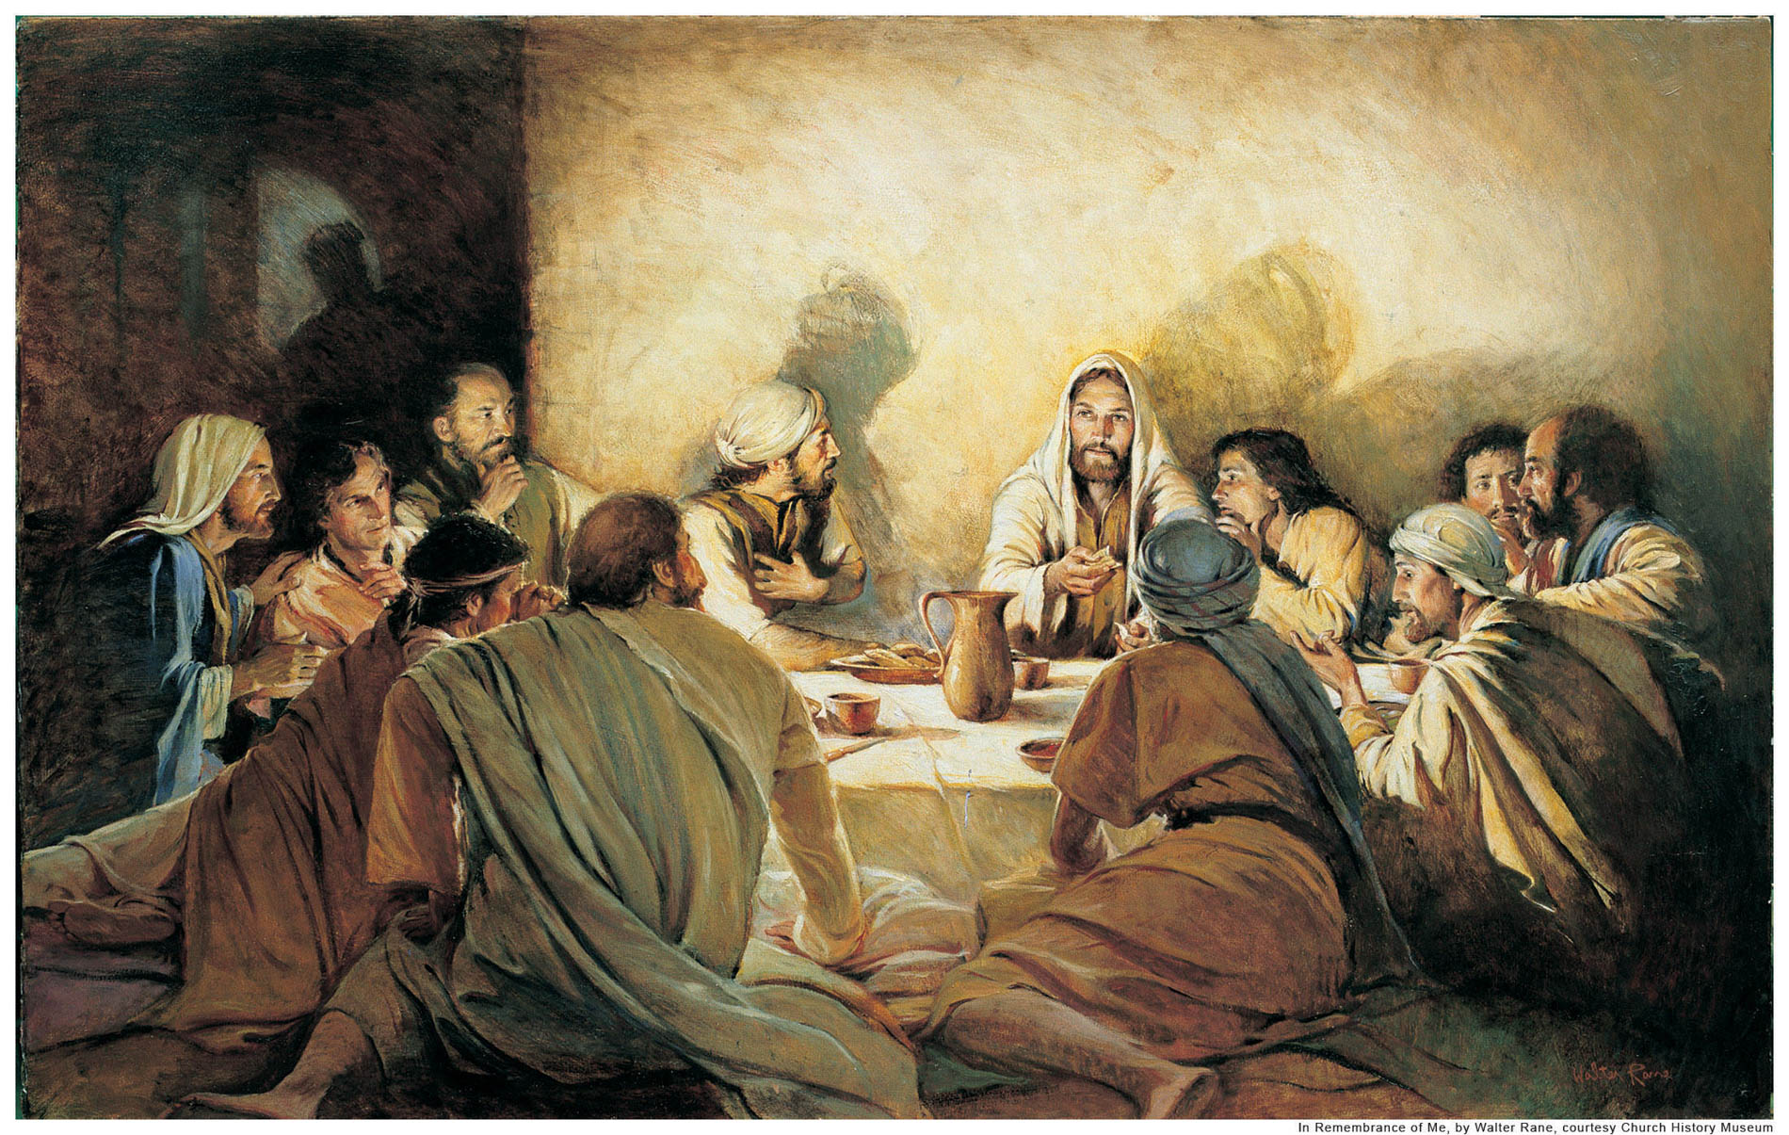
THE 12
Thursday at 7:06 PM
If only we could all be so perfect 🙄

Slide 7
It may cause us to reject God’s love (Hebrews 12.6)
Puede hacer que rechacemos el amor de Dios (Hebreos 12.6)
I’m concerned
😡
Los peligros de ser “de piel fina”
The Dangers of Being “Thin-Skinned”

Slide 8
It will prevent us from realizing the full value of Scripture (2Timothy 3.16)
Nos impedirá darnos cuenta del valor total de las Escrituras (2Timoteo 3.16)
I’m concerned
😡
Los peligros de ser “de piel fina”
The Dangers of Being “Thin-Skinned”

Slide 9
It will stunt our growth (Proverbs 19.25; Ecclesiastes 7.5)
Detendrá nuestro crecimiento (Proverbios 19.25; Eclesiastés 7.5)
I’m concerned
😡
Los peligros de ser “de piel fina”
The Dangers of Being “Thin-Skinned”

Slide 10
Be willing to grow Estar dispuesto a crecer
Focus on the message, not the messenger Céntrese en el mensaje, no en el mensajero
Believe and hope all things Cree y espera todas las cosas
If you reject an application, don’t reject the principle Si rechazas una solicitud, no rechaces el principio
I’m concerned
😡
¿Qué Se Puede Hacer?
What Can Be Done?

