Slide 1
Class 20, Jesus crucified

Slide 2
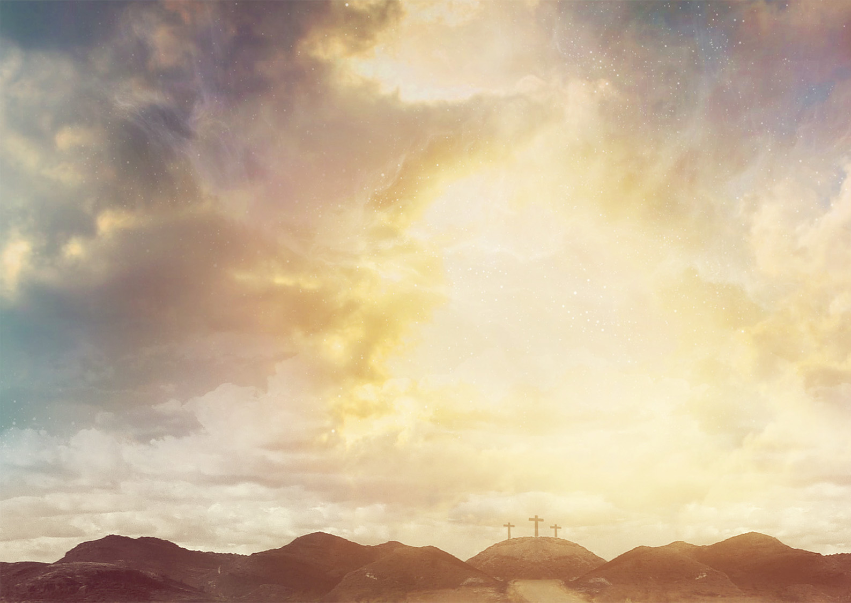
Overview
Luke 23:26-56

Slide 3
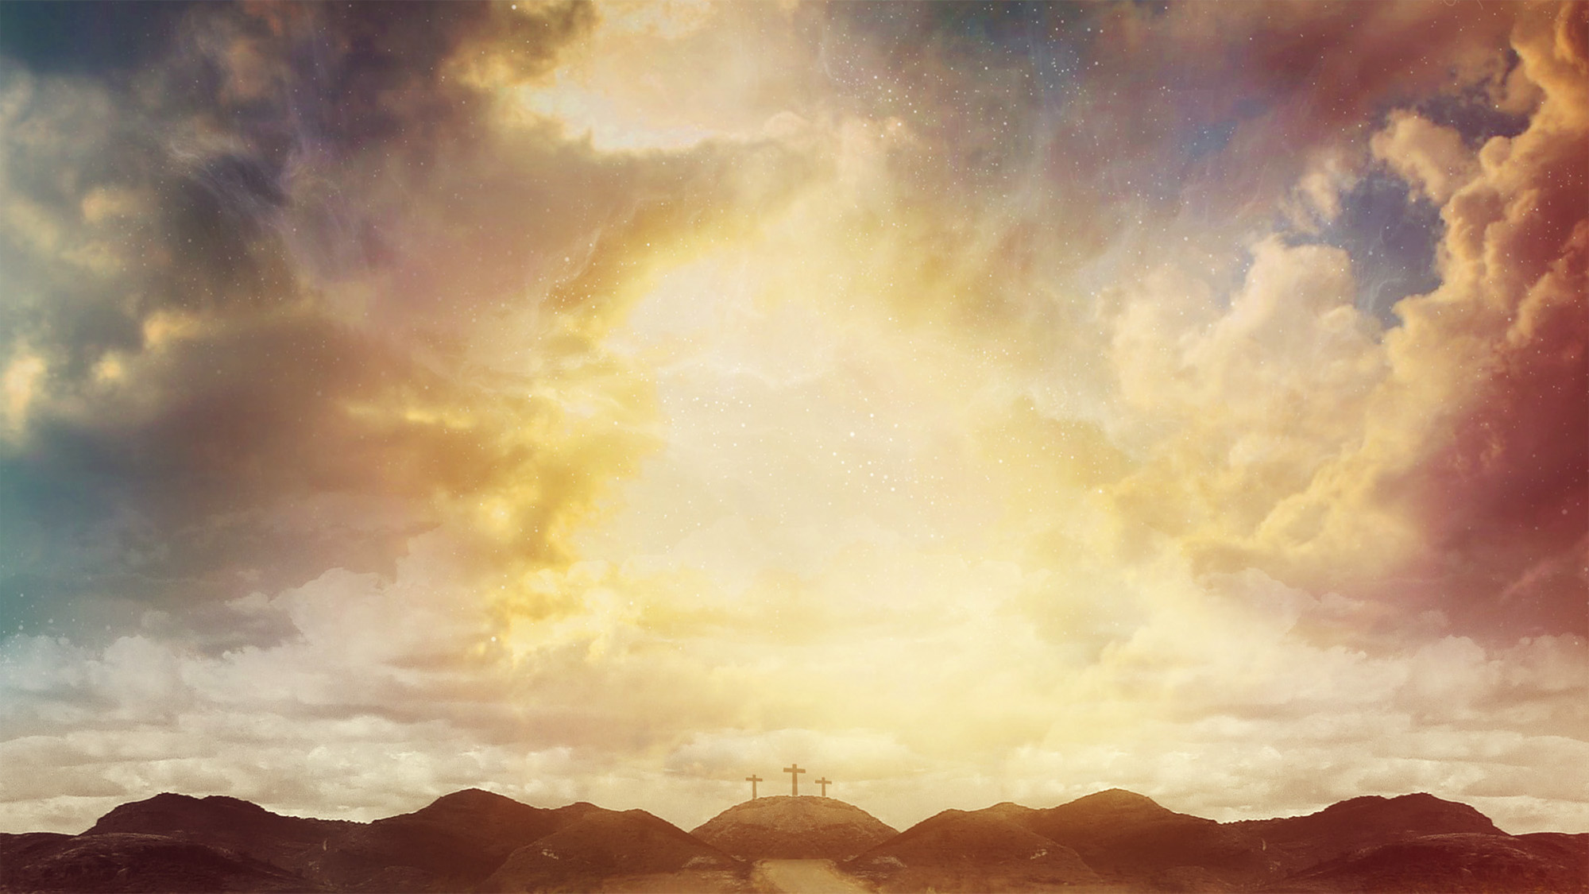
Upside down coronation
Suffering servant

Slide 4
Luke 23:26-43
Simon carries the cross
“Daughters of Jerusalem, do not weep for me, but weep for yourselves and for your children.”
Two criminals
One sided with the crowd
One sided with Jesus

Slide 5
Luke 23:44-49
Curtain of temple torn in two
30 feet long, 30 feet wide (I Kings 6:19-20), and (by tradition) 4 inches thick
Matthew torn top to bottom
Symbolic God took away a barrier (Hebrews 10:19-20)
Acquaintances stood at a distance

Slide 6
Luke 23:50-56
Joseph, from the council, asked for the body of Jesus
The women followed
Prepared spices and ointments
They observed the Sabbath

Slide 7
A few questions
An innocent man being killed isn’t unusual. Why is this story unusual?
Was the crucifixion preventable?
Was Joseph of Arimathea a hero or a coward?
What was Jesus’s attitude toward injustice toward himself or his disciples?

