Slide 1
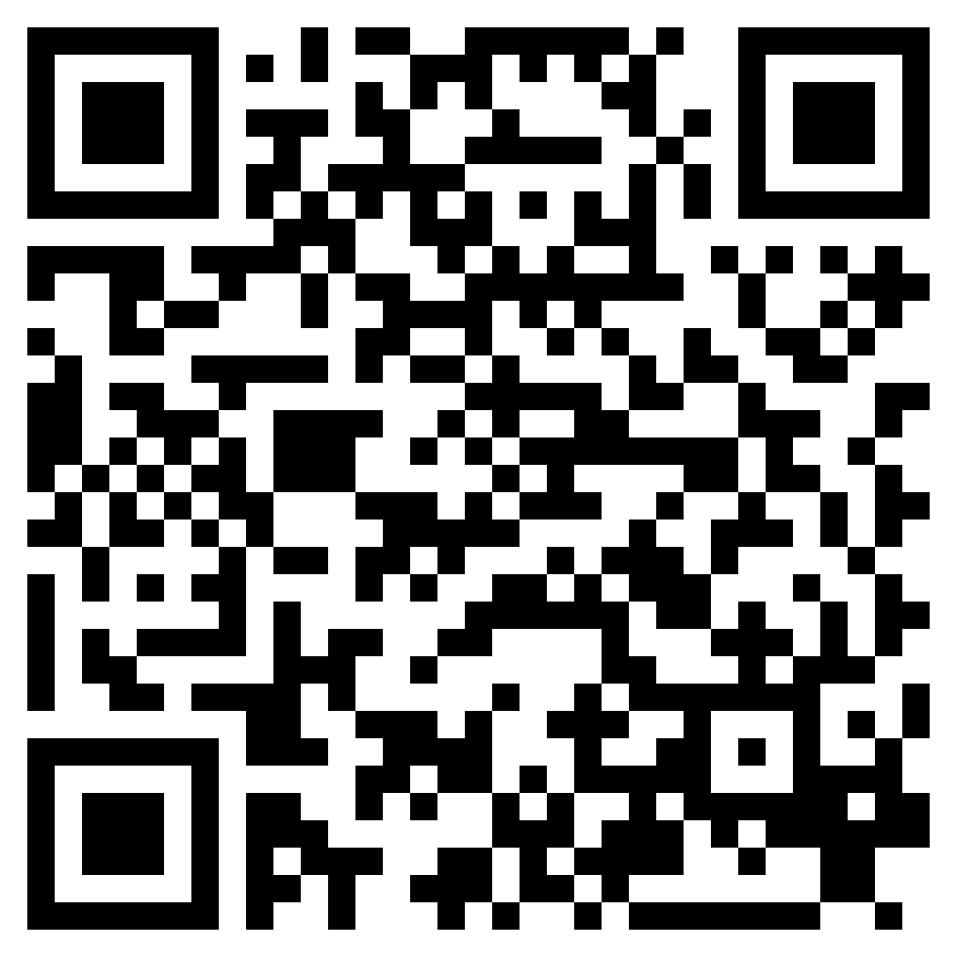
WHO IS THE LORD?
ACTS 2.1-36

Slide 2
“And it shall come to pass that everyone who calls upon the name of the Lord shall be saved.’” (Acts 2:21, ESV)

Slide 3
“Let all the house of Israel therefore know for certain that God has made him both Lord and Christ, this Jesus whom you crucified.”” (Acts 2:36, ESV)

Slide 4
Acts 2:37–41 (ESV)
³⁷Now when they heard this they were cut to the heart, and said to Peter and the rest of the apostles, “Brothers, what shall we do?”
³⁸And Peter said to them, “Repent and be baptized every one of you in the name of Jesus Christ for the forgiveness of your sins, and you will receive the gift of the Holy Spirit.
³⁹For the promise is for you and for your children and for all who are far off, everyone whom the Lord our God calls to himself.”
⁴⁰And with many other words he bore witness and continued to exhort them, saying, “Save yourselves from this crooked generation.”
⁴¹So those who received his word were baptized, and there were added that day about three thousand souls.
PEOPLE ARE SAVED
ACTS 2.37-41

Slide 5
Acts 2:37–41 (ESV)
³⁷Now when they heard this they were cut to the heart, and said to Peter and the rest of the apostles, “Brothers, what shall we do?”
³⁸And Peter said to them, “Repent and be baptized every one of you in the name of Jesus Christ for the forgiveness of your sins, and you will receive the gift of the Holy Spirit.
³⁹For the promise is for you and for your children and for all who are far off, everyone whom the Lord our God calls to himself.”
⁴⁰And with many other words he bore witness and continued to exhort them, saying, “Save yourselves from this crooked generation.”
⁴¹So those who received his word were baptized, and there were added that day about three thousand souls.
PEOPLE ARE SAVED
ACTS 2.37-41

Slide 6
Acts 2:37–41 (ESV)
³⁷Now when they heard this they were cut to the heart, and said to Peter and the rest of the apostles, “Brothers, what shall we do?”
³⁸And Peter said to them, “Repent and be baptized every one of you in the name of Jesus Christ for the forgiveness of your sins, and you will receive the gift of the Holy Spirit.
³⁹For the promise is for you and for your children and for all who are far off, everyone whom the Lord our God calls to himself.”
⁴⁰And with many other words he bore witness and continued to exhort them, saying, “Save yourselves from this crooked generation.”
⁴¹So those who received his word were baptized, and there were added that day about three thousand souls.
PEOPLE ARE SAVED
ACTS 2.37-41

Slide 7
Acts 2:37–41 (ESV)
³⁷Now when they heard this they were cut to the heart, and said to Peter and the rest of the apostles, “Brothers, what shall we do?”
³⁸And Peter said to them, “Repent and be baptized every one of you in the name of Jesus Christ for the forgiveness of your sins, and you will receive the gift of the Holy Spirit.
³⁹For the promise is for you and for your children and for all who are far off, everyone whom the Lord our God calls to himself.”
⁴⁰And with many other words he bore witness and continued to exhort them, saying, “Save yourselves from this crooked generation.”
⁴¹So those who received his word were baptized, and there were added that day about three thousand souls.
PEOPLE ARE SAVED
ACTS 2.37-41

Slide 8
Acts 2:37–41 (ESV)
³⁷Now when they heard this they were cut to the heart, and said to Peter and the rest of the apostles, “Brothers, what shall we do?”
³⁸And Peter said to them, “Repent and be baptized every one of you in the name of Jesus Christ for the forgiveness of your sins, and you will receive the gift of the Holy Spirit.
³⁹For the promise is for you and for your children and for all who are far off, everyone whom the Lord our God calls to himself.”
⁴⁰And with many other words he bore witness and continued to exhort them, saying, “Save yourselves from this crooked generation.”
⁴¹So those who received his word were baptized, and there were added that day about three thousand souls.
PEOPLE ARE SAVED
ACTS 2.37-41

Slide 9
They recognized the authority of the apostles and their teachings (vss. 42-43)
Fellowship and worship were given priority (vss. 42,46)
They loved each other (vss. 44-45)
They fulfilled their responsibility to shine the light of the gospel (vs. 46)
A GLIMPSE OF KINGDOM CITIZENS
ACTS 2.42-47

Slide 10
Isaiah 32:14–18 (ESV)
¹⁴For the palace is forsaken, the populous city deserted; the hill and the watchtower will become dens forever, a joy of wild donkeys, a pasture of flocks;
¹⁵until the Spirit is poured upon us from on high, and the wilderness becomes a fruitful field, and the fruitful field is deemed a forest.
¹⁶Then justice will dwell in the wilderness, and righteousness abide in the fruitful field.
¹⁷And the effect of righteousness will be peace, and the result of righteousness, quietness and trust forever.
¹⁸My people will abide in a peaceful habitation, in secure dwellings, and in quiet resting places.
The King & The Spirit

Slide 11
Ezekiel 36:24–27 (ESV)
²⁴I will take you from the nations and gather you from all the countries and bring you into your own land.
²⁵I will sprinkle clean water on you, and you shall be clean from all your uncleannesses, and from all your idols I will cleanse you.
²⁶And I will give you a new heart, and a new spirit I will put within you. And I will remove the heart of stone from your flesh and give you a heart of flesh.
²⁷And I will put my Spirit within you, and cause you to walk in my statutes and be careful to obey my rules.
The King & The Spirit

Slide 12
Joel 2:28–32 (ESV)
²⁸“And it shall come to pass afterward, that I will pour out my Spirit on all flesh; your sons and your daughters shall prophesy, your old men shall dream dreams, and your young men shall see visions.
²⁹Even on the male and female servants in those days I will pour out my Spirit.
³⁰“And I will show wonders in the heavens and on the earth, blood and fire and columns of smoke.
³¹The sun shall be turned to darkness, and the moon to blood, before the great and awesome day of the Lord comes.
³²And it shall come to pass that everyone who calls on the name of the Lord shall be saved. For in Mount Zion and in Jerusalem there shall be those who escape, as the Lord has said, and among the survivors shall be those whom the Lord calls.
The King & The Spirit

Slide 13
Luke 3:16–17 (ESV)
¹⁶John answered them all, saying, “I baptize you with water, but he who is mightier than I is coming, the strap of whose sandals I am not worthy to untie. He will baptize you with the Holy Spirit and fire.
¹⁷His winnowing fork is in his hand, to clear his threshing floor and to gather the wheat into his barn, but the chaff he will burn with unquenchable fire.”
The King & The Spirit

Slide 14
John 3:5 (ESV)
⁵Jesus answered, “Truly, truly, I say to you, unless one is born of water and the Spirit, he cannot enter the kingdom of God.
The King & The Spirit

Slide 15
Acts 2:38 (ESV)
³⁸And Peter said to them, “Repent and be baptized every one of you in the name of Jesus Christ for the forgiveness of your sins, and you will receive the gift of the Holy Spirit.
The King & The Spirit

Slide 16
John 16:7 (ESV)
⁷Nevertheless, I tell you the truth: it is to your advantage that I go away, for if I do not go away, the Helper will not come to you. But if I go, I will send him to you.
The King & The Spirit

