Slide 1
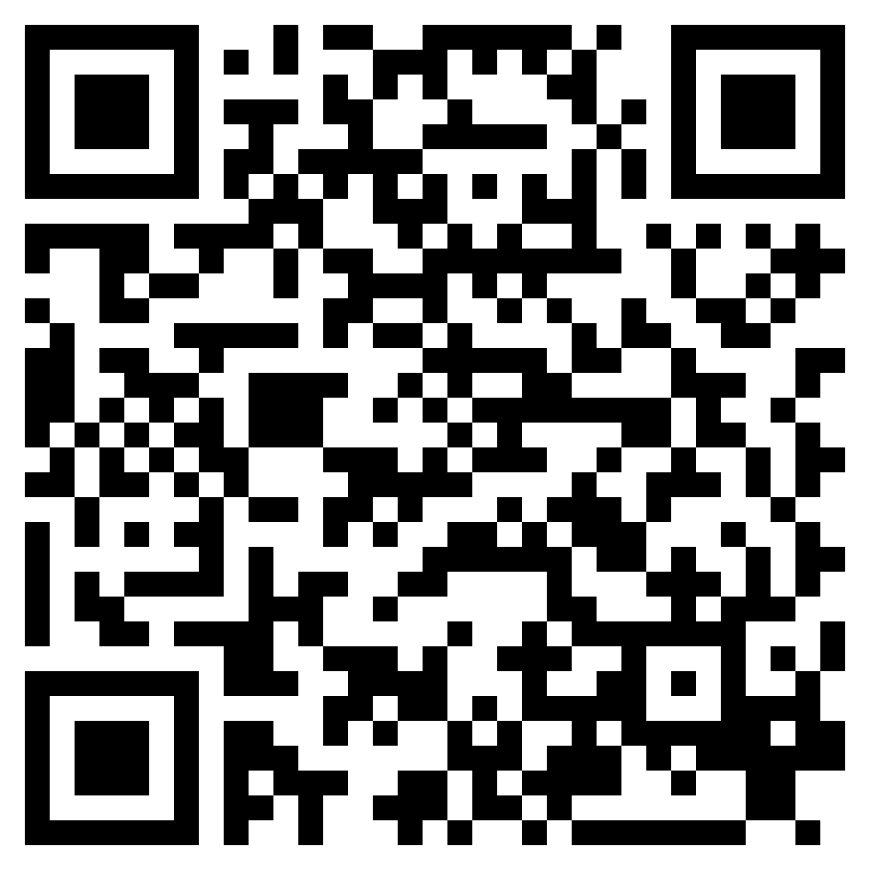
IN THE NAME OF JESUS CHRIST
ACTS 3

Slide 2
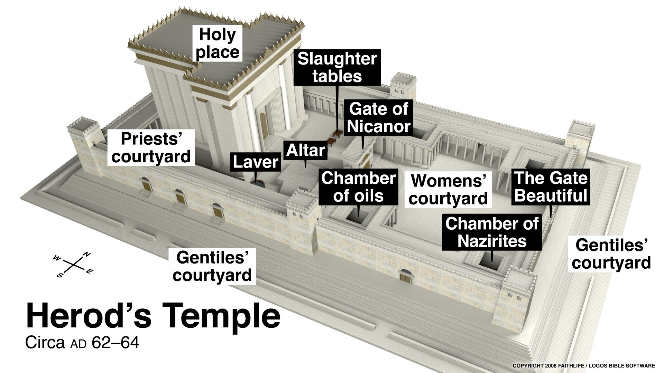

Slide 3
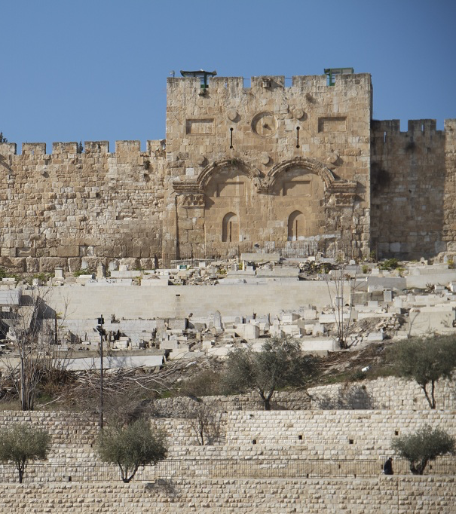

Slide 5
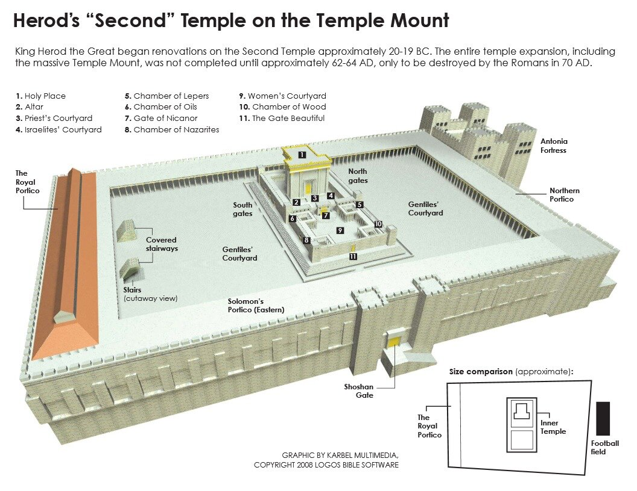
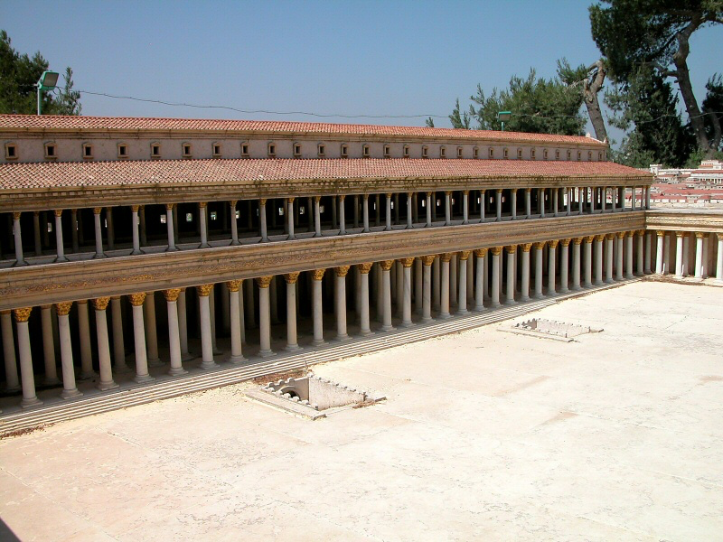

Slide 7
Acts 3:12 (ESV)
¹²And when Peter saw it he addressed the people: “Men of Israel, why do you wonder at this, or why do you stare at us, as though by our own power or piety we have made him walk?

Slide 8
Acts 3:16 (ESV)
¹⁶And his name—by faith in his name—has made this man strong whom you see and know, and the faith that is through Jesus has given the man this perfect health in the presence of you all.

Slide 9
Acts 3:18–21 (ESV)
¹⁸But what God foretold by the mouth of all the prophets, that his Christ would suffer, he thus fulfilled.
¹⁹Repent therefore, and turn back, that your sins may be blotted out,
²⁰that times of refreshing may come from the presence of the Lord, and that he may send the Christ appointed for you, Jesus,
²¹whom heaven must receive until the time for restoring all the things about which God spoke by the mouth of his holy prophets long ago.

Slide 10
IN THE NAME OF JESUS CHRIST
ACTS 3

