Slide 1
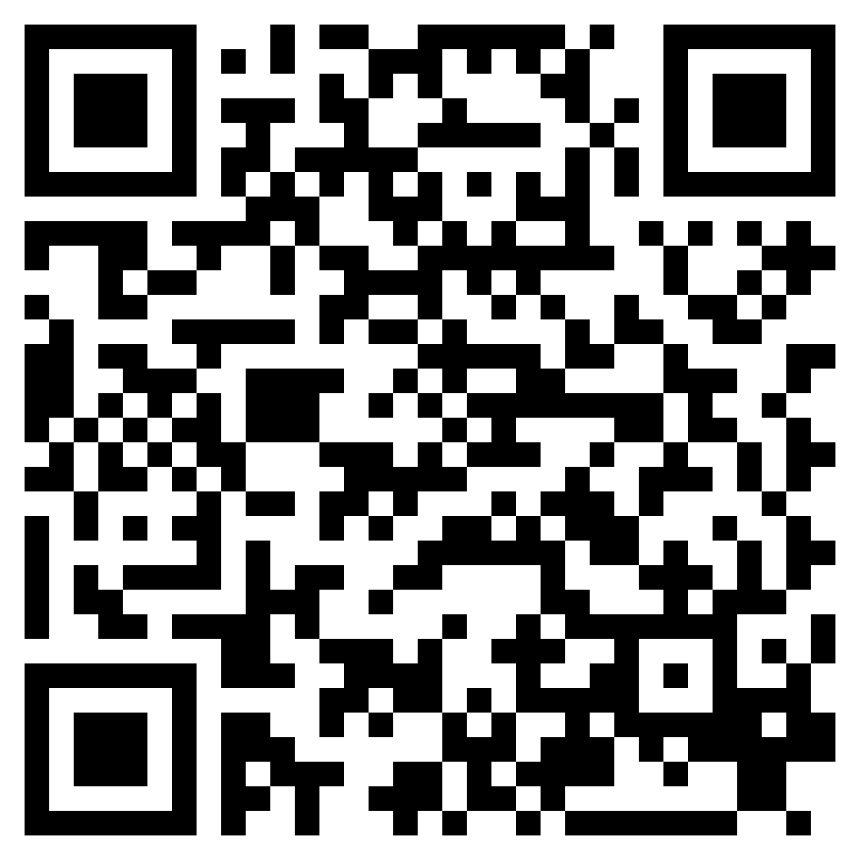
Those Who Reject The Kingdom
ACTS 6.8-7.60

Slide 2
“They will put you out of the synagogues. Indeed, the hour is coming when whoever kills you will think he is offering service to God.” (John 16:2, ESV)

Slide 3
Acts 6:11–14 (ESV)
¹¹ Then they secretly instigated men who said, “We have heard him speak blasphemous words against Moses and God.” ¹² And they stirred up the people and the elders and the scribes, and they came upon him and seized him and brought him before the council, ¹³ and they set up false witnesses who said, “This man never ceases to speak words against this holy place and the law, ¹⁴ for we have heard him say that this Jesus of Nazareth will destroy this place and will change the customs that Moses delivered to us.”

Slide 4
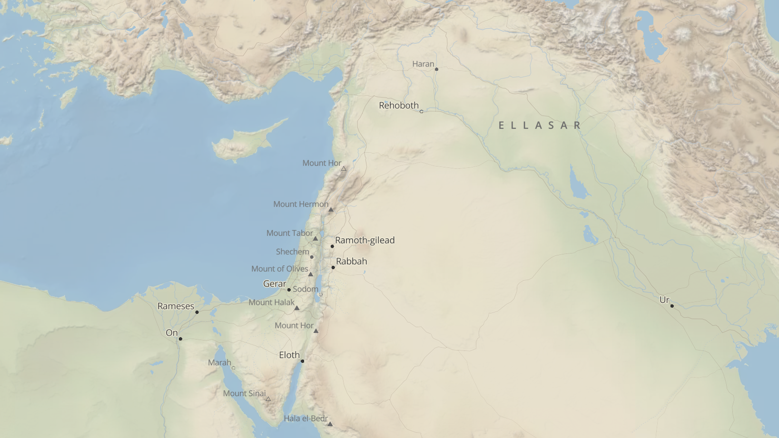

Slide 5
Acts 7:54–56 (ESV)
⁵⁴ Now when they heard these things they were enraged, and they ground their teeth at him. ⁵⁵ But he, full of the Holy Spirit, gazed into heaven and saw the glory of God, and Jesus standing at the right hand of God. ⁵⁶ And he said, “Behold, I see the heavens opened, and the Son of Man standing at the right hand of God.”

Slide 6
Acts 7:57–60 (ESV)
⁵⁷ But they cried out with a loud voice and stopped their ears and rushed together at him. ⁵⁸ Then they cast him out of the city and stoned him. And the witnesses laid down their garments at the feet of a young man named Saul. ⁵⁹ And as they were stoning Stephen, he called out, “Lord Jesus, receive my spirit.” ⁶⁰ And falling to his knees he cried out with a loud voice, “Lord, do not hold this sin against them.” And when he had said this, he fell asleep.

Slide 7
Those Who Reject The Kingdom
ACTS 6.8-7.60

