Slide 1
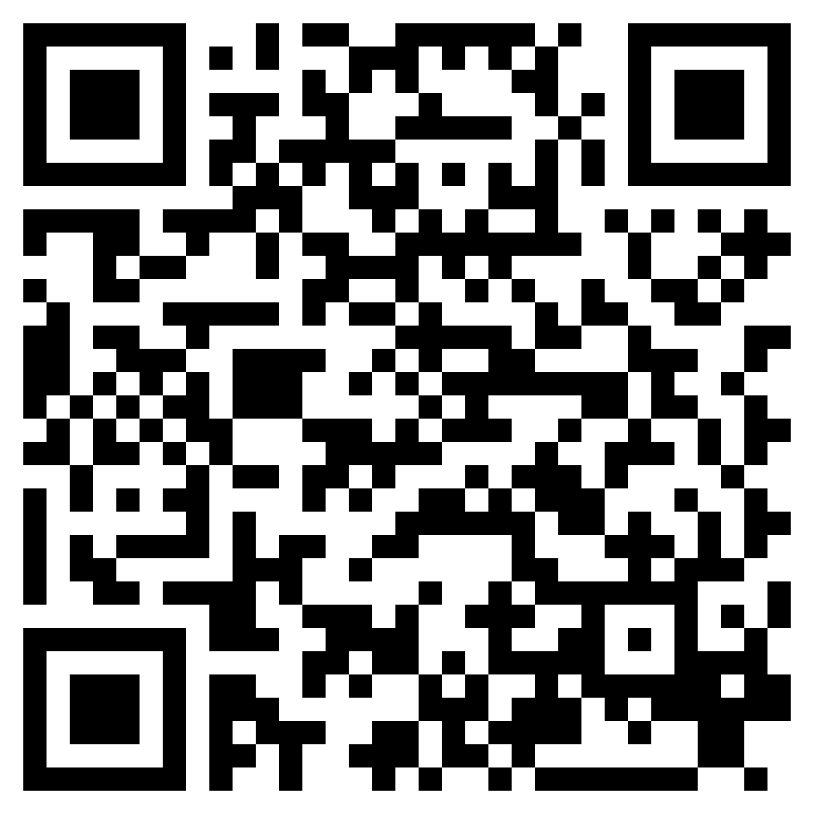
THE WORD GOES FORTH
ACTS 8

Slide 2
“But you will receive power when the Holy Spirit has come upon you, and you will be my witnesses in Jerusalem and in all Judea and Samaria, and to the end of the earth.”” (Acts 1:8, ESV)

Slide 3
Acts 8:1–4 (ESV)
¹ And Saul approved of his execution. And there arose on that day a great persecution against the church in Jerusalem, and they were all scattered throughout the regions of Judea and Samaria, except the apostles. ² Devout men buried Stephen and made great lamentation over him. ³ But Saul was ravaging the church, and entering house after house, he dragged off men and women and committed them to prison. ⁴ Now those who were scattered went about preaching the word.

Slide 4
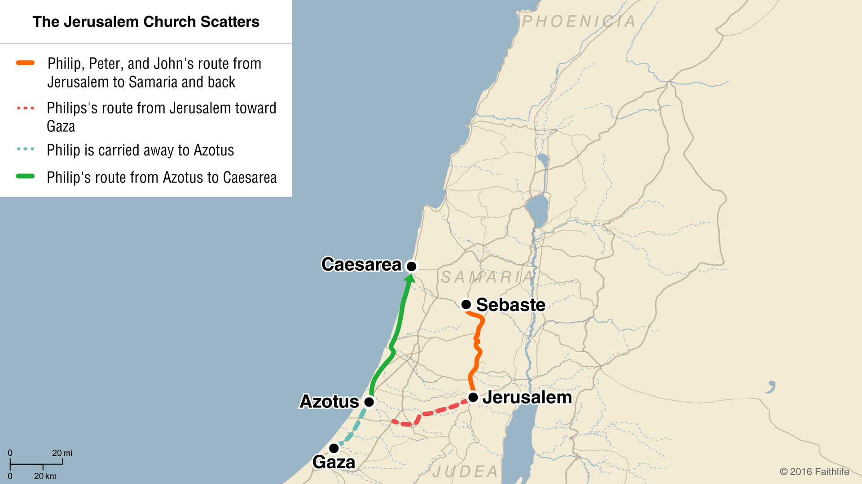

Slide 5
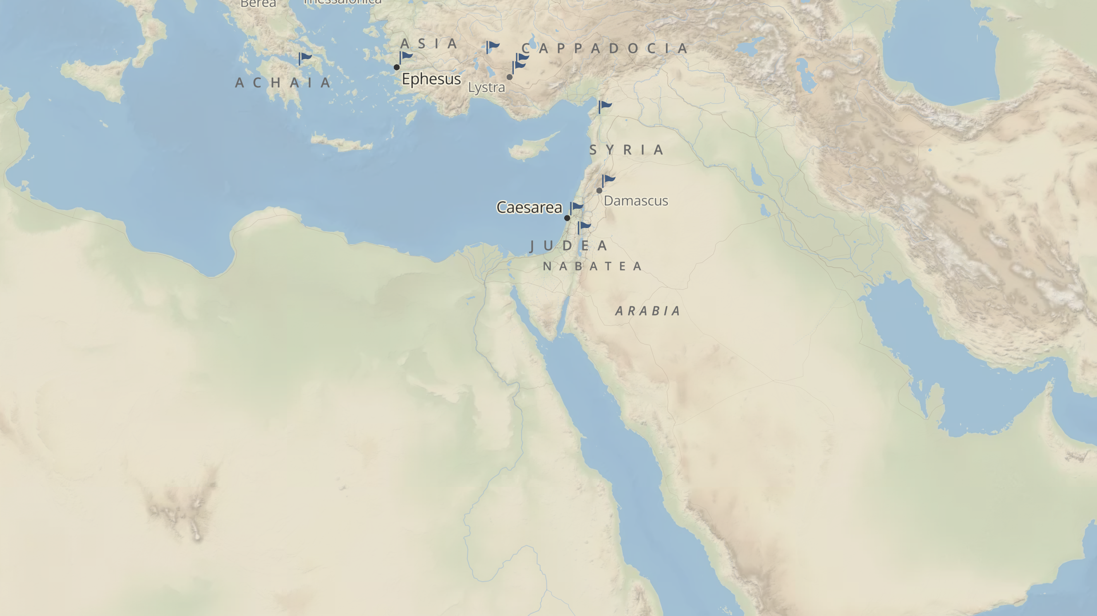
CUSH

Slide 6
Deuteronomy 23:1 (ESV)
¹ “No one whose testicles are crushed or whose male organ is cut off shall enter the assembly of the Lord.

Slide 7
Isaiah 56:3–7 (ESV)
³ Let not the foreigner who has joined himself to the Lord say, “The Lord will surely separate me from his people”; and let not the eunuch say, “Behold, I am a dry tree.” ⁴ For thus says the Lord: “To the eunuchs who keep my Sabbaths, who choose the things that please me and hold fast my covenant, ⁵ I will give in my house and within my walls a monument and a name better than sons and daughters; I will give them an everlasting name that shall not be cut off. ⁶ “And the foreigners who join themselves to the Lord, to minister to him, to love the name of the Lord, and to be his servants, everyone who keeps the Sabbath and does not profane it, and holds fast my covenant— ⁷ these I will bring to my holy mountain, and make them joyful in my house of prayer; their burnt offerings and their sacrifices will be accepted on my altar; for my house shall be called a house of prayer for all peoples.”

Slide 9
THE WORD GOES FORTH
ACTS 8

