Slide 1
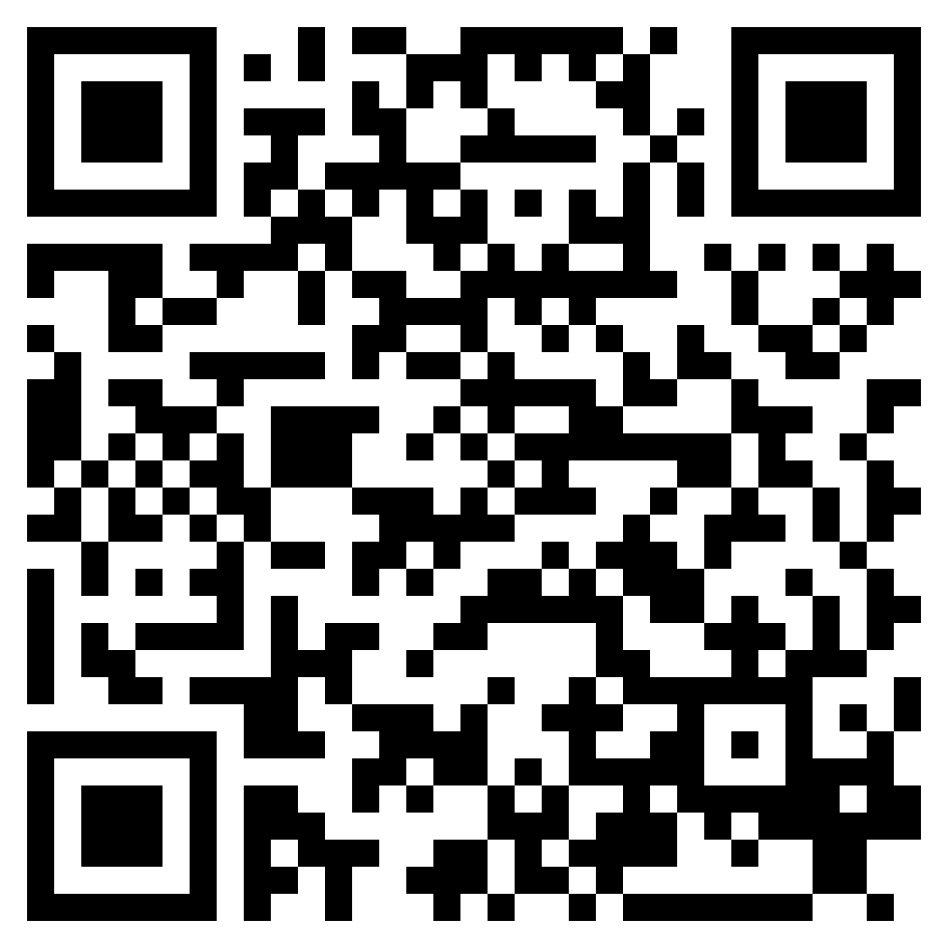
THE KING’S WITNESSES
ACTS 1

Slide 2
Acts 1:1–3 (ESV)
¹In the first book, O Theophilus, I have dealt with all that Jesus began to do and teach,
²until the day when he was taken up, after he had given commands through the Holy Spirit to the apostles whom he had chosen.
³He presented himself alive to them after his suffering by many proofs, appearing to them during forty days and speaking about the kingdom of God.

Slide 3
Acts 1:1–3 (ESV)
¹In the first book, O Theophilus, I have dealt with all that Jesus began to do and teach,
²until the day when he was taken up, after he had given commands through the Holy Spirit to the apostles whom he had chosen.
³He presented himself alive to them after his suffering by many proofs, appearing to them during forty days and speaking about the kingdom of God.

Slide 4
Acts 1:1–3 (ESV)
¹In the first book, O Theophilus, I have dealt with all that Jesus began to do and teach,
²until the day when he was taken up, after he had given commands through the Holy Spirit to the apostles whom he had chosen.
³He presented himself alive to them after his suffering by many proofs, appearing to them during forty days and speaking about the kingdom of God.

Slide 5
Acts 1:1–3 (ESV)
¹In the first book, O Theophilus, I have dealt with all that Jesus began to do and teach,
²until the day when he was taken up, after he had given commands through the Holy Spirit to the apostles whom he had chosen.
³He presented himself alive to them after his suffering by many proofs, appearing to them during forty days and speaking about the kingdom of God.

Slide 6
Acts 1:4–5 (ESV)
⁴And while staying with them he ordered them not to depart from Jerusalem, but to wait for the promise of the Father, which, he said, “you heard from me;
⁵for John baptized with water, but you will be baptized with the Holy Spirit not many days from now.”

Slide 7
Acts 1:4–5 (ESV)
⁴And while staying with them he ordered them not to depart from Jerusalem, but to wait for the promise of the Father, which, he said, “you heard from me;
⁵for John baptized with water, but you will be baptized with the Holy Spirit not many days from now.”

Slide 8
Acts 1:6–8 (ESV)
⁶So when they had come together, they asked him, “Lord, will you at this time restore the kingdom to Israel?”
⁷He said to them, “It is not for you to know times or seasons that the Father has fixed by his own authority.
⁸But you will receive power when the Holy Spirit has come upon you, and you will be my witnesses in Jerusalem and in all Judea and Samaria, and to the end of the earth.”

Slide 9
Acts 1:6–8 (ESV)
⁶So when they had come together, they asked him, “Lord, will you at this time restore the kingdom to Israel?”
⁷He said to them, “It is not for you to know times or seasons that the Father has fixed by his own authority.
⁸But you will receive power when the Holy Spirit has come upon you, and you will be my witnesses in Jerusalem and in all Judea and Samaria, and to the end of the earth.”

Slide 10
Acts 1:6–8 (ESV)
⁶So when they had come together, they asked him, “Lord, will you at this time restore the kingdom to Israel?”
⁷He said to them, “It is not for you to know times or seasons that the Father has fixed by his own authority.
⁸But you will receive power when the Holy Spirit has come upon you, and you will be my witnesses in Jerusalem and in all Judea and Samaria, and to the end of the earth.”

Slide 11
Acts 1:9–11 (ESV)
⁹And when he had said these things, as they were looking on, he was lifted up, and a cloud took him out of their sight.
¹⁰And while they were gazing into heaven as he went, behold, two men stood by them in white robes,
¹¹and said, “Men of Galilee, why do you stand looking into heaven? This Jesus, who was taken up from you into heaven, will come in the same way as you saw him go into heaven.”

Slide 12
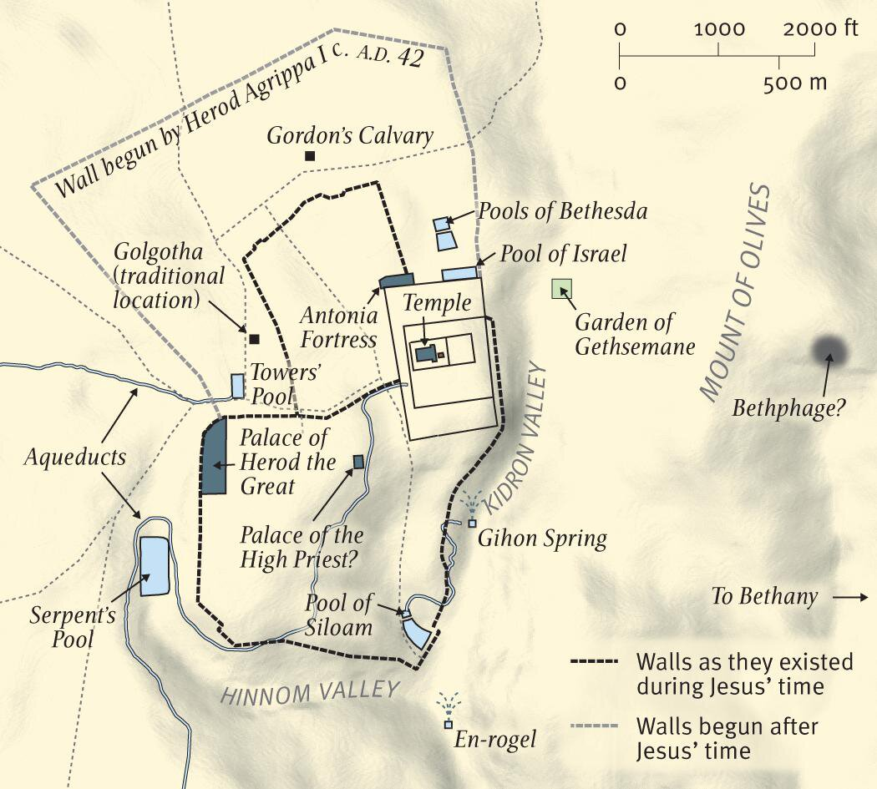

Slide 14
Acts 1:21–23 (ESV)
²¹So one of the men who have accompanied us during all the time that the Lord Jesus went in and out among us,
²²beginning from the baptism of John until the day when he was taken up from us—one of these men must become with us a witness to his resurrection.”
²³And they put forward two, Joseph called Barsabbas, who was also called Justus, and Matthias.

Slide 15
Acts 1:24–26 (ESV)
²⁴And they prayed and said, “You, Lord, who know the hearts of all, show which one of these two you have chosen
²⁵to take the place in this ministry and apostleship from which Judas turned aside to go to his own place.”
²⁶And they cast lots for them, and the lot fell on Matthias, and he was numbered with the eleven apostles.

