Slide 1
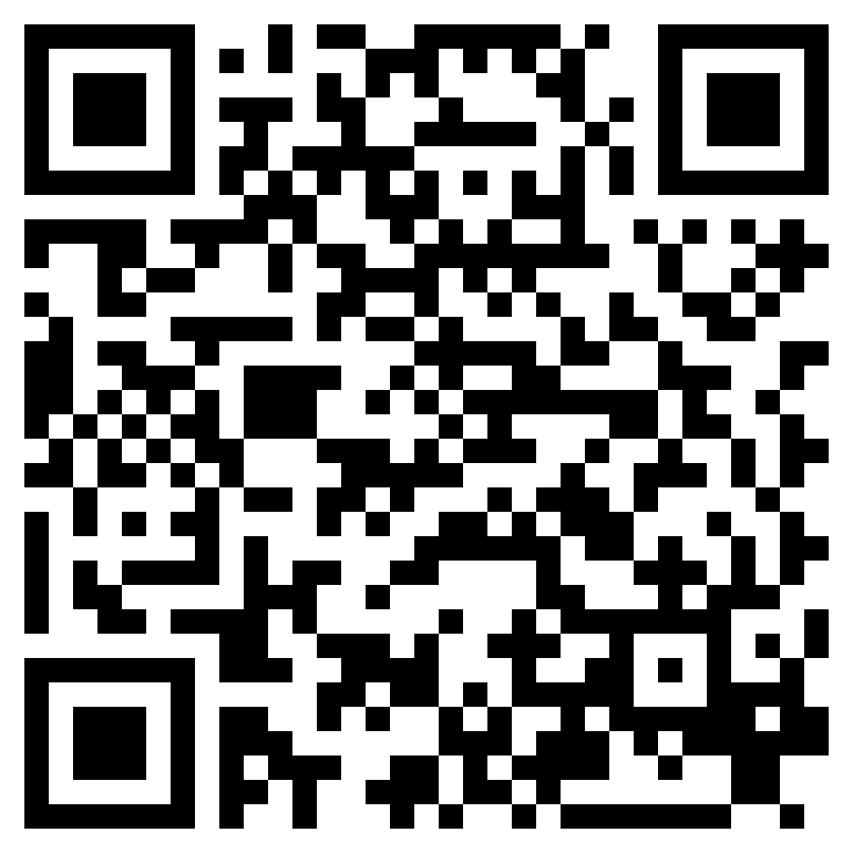
IN THE NAME OF JESUS CHRIST
ACTS 3

Slide 2
Psalm 2:1–2 (ESV)
¹ Why do the nations rage
and the peoples plot in vain?
² The kings of the earth set themselves,
and the rulers take counsel together,
against the Lord and against his Anointed…,

Slide 3
John 15:18–19 (ESV)
¹⁸“If the world hates you, know that it has hated me before it hated you.
¹⁹If you were of the world, the world would love you as its own; but because you are not of the world, but I chose you out of the world, therefore the world hates you.

Slide 5
Psalm 2:4–12 (ESV)
⁴He who sits in the heavens laughs; the Lord holds them in derision.
⁵Then he will speak to them in his wrath, and terrify them in his fury, saying,
⁶“As for me, I have set my King on Zion, my holy hill.”
⁷I will tell of the decree: The Lord said to me, “You are my Son; today I have begotten you.
⁸Ask of me, and I will make the nations your heritage, and the ends of the earth your possession.
⁹You shall break them with a rod of iron and dash them in pieces like a potter’s vessel.”
¹⁰Now therefore, O kings, be wise; be warned, O rulers of the earth.
¹¹Serve the Lord with fear, and rejoice with trembling.
¹²Kiss the Son, lest he be angry, and you perish in the way, for his wrath is quickly kindled. Blessed are all who take refuge in him.

Slide 6
IN THE NAME OF JESUS CHRIST
ACTS 3

