Slide 1
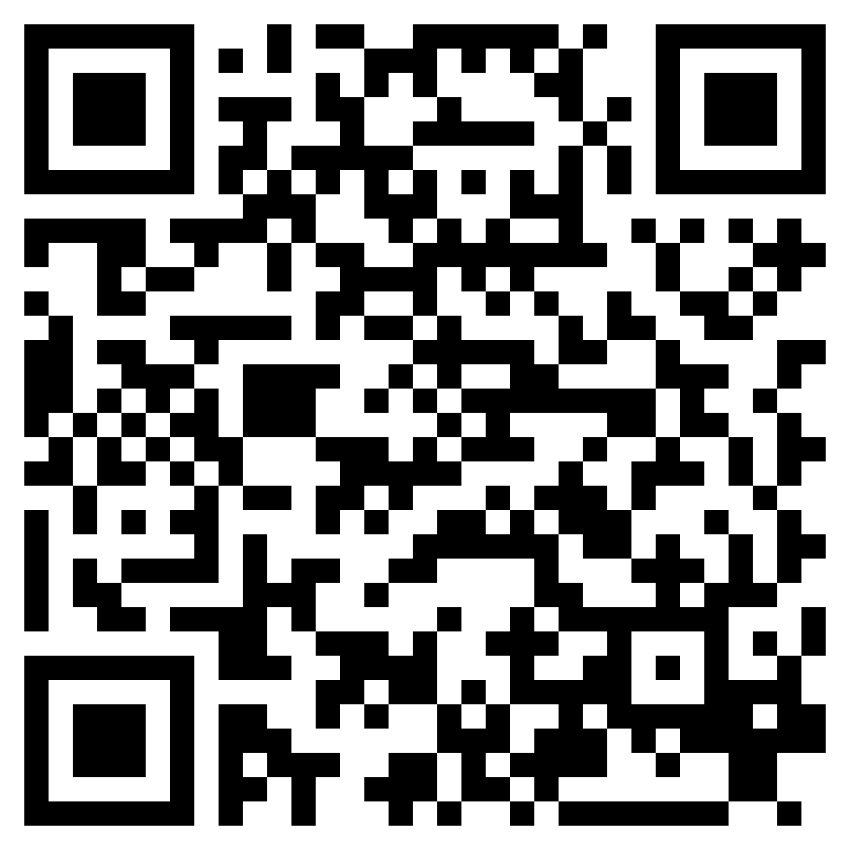
WHO IS THE LORD?
ACTS 2.1-36

Slide 2
“And it shall come to pass that everyone who calls upon the name of the Lord shall be saved.’” (Acts 2:21, ESV)

Slide 3
“Let all the house of Israel therefore know for certain that God has made him both Lord and Christ, this Jesus whom you crucified.”” (Acts 2:36, ESV)

Slide 4
PROMISE FULFILLED
ACTS 2.1-4

Slide 5
Ezekiel 37:9–10 (ESV)
⁹Then he said to me, “Prophesy to the breath; prophesy, son of man, and say to the breath, Thus says the Lord God: Come from the four winds, O breath, and breathe on these slain, that they may live.”
¹⁰So I prophesied as he commanded me, and the breath came into them, and they lived and stood on their feet, an exceedingly great army.
PROMISE FULFILLED
ACTS 2.1-4

Slide 6
Exodus 19:18 (ESV)
¹⁸Now Mount Sinai was wrapped in smoke because the Lord had descended on it in fire. The smoke of it went up like the smoke of a kiln, and the whole mountain trembled greatly.
PROMISE FULFILLED
ACTS 2.1-4

Slide 7
Acts 1:8 (ESV)
⁸But you will receive power when the Holy Spirit has come upon you, and you will be my witnesses in Jerusalem and in all Judea and Samaria, and to the end of the earth.”
PROMISE FULFILLED
ACTS 2.1-4

Slide 8
THE MULTITUDE GATHERS
ACTS 2.5-13

Slide 9
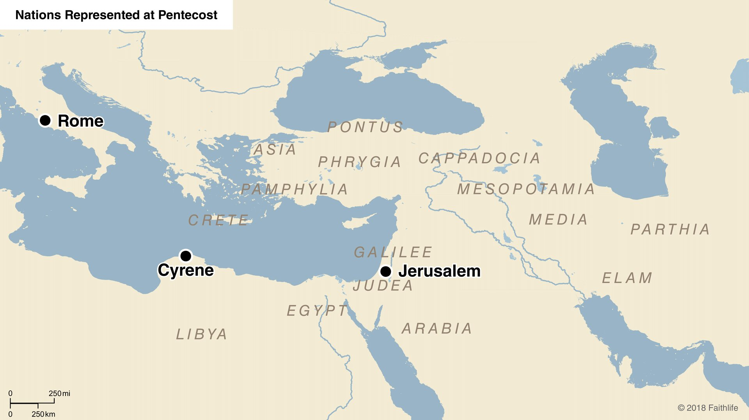

Slide 10
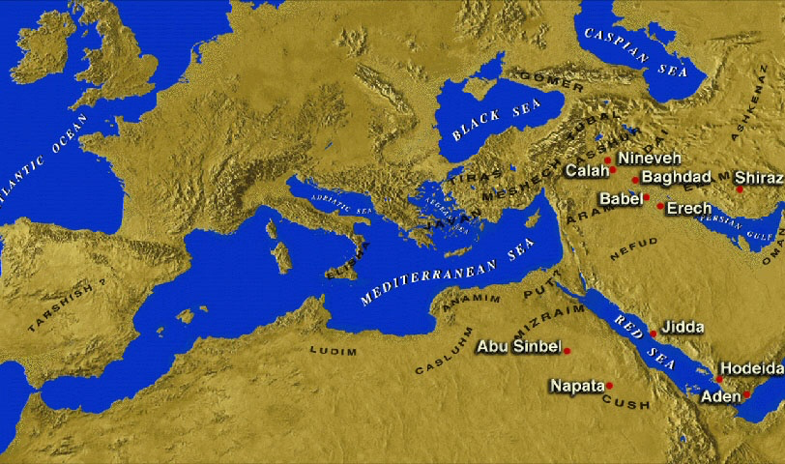

Slide 12
THE MULTITUDE GATHERS
ACTS 2.5-13

Slide 13
PETER’S EXPLANATION
ACTS 2.14-21

Slide 14
Joel 2:32 (ESV)
³²And it shall come to pass that everyone who calls on the name of the LORD shall be saved. For in Mount Zion and in Jerusalem there shall be those who escape, as the Lord has said, and among the survivors shall be those whom the Lord calls.
PETER’S EXPLANATION
ACTS 2.14-21

Slide 15
Jesus’ life & death (vss. 22-23)
Jesus’ resurrection (vss. 24-32)
Jesus’ ascension (vss. 33-35)
Conclusion: Jesus is Lord & Christ! (vs. 36)
PETER BEARS WITNESS
ACTS 2.22-36

Slide 16
“Let all the house of Israel therefore know for certain that God has made him both Lord and Christ, this Jesus whom you crucified.”” (Acts 2:36, ESV)

