Slide 1
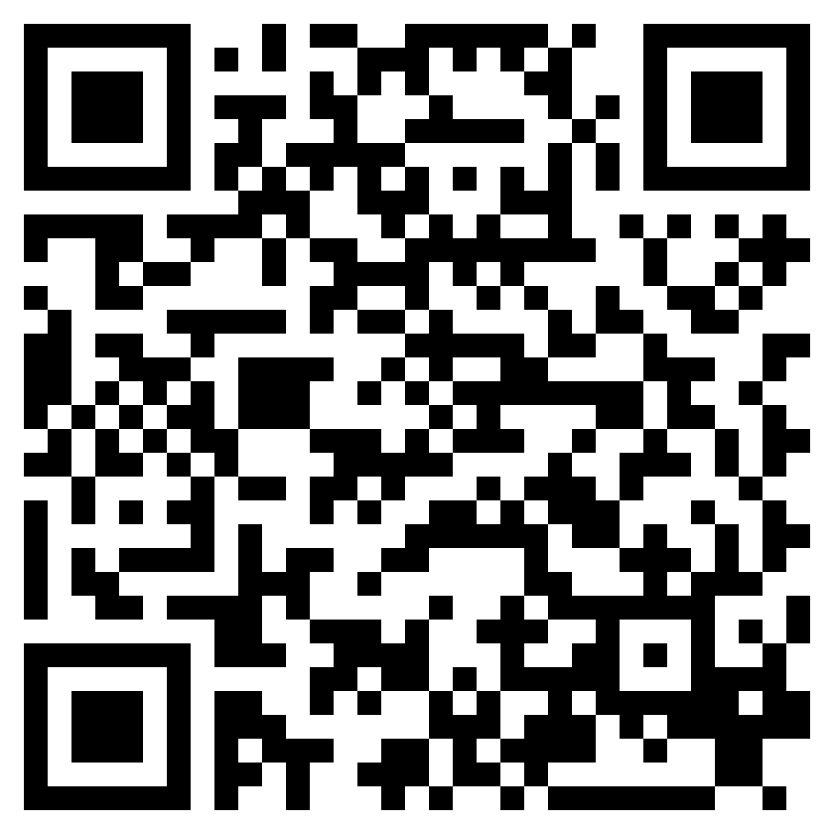
TO THE ENDS OF THE EARTH
ACTS 13

Slide 2
“But you will receive power when the Holy Spirit has come upon you, and you will be my witnesses in Jerusalem and in all Judea and Samaria, and to the end of the earth.”” (Acts 1:8, ESV)

Slide 3
Acts 13:1–3 (ESV)
¹ Now there were in the church at Antioch prophets and teachers, Barnabas, Simeon who was called Niger, Lucius of Cyrene, Manaen a lifelong friend of Herod the tetrarch, and Saul. ² While they were worshiping the Lord and fasting, the Holy Spirit said, “Set apart for me Barnabas and Saul for the work to which I have called them.” ³ Then after fasting and praying they laid their hands on them and sent them off.

Slide 4
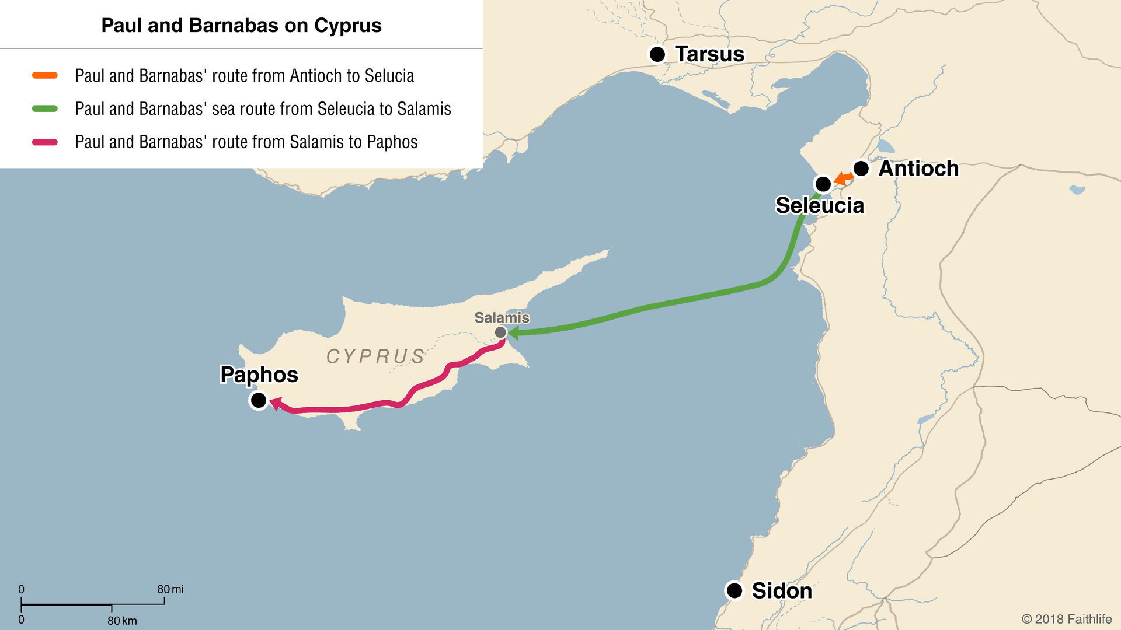

Slide 5
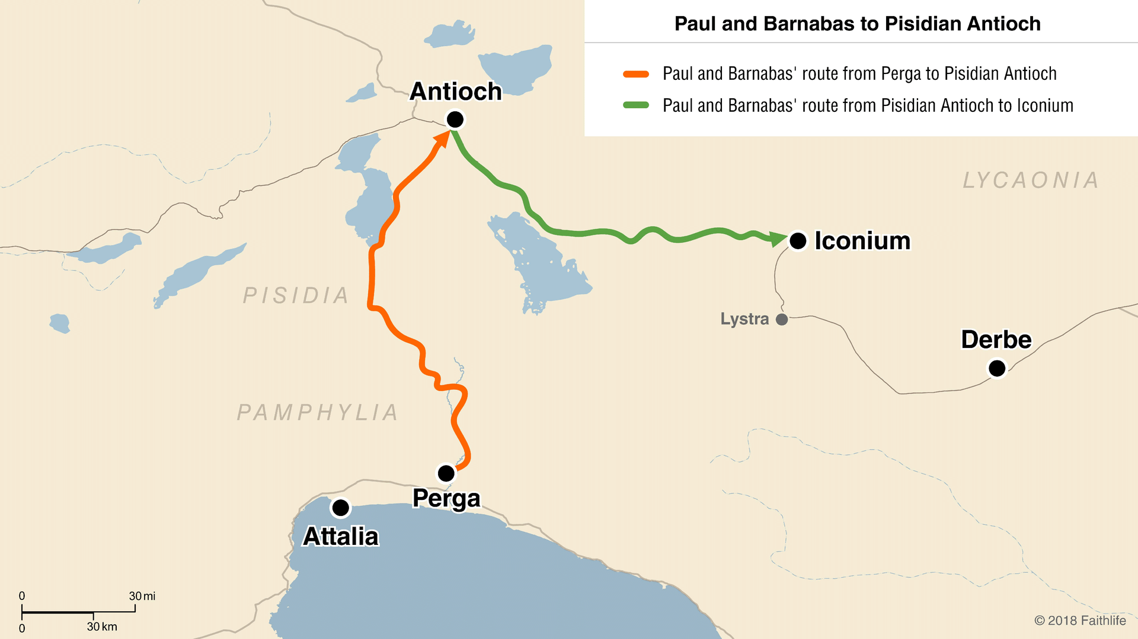

Slide 6
Jesus is the fulfillment of God’s dealings with Israel (vss. 17-26).
The Jews rejected Jesus, but ultimately fulfilled God’s purpose (vss. 27-29).
God fulfilled His promise to the fathers by raising Jesus from the dead (vss. 30-37).
Forgiveness and justification, which the Law could not provide, are available to all who believe in Jesus (vss. 38-39).
Beware lest you reject God’s promise (vss. 40-41).

Slide 7
Acts 13:46 (ESV)
⁴⁶ And Paul and Barnabas spoke out boldly, saying, “It was necessary that the word of God be spoken first to you. Since you thrust it aside and judge yourselves unworthy of eternal life, behold, we are turning to the Gentiles.
Acts 13:48 (ESV)
⁴⁸ And when the Gentiles heard this, they began rejoicing and glorifying the word of the Lord, and as many as were appointed to eternal life believed.

Slide 9
TO THE ENDS OF THE EARTH
ACTS 13

