Slide 1
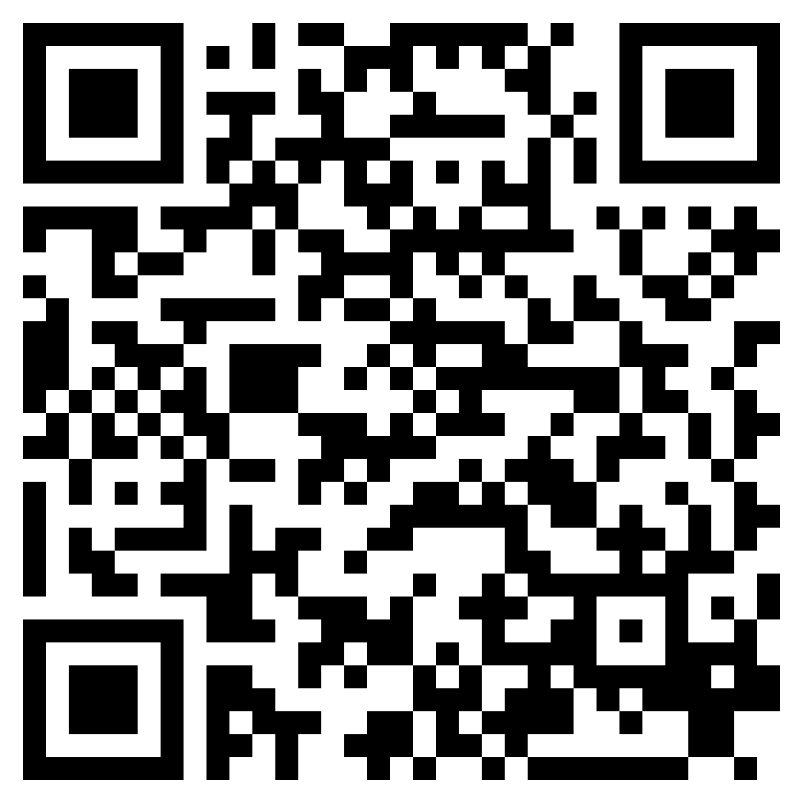
WHAT GOD HAS MADE CLEAN
ACTS 9.32-10.48

Slide 2
Leviticus 11:45 (ESV)
⁴⁵ For I am the Lord who brought you up out of the land of Egypt to be your God. You shall therefore be holy, for I am holy.”

Slide 3
Genesis 12:3 (ESV)
³ I will bless those who bless you, and him who dishonors you I will curse, and in you all the families of the earth shall be blessed.”

Slide 4
Isaiah 49:6 (ESV)
⁶ he says: “It is too light a thing that you should be my servant to raise up the tribes of Jacob and to bring back the preserved of Israel; I will make you as a light for the nations, that my salvation may reach to the end of the earth.”

Slide 5
John 10:16 (ESV)
¹⁶ And I have other sheep that are not of this fold. I must bring them also, and they will listen to my voice. So there will be one flock, one shepherd.

Slide 6
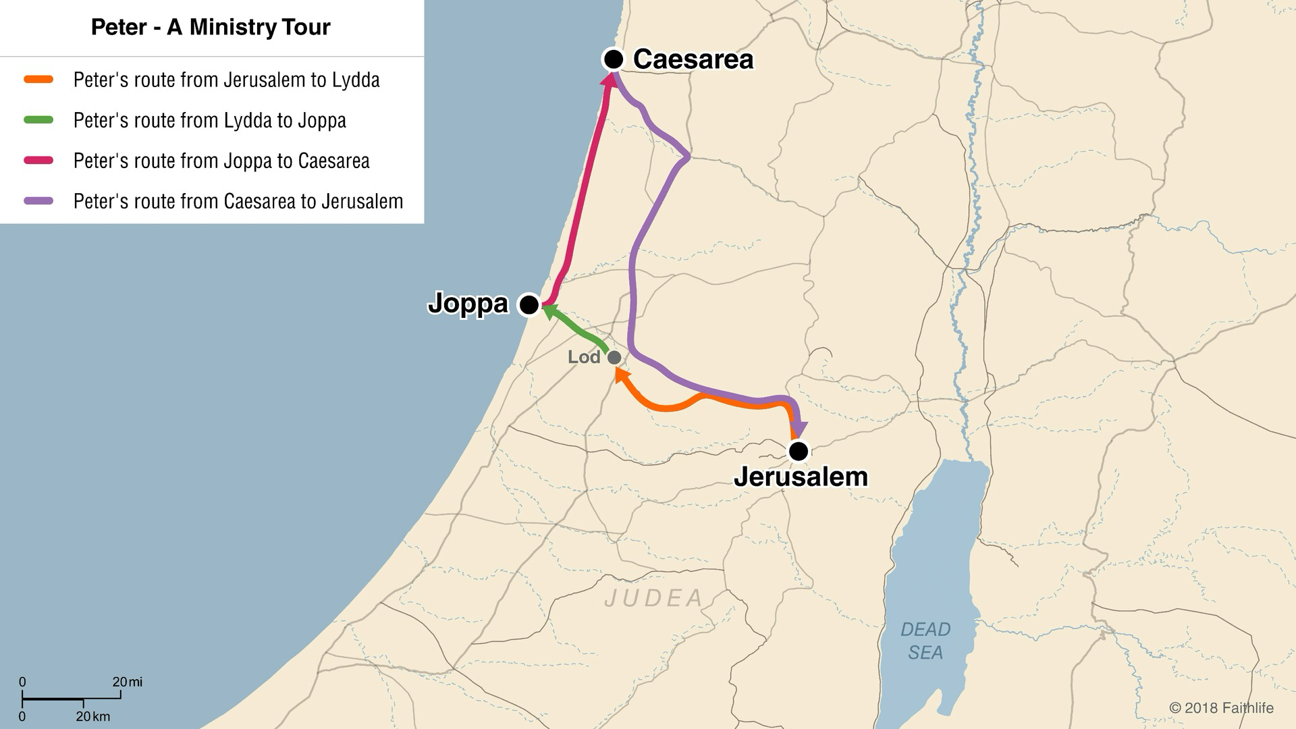

Slide 7
Acts 10:1–4 (ESV)
¹ At Caesarea there was a man named Cornelius, a centurion of what was known as the Italian Cohort, ² a devout man who feared God with all his household, gave alms generously to the people, and prayed continually to God. ³ About the ninth hour of the day he saw clearly in a vision an angel of God come in and say to him, “Cornelius.” ⁴ And he stared at him in terror and said, “What is it, Lord?” And he said to him, “Your prayers and your alms have ascended as a memorial before God.

Slide 8
Acts 11:13–14 (ESV)
¹³ And he told us how he had seen the angel stand in his house and say, ‘Send to Joppa and bring Simon who is called Peter; ¹⁴ he will declare to you a message by which you will be saved, you and all your household.’

Slide 10
Acts 10:13–16 (ESV)
¹³ And there came a voice to him: “Rise, Peter; kill and eat.” ¹⁴ But Peter said, “By no means, Lord; for I have never eaten anything that is common or unclean.” ¹⁵ And the voice came to him again a second time, “What God has made clean, do not call common.” ¹⁶ This happened three times, and the thing was taken up at once to heaven.

Slide 12
Acts 10:28–29 (ESV)
²⁸ And he said to them, “You yourselves know how unlawful it is for a Jew to associate with or to visit anyone of another nation, but God has shown me that I should not call any person common or unclean. ²⁹ So when I was sent for, I came without objection. I ask then why you sent for me.”

Slide 14
Acts 10:34–35 (ESV)
³⁴ So Peter opened his mouth and said: “Truly I understand that God shows no partiality, ³⁵ but in every nation anyone who fears him and does what is right is acceptable to him.

Slide 16
Acts 10:44–48 (ESV)
⁴⁴ While Peter was still saying these things, the Holy Spirit fell on all who heard the word. ⁴⁵ And the believers from among the circumcised who had come with Peter were amazed, because the gift of the Holy Spirit was poured out even on the Gentiles. ⁴⁶ For they were hearing them speaking in tongues and extolling God. Then Peter declared, ⁴⁷ “Can anyone withhold water for baptizing these people, who have received the Holy Spirit just as we have?” ⁴⁸ And he commanded them to be baptized in the name of Jesus Christ. Then they asked him to remain for some days.

Slide 17
WHAT GOD HAS MADE CLEAN
ACTS 9.32-10.48

