Slide 1
DEFENDING THE KINGDOM, PART 2
ACTS 23-24

Slide 2
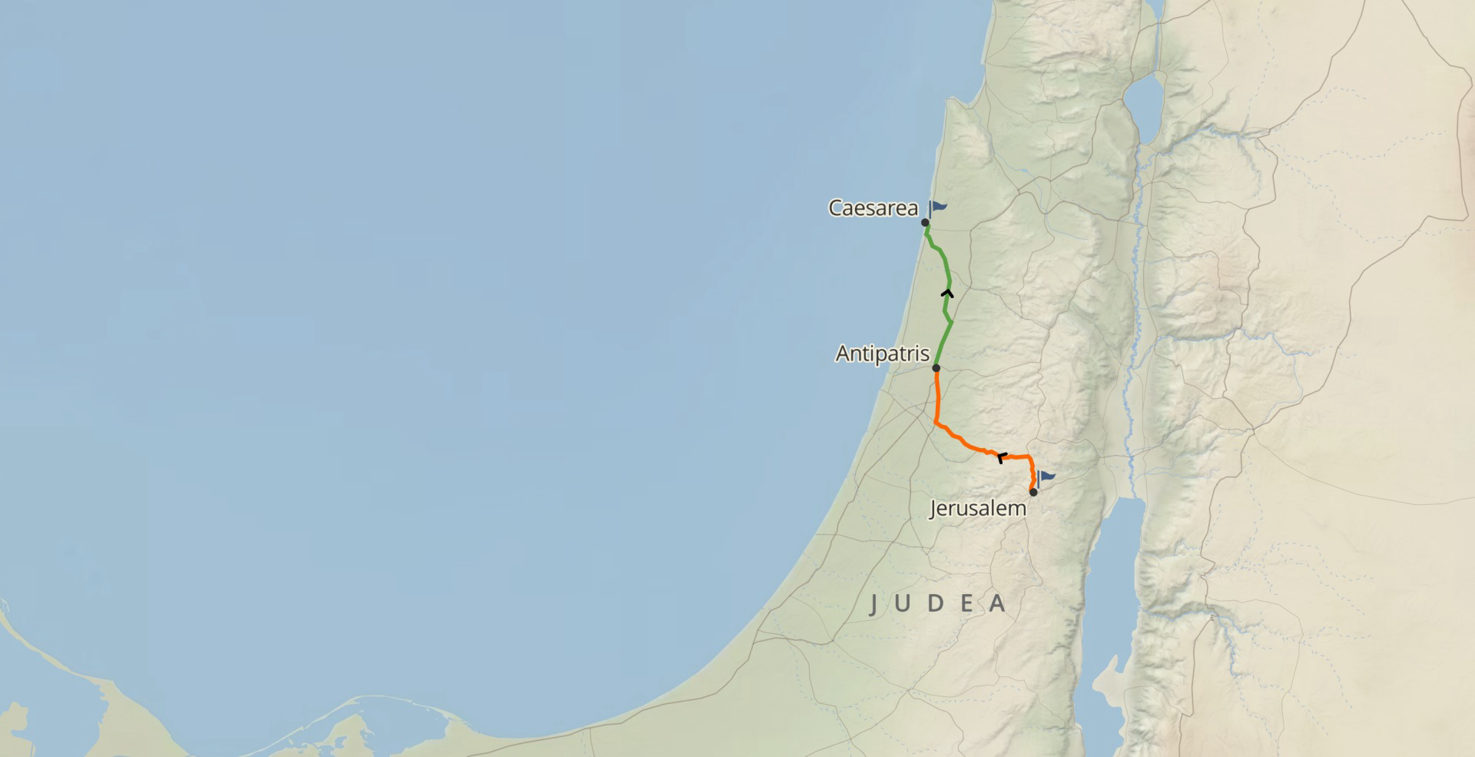

Slide 3
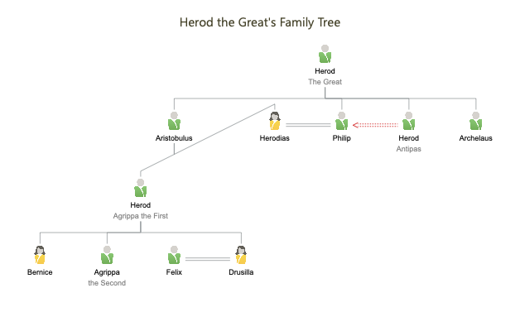

Slide 5
DEFENDING THE KINGDOM, PART 2
ACTS 23-24

