Slide 1
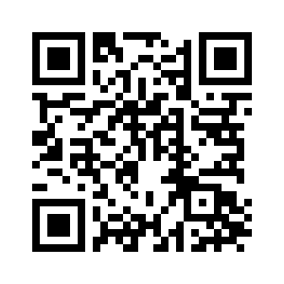
CHAPTER 3

Slide 2
“Therefore, just as sin came into the world through one man, and death through sin, and so death spread to all men because all sinned—” (Romans 5:12, ESV)

Slide 3
“He was foreknown before the foundation of the world but was made manifest in the last times for the sake of you who through him are believers in God, who raised him from the dead and gave him glory, so that your faith and hope are in God.” (1 Peter 1:20–21, ESV)

Slide 4
CHAPTER 3
The Tempter (vs. 1)
The Temptation (vss. 1-5)
The Transgression (vs. 6)
The Consequences (vss. 7-19, 22-24)
Hope (vss. 15, 20-21)

Slide 5
“I will put enmity between you and the woman, and between your offspring and her offspring; he shall bruise your head, and you shall bruise his heel.”” (Genesis 3:15, ESV)

