Slide 1
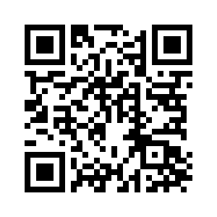
CHAPTER 18

Slide 2
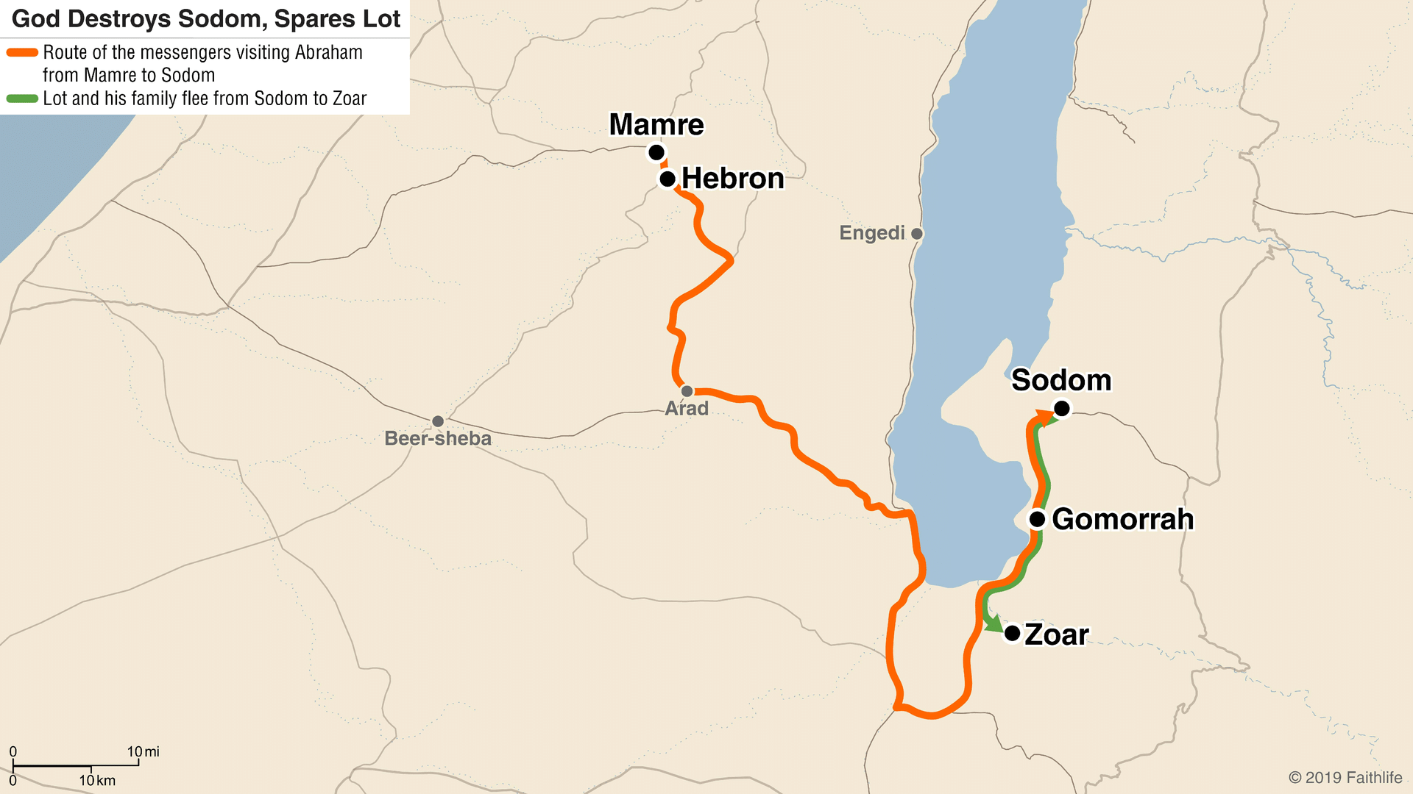
SETTING FOR CHAPTER 18

Slide 3
CHAPTER 18 – The LORD visits Abraham
Hebrews 13:2 (ESV)
“Do not neglect to show hospitality to strangers, for thereby some have entertained angels unawares.”

Slide 4
CHAPTER 18 – The LORD visits Abraham
Genesis 18:10-14 (ESV)
10 The Lord said, “I will surely return to you about this time next year, and Sarah your wife shall have a son.” And Sarah was listening at the tent door behind him. 11 Now Abraham and Sarah were old, advanced in years. The way of women had ceased to be with Sarah. 12 So Sarah laughed to herself, saying, “After I am worn out, and my lord is old, shall I have pleasure?” 13 The Lord said to Abraham, “Why did Sarah laugh and say, ‘Shall I indeed bear a child, now that I am old?’ 14 Is anything too hard for the Lord? At the appointed time I will return to you, about this time next year, and Sarah shall have a son.”

Slide 5
CHAPTER 18 – The LORD visits Abraham
Hebrews 11:11 (ESV)
“By faith Sarah herself received power to conceive, even when she was past the age, since she considered him faithful who had promised.”

Slide 6
CHAPTER 18 – The LORD visits Abraham
Genesis 18:17-19 (ESV)
17 The Lord said, “Shall I hide from Abraham what I am about to do, 18 seeing that Abraham shall surely become a great and mighty nation, and all the nations of the earth shall be blessed in him? 19 For I have chosen him, that he may command his children and his household after him to keep the way of the Lord by doing righteousness and justice, so that the Lord may bring to Abraham what he has promised him.”

Slide 7
CHAPTER 18 – The LORD visits Abraham
Genesis 18:20-21 (ESV)
20 Then the Lord said, “Because the outcry against Sodom and Gomorrah is great and their sin is very grave, 21 I will go down to see whether they have done altogether according to the outcry that has come to me. And if not, I will know.”

Slide 8
CHAPTER 18 – The LORD visits Abraham
Genesis 18:23-25 (ESV)
23 Then Abraham drew near and said, “Will you indeed sweep away the righteous with the wicked? 24 Suppose there are fifty righteous within the city. Will you then sweep away the place and not spare it for the fifty righteous who are in it? 25 Far be it from you to do such a thing, to put the righteous to death with the wicked, so that the righteous fare as the wicked! Far be that from you! Shall not the Judge of all the earth do what is just?”

Slide 9
Applications from Chapter 18
God cares for his friends. We’re His friends if we live by his principles.
Nothing is too hard for God
God hears the outcries against sin and evil (vs. 20)
God’s judgement is just
God is approachable
Care for strangers as Abraham did
God is merciful, but his mercy can reach limitations
Any others?

