Slide 1
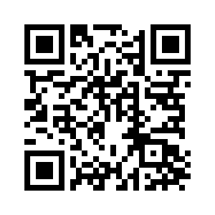
CHAPTER 15

Slide 3
God’s Covenant With Abram
Genesis 15:6 (ESV)
⁶ And he believed the Lord, and he counted it to him as righteousness.

Slide 4
God’s Covenant With Abram
Genesis 15:8 (ESV)
⁸ But he said, “O Lord God, how am I to know that I shall possess it?”

Slide 5
God’s Covenant With Abram
Covenants Are Founded On Grace
Faith Is The Stipulation
Covenants Are Ratified With Blood

