Slide 1
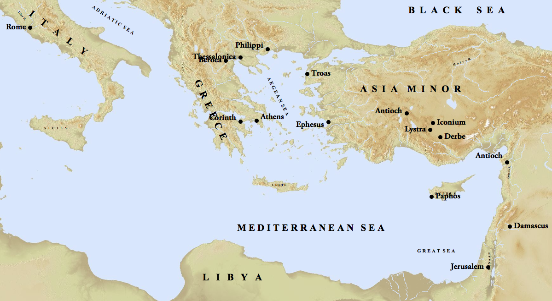

Slide 2
“Now Saul, still breathing threats and murder against the disciples of the Lord, went to the high priest, and asked for letters from him to the synagogues at Damascus, so that if he found any belonging to the Way, both men and women, he might bring them bound to Jerusalem.”
(Acts 9:1–2, NASB95)

Slide 3
What Paul’s Conversion Meant For His Work
He quit rejecting the Lord’s will
He found completion in Christ

Slide 4
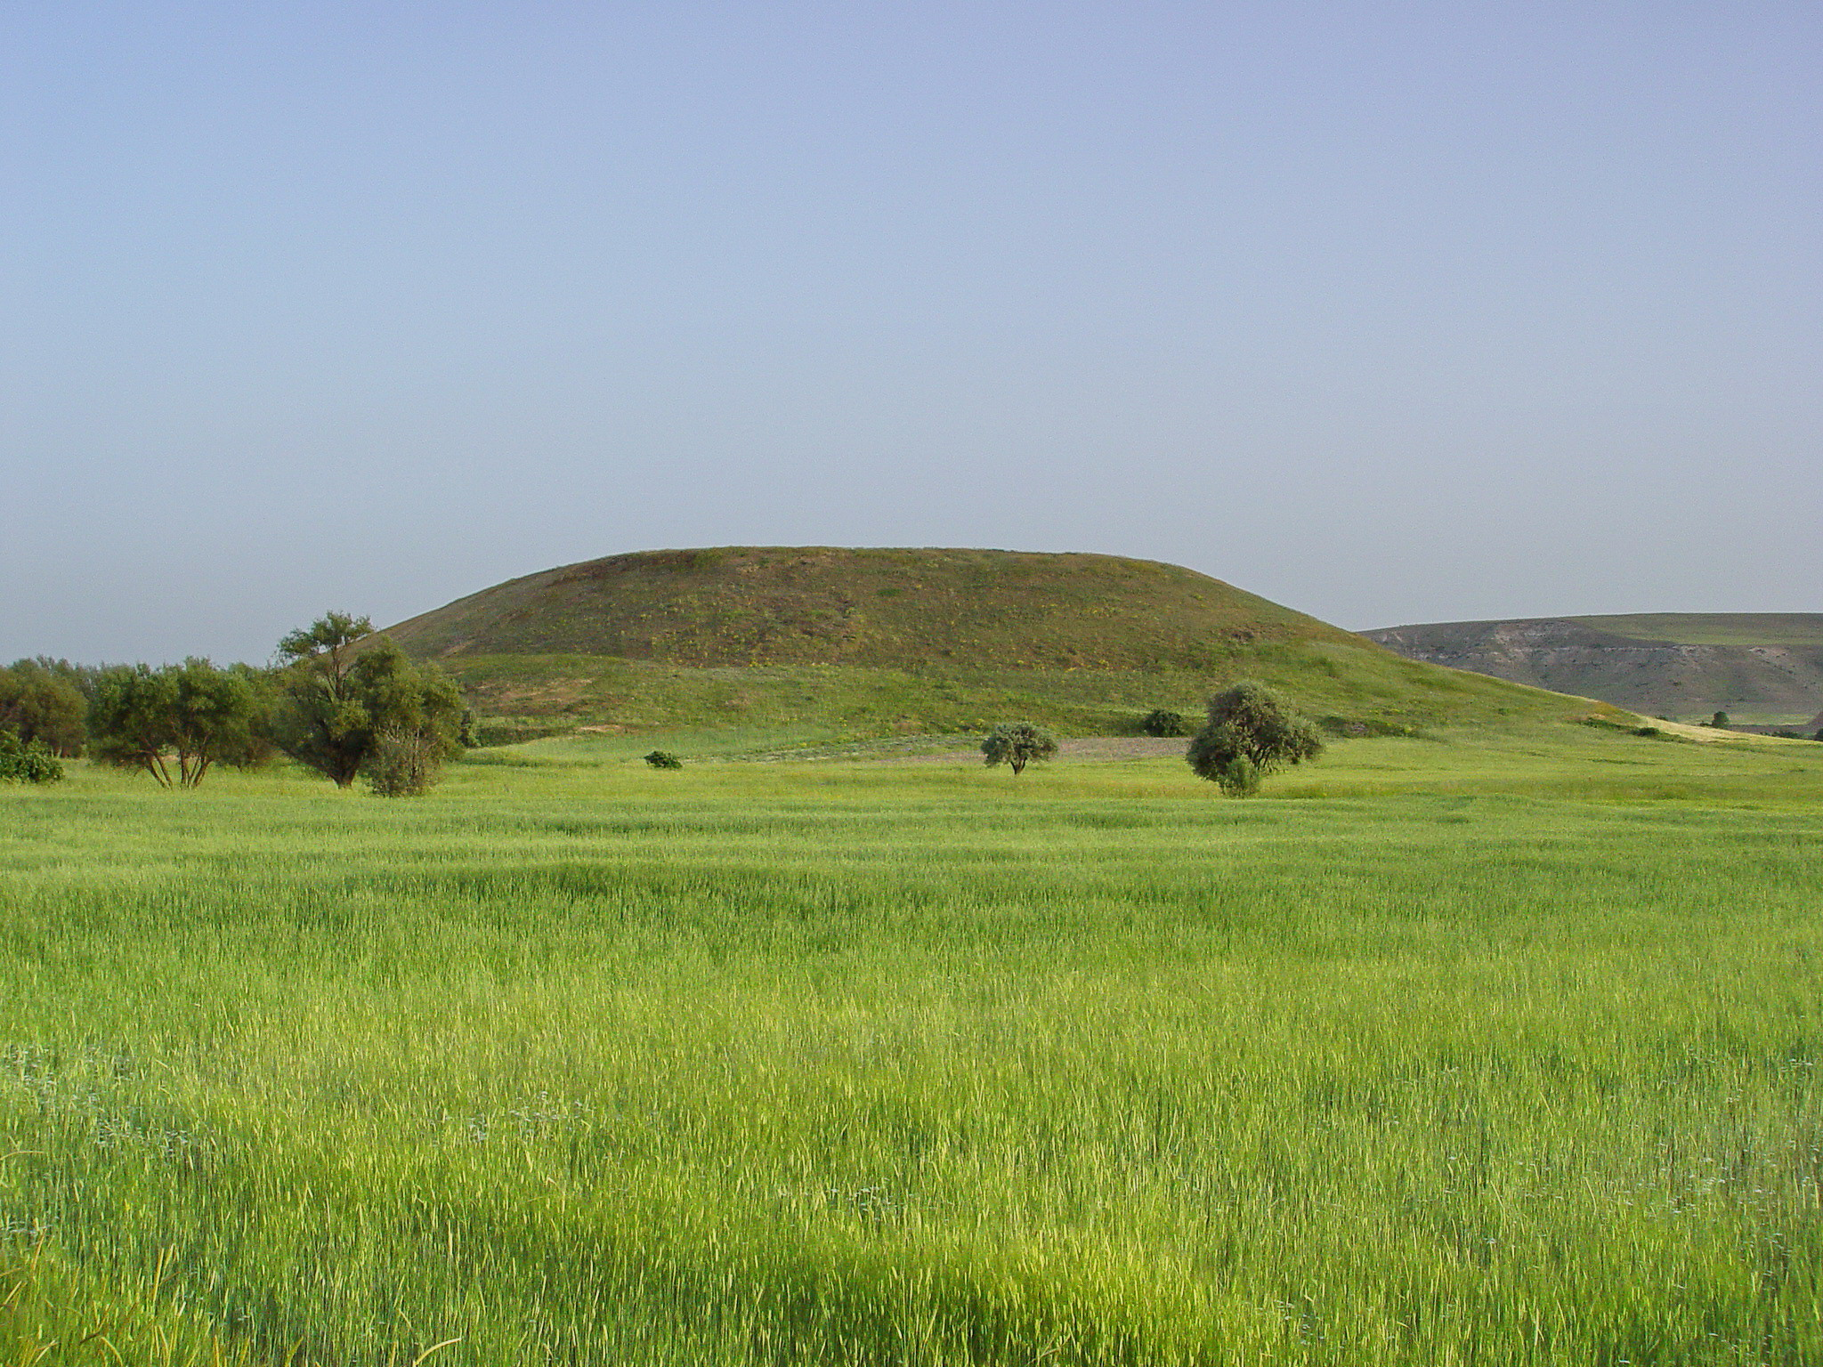

Slide 5
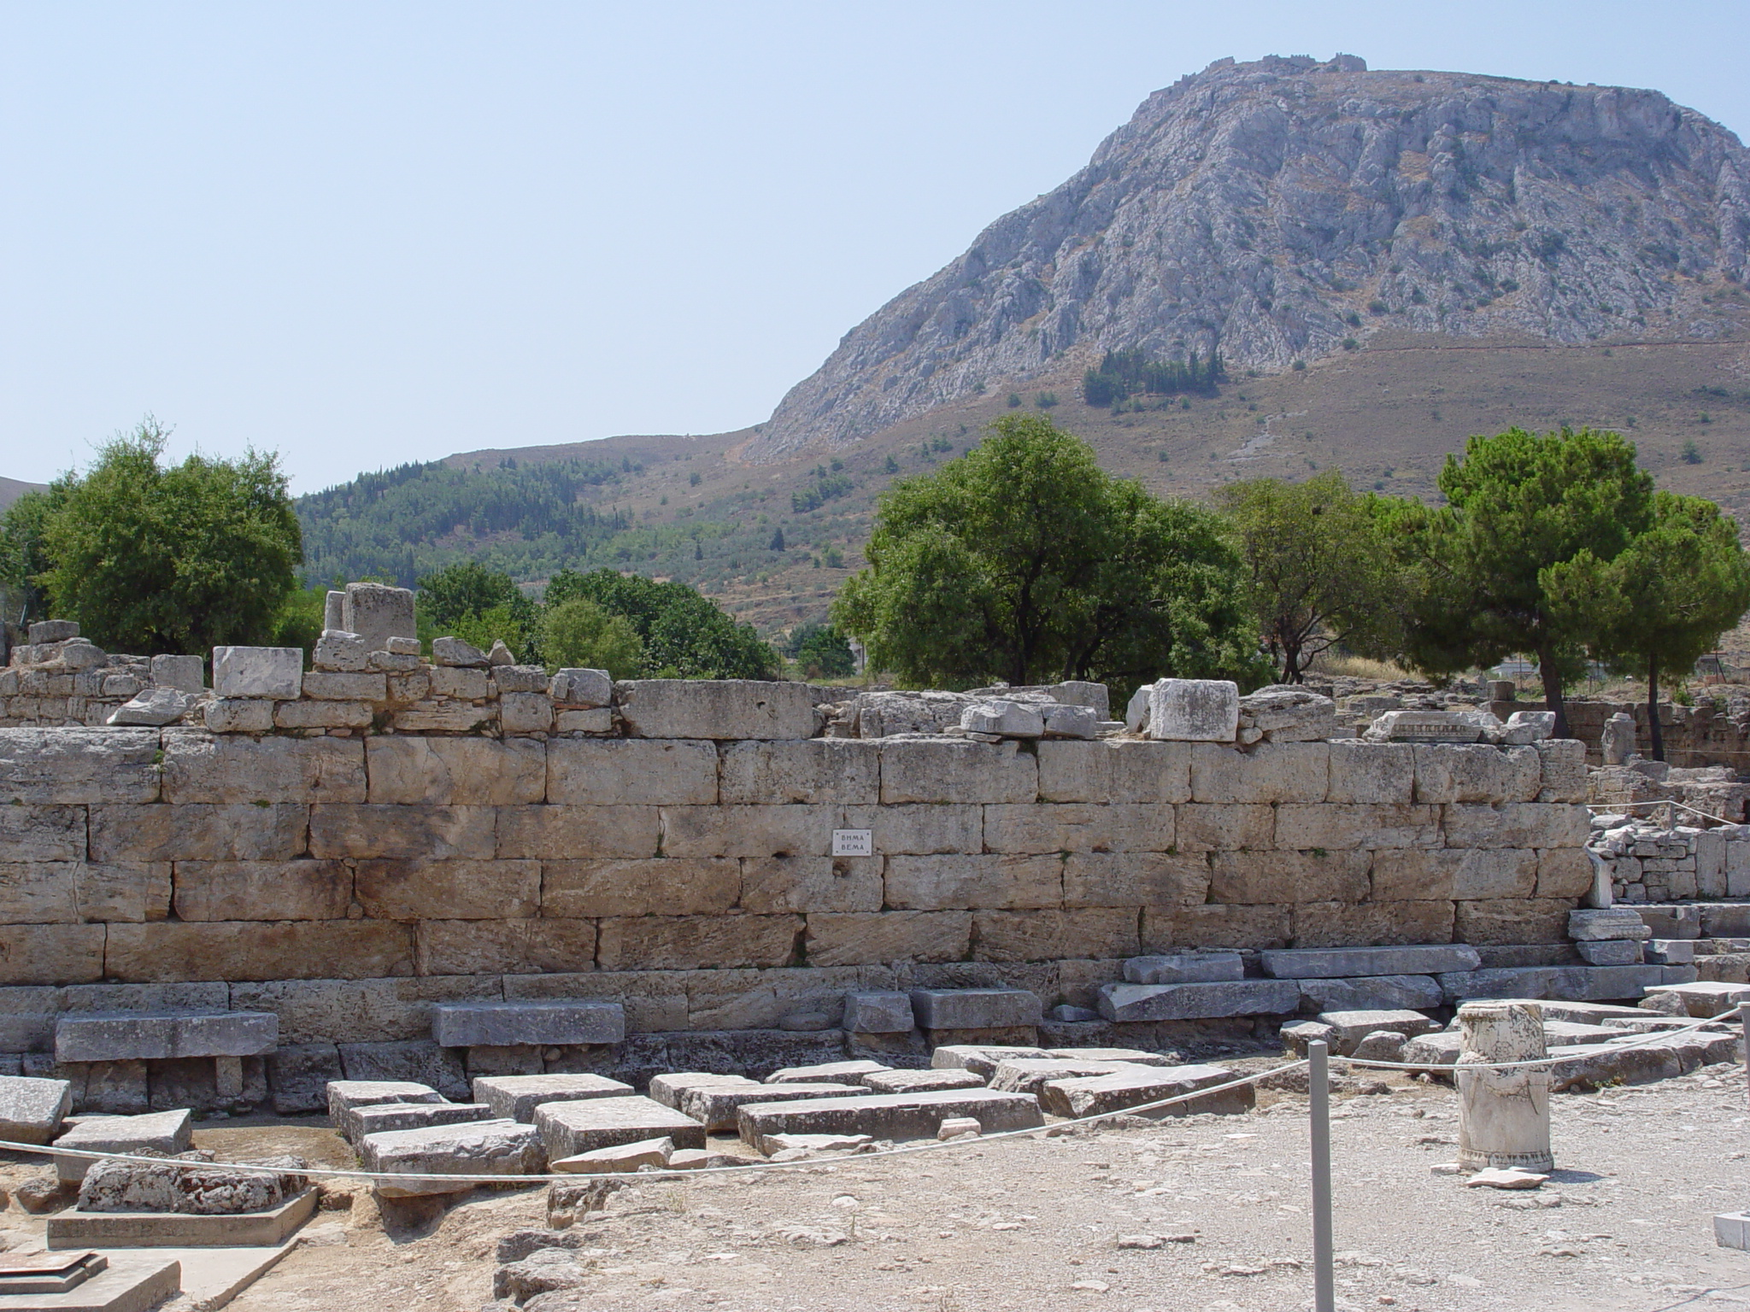

Slide 6
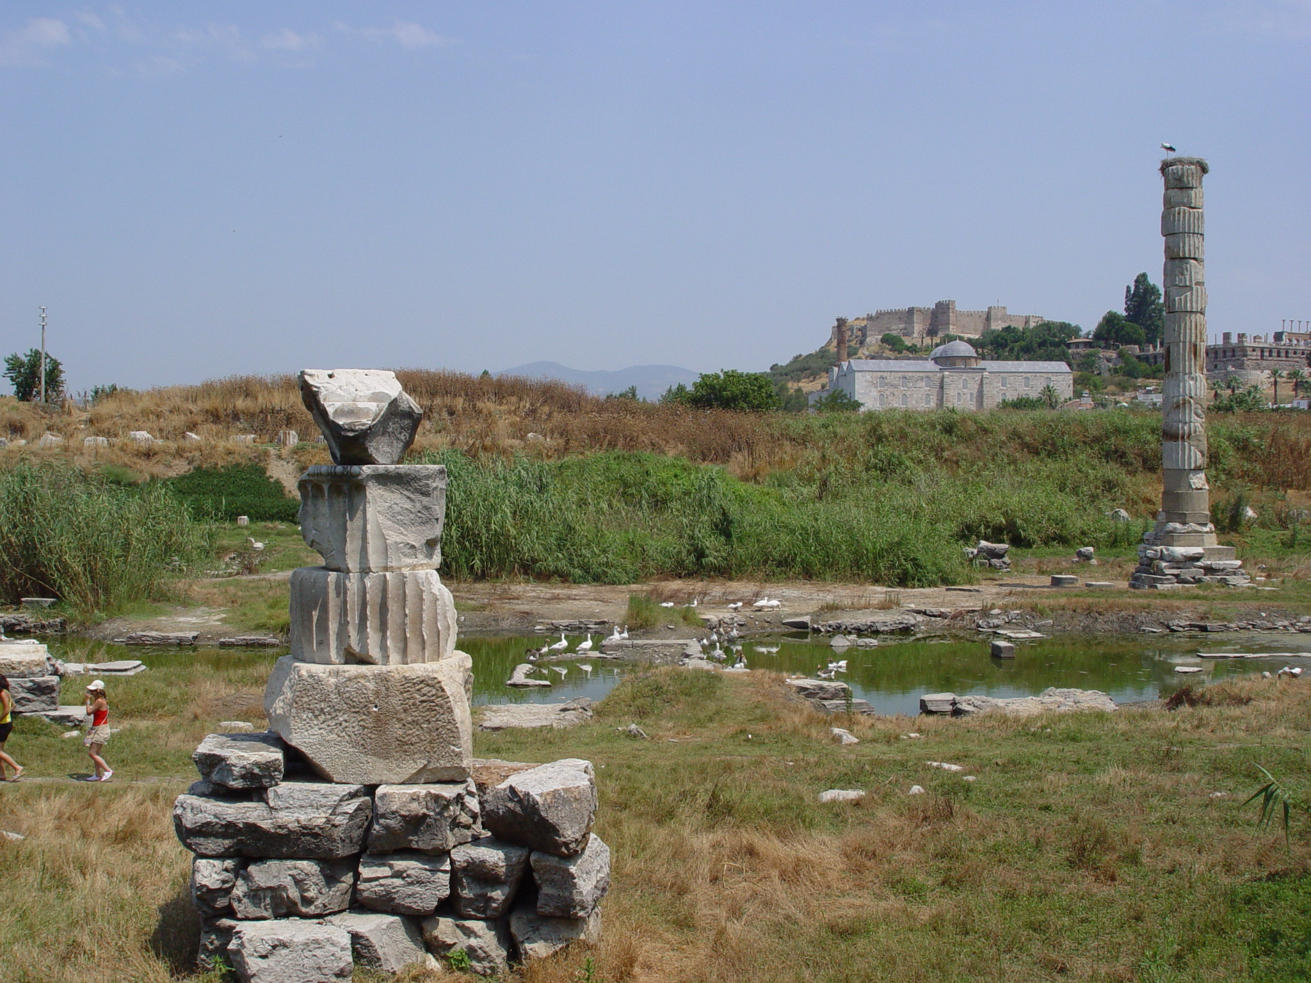
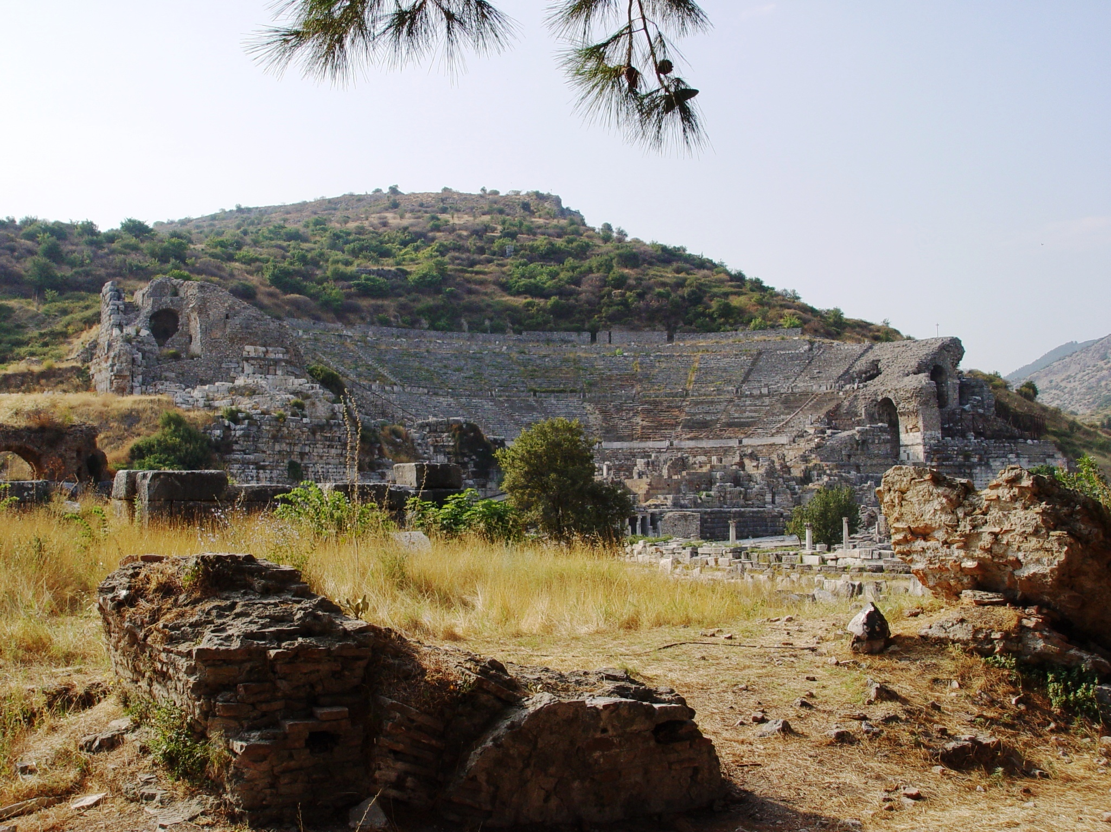

Slide 7
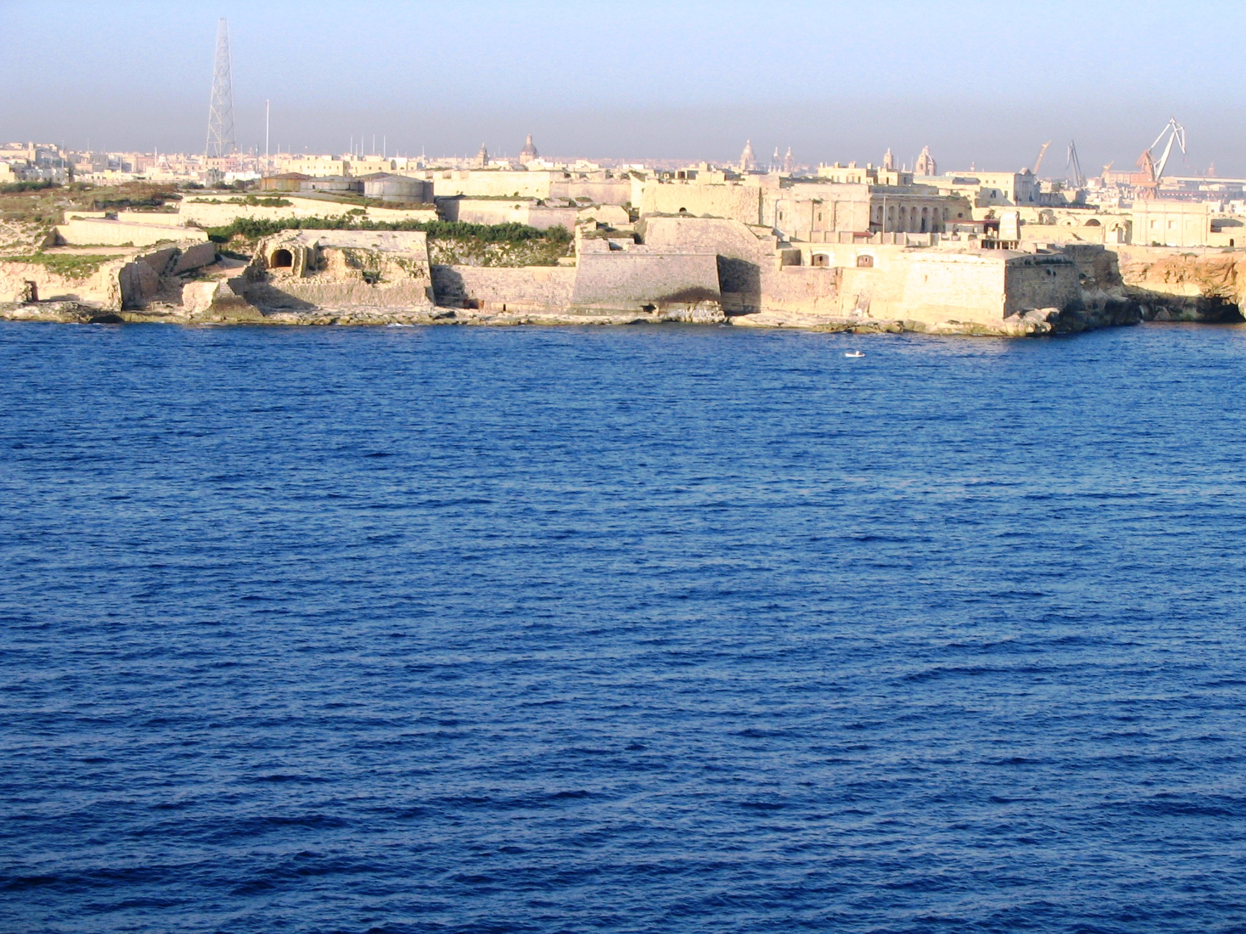

Slide 8
What Paul’s Conversion Meant For His Work
He quit rejecting the Lord’s will
He found completion in Christ

Slide 9
What Paul’s Conversion Meant For His Work
He quit rejecting the Lord’s will
He found completion in Christ
He gave the Lord complete control of his life

