Slide 1
Rationalism versus Postmodernism versus Christ
Colossians 2:8-10

Slide 2
Colossians 2:8
See to it that no one takes you captive by philosophy and empty deceit, according to human tradition, according to the elemental spirits of the world, and not according to Christ.

Slide 3
Colossians 2:9-10
For in him the whole fullness of deity dwells bodily,
and you have been filled in him, who is the head of all rule and authority.

Slide 4
Philosophies that threatened early Christians
Jewish mysticism, asceticism (Colossians 2:20-23)
Popular Greek Philosophy
Gnosticism

Slide 5
Three Philosophical Epochs
Premodernism (to about 1700)
Modernism/Rationalism (1700-1950)
Postmodernism (1950 - )

Slide 6
Key Concepts of Postmodernism
No absolute truth
Words and language are simply “games.”
Pluralism – All ideas, are equally good

Slide 7
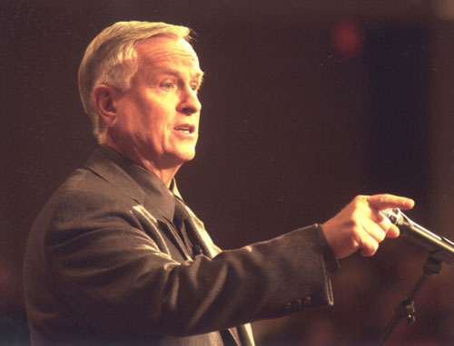
Josh McDowell - lecturer
Primary challenge in the 1960’s and early 1970’s – “How do you know that’s true”
Challenge heard since 1970’s – “How dare you say that Buddhist and Muslims are wrong!”

Slide 8
Some good things about Postmodernism
Not impressed with dogmatic statements about evolution
Anti-denominational
Anti-Pharisee – (emphasis on externals and not the heart)

Slide 9
Promoters of Postmodernism
Schools
The word “tolerance.”
Not.. “treat kindly,” but “accept as good!
Television, media
Attitudes towards marriage, sex, drugs, gambling, materialism, etc.

Slide 10
Postmodernism in religion
Uncertainty about the Bible message
Feelings are emphasized more than analyzing the scripture
Entertainment-oriented worship

Slide 11
Confronting Postmodernism
“I am the way, and the truth, and the life. No one comes to the Father except through me.” John 14:6

Slide 12
Confronting Postmodernism
“…how the mystery was made known to me by revelation, as I have written briefly. When you read this, you can perceive my insight into the mystery of Christ,” (Ephesians 3:3,4)

Slide 13
Confronting Postmodernism
“If you love me, you will keep my commandments.”
(John 14:15)

Slide 14
Confronting Postmodernism
“Not everyone who says to me, ‘Lord, Lord,’ will enter the kingdom of heaven, but the one who does the will of my Father who is in heaven.” (Matt. 7:21)
“Everyone then who hears these words of mine and does them…” (Matt. 7:24)

Slide 15
What about 2 Peter 3:16?
There are some things in them [the writings of Paul] that are hard to understand, which the ignorant and unstable twist to their own destruction, as they do the other Scriptures.

Slide 16
The explanation – Milk and Meat
“…You need someone to teach you again the basic principles of the oracles of God. You need milk, not solid food, … But solid food is for the mature,” (Hebrews 5:12,14)_
I fed you with milk, not solid food, for you were not ready for it. (1 Cor. 3:2)

Slide 17
A new hermeneutic?
The bad guy for Postmodernists
CENI
(Command, Example, Necessary Inference)

Slide 18
Common sense interpretation
“Command” (tell me)
“Example (show me)
Necessary inference (Inescapable conclusion, Imply)

Slide 19
How do we look to God?
As humble children looking for any indication of His will for us?
Or, as defense attorneys trying to find loopholes?
Or, as prosecutors trying to find fault?

Slide 20
Matthew 24:35
“Heaven and earth will pass away, but my words will not pass away.”

