Slide 1
How does Jesus Look at Me?
John 17:6-26

Slide 2
John 17:6
…and they have kept Your word.

Slide 3
He looks at me as He looked at the apostles!
Obedient in spite of faults (vs. 6)

Slide 4
Obedient Disciples?? #1
Arguing over who was the greatest (Luke 9:46)
Asking for fire to come down and destroy a Samaritan village (Luke 9:54)
Showing inability to cast out a demon in a young boy (Luke 9:40).
Doubting that they would have enough food after Jesus fed the 5000 (Mark 9:16)

Slide 5
Obedient Disciples?? #2
Chasing away children (Luke 18:15)
Peter's unbelief when slipping beneath the waves (Matt. 14:30)
Peter's "foot in the mouth” on the mount of transfiguration (Luke 9:33)
Wanting to sit on his right and left hand in the kingdom (Mark 10:37)

Slide 6
Obedient Disciples?? #3
Peter's rebuke of Jesus for saying that he would suffer and die in Jerusalem (Mark 8:32)
Fleeing when he was arrested (Matt. 26:56)
Peter's denial (Matt. 26:69ff)
Disbelieving the women's testimony about Jesus' resurrection (Luke 24:11)

Slide 7
John 17:6
…and they have kept Your word.

Slide 8
John 17:10
“I am glorified in them.”

Slide 9
He looks at me as He looked at the apostles!
Obedient in spite of faults (vs. 6)
Glorified in them (vss. 9, 10)

Slide 10
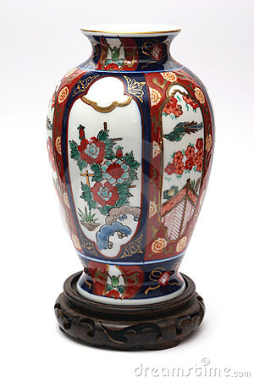
Ephesians 3:10
…”So that through the church the manifold wisdom of God might now be made known to the rulers and authorities in the heavenly places.”

Slide 11
John 17:11 ,12
“Keep them in Your Name…”

Slide 12
He looks at me as He looked at the apostles!
Obedient in spite of faults (vs. 6)
Glorified in them (vss. 9, 10)
Concerned for spiritual dangers (vss. 11, 12)

Slide 13
Who is in Whom? (verses 20-23)
The Father in Christ (vs. 21, 23)
Christ is in the Father (vs. 21)
Christ wants us to be in them (vs. 21)
Christ in us (vs. 23)

Slide 14
The word “in”
"Of a person to whom another is wholly joined and to whose power and influence he is subject, so that the former may be said to be likened to the place in which the latter lives and moves.” (John Henry Thayer, p. 211)

Slide 15
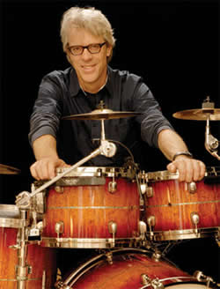
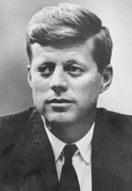
The use of the word “in” in modern language
“He has rhythm in his bones.”
“He has football in his blood.”
“I see John Kennedy in him..”
“I see his father in him.”

Slide 16
He looks at me as He looked at the apostles!
Obedient in spite of faults (vs. 6)
Glorified in them (vss. 9, 10)
Concerned for spiritual dangers (vss. 11, 12)
Wants closer relationship (20-23)

