Slide 2
Things Jesus
Said

Slide 3
John faced some doubts (vss. 18-19)
“Blessed Is He Who Does Not Take Offense At Me.”
Luke 7.23

Slide 4
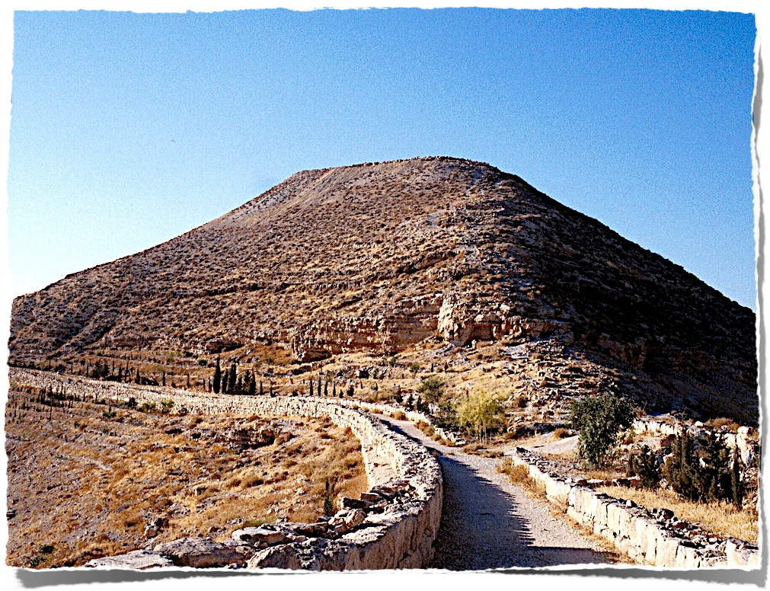
“Are You the Expected One, or do we look for another?”
Luke 7.19

Slide 5
John faced some doubts (vss. 18-19)
John sent to Jesus for answers (vss. 19-20)
Jesus explained Himself (vss. 21-22)
“Blessed Is He Who Does Not Take Offense At Me.”
Luke 7.23

