Slide 3
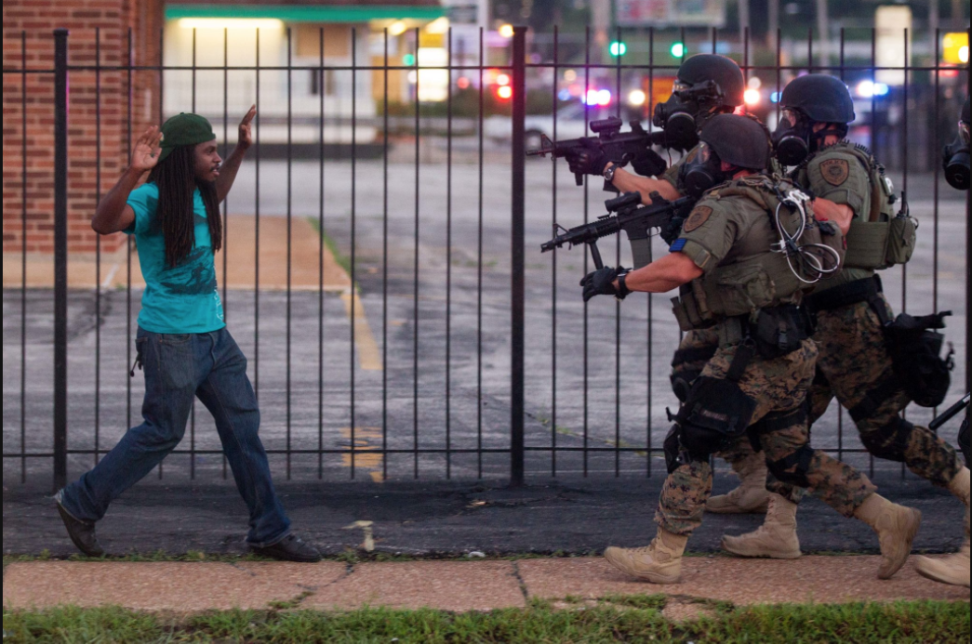

Slide 6
The gospel shows that your group isn’t better than other groups.
The gospel shows that the only hope for anyone is Christ.
Those who’ve experienced the grace of the gospel want others to experience the same.

Slide 7
“Every Christian should strive to be more & more like Jesus. Jesus talked to everybody. Every local congregation should look like the community it is in… Leadership should have a plan to bring to the forefront of the church how the goal of each assembly & in the directory is to look like Heaven here on Earth. Is Heaven going to be filled with white people only? Blacks only? Hispanics only? If not, then why do our local congregations?”
–Antoine Holloway

Slide 8
Those who’ve experienced the grace of the gospel now use their lives to serve others.
Those who’ve experienced the grace of the gospel will try and understand others.

Slide 9
“We have faced great struggles in the past. We have overcome many of them, but not all. And we think about them from time to time. But we try to not allow it to cloud our love for all the brethren.”
-Rufus Barfield Sr.

Slide 10
“I love God, Christ & the brotherhood like you do… Allow me to have my baggage and allow me to be."
-Rufus Barfield II

Slide 11
“At least try to understand. Don't just tell me to let it roll off my shoulders when I'm always somebody's suspect. Even if I'm completely wrong when I see racism, at least say something nice. At least take me seriously. At least acknowledge the potential validity of how I'm perceiving my experience. And don't tell me you don't see me as black. That's part of who God made me and it's part of my identity.”

Slide 13
“Therefore, accept one another, just as Christ also accepted us to the glory of God.”
-Romans 15.7

