Slide 2
Undenominational Christianity

Slide 3
Restoring New Testament Christianity

Slide 4
Three Principles
Apostolic Authority
Scriptures are understandable
New Testament practices rest on apostolic authority intentionally designed by God to promote uniformity.

Slide 5
The Reformation
1517-1648

Slide 6
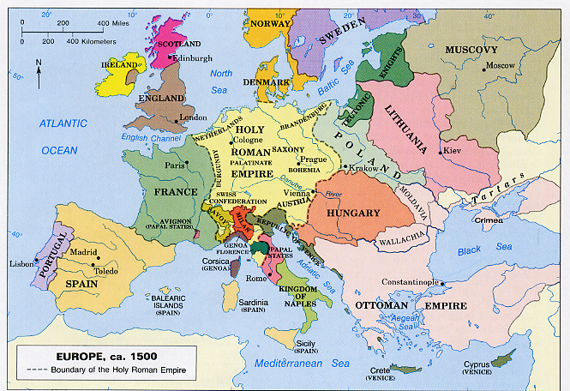

Slide 7
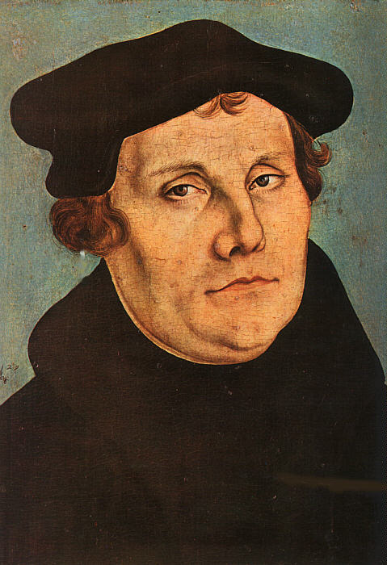
The Reformation
1517-1648

Slide 8
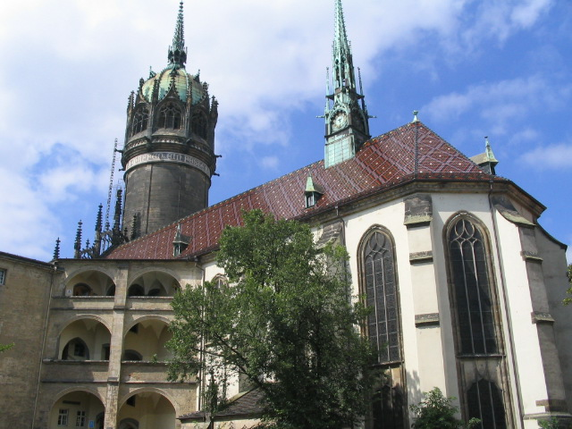
State Churches
Lutheran (Germany)
Presbyterian (Switzerland)
Anglican (England)
Other Reformation churches include Methodist, Baptist, Congregational, etc.

Slide 9
Where is New Testament Christianity?

Slide 10
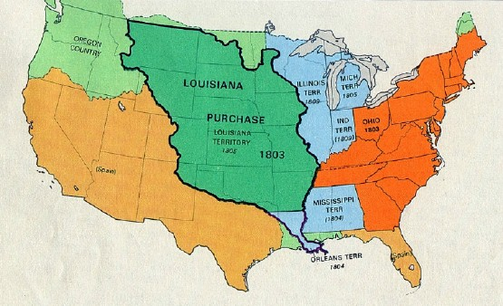
19th Century America

Slide 11
“Restoration” beliefs
Free will of the individual
Immersion necessary for salvation
Congregational Independence
Simple New Testament worship
Absolute authority of the New Testament
We speak where the Bible speaks and we are silent where the Bible is silent.

Slide 12
Division
Among
Churches of Christ/Disciples of Christ

Slide 13
World Evangelism
How does the church accomplish it?

Slide 14
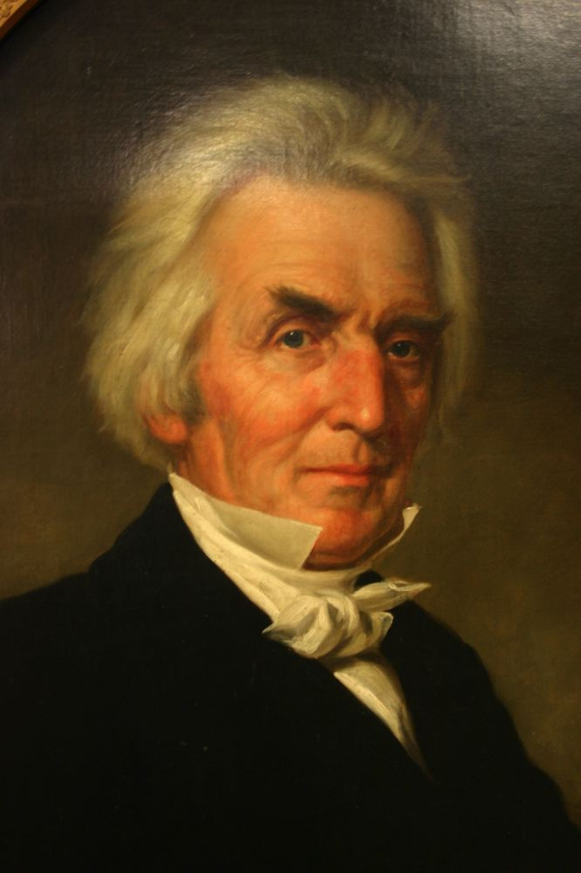
American Christian Missionary Society
Created 1849

Slide 15
American Christian Missionary Society
Philippi
Paul
Corinth
Ephesus

Slide 16
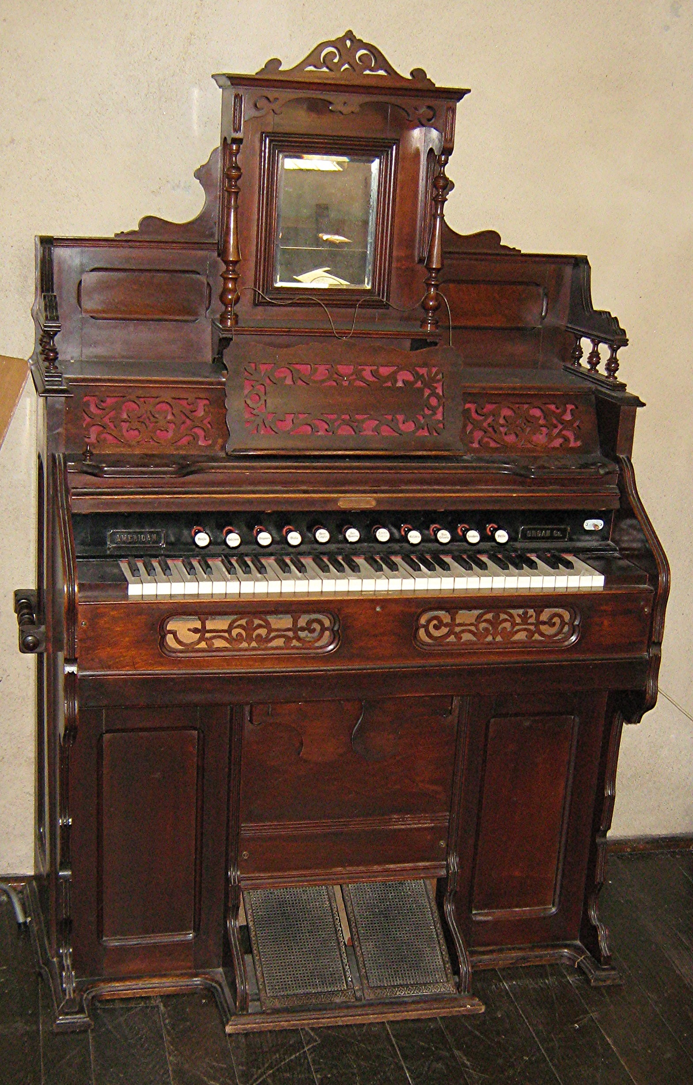
Instrumental Music
Midway, Ky
1849

Slide 17
Differing Views on Bible Authority
The scriptures must expressly authorize whatever we believe and practice.
Anything not expressly forbidden is acceptable.

Slide 18
Division
Among
Churches of Christ/Disciples of Christ
1910 U.S. Census lists
Churches of Christ & Disciples of Christ as two separate groups

