Slide 2
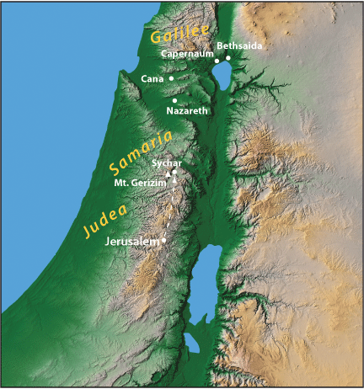

Slide 3
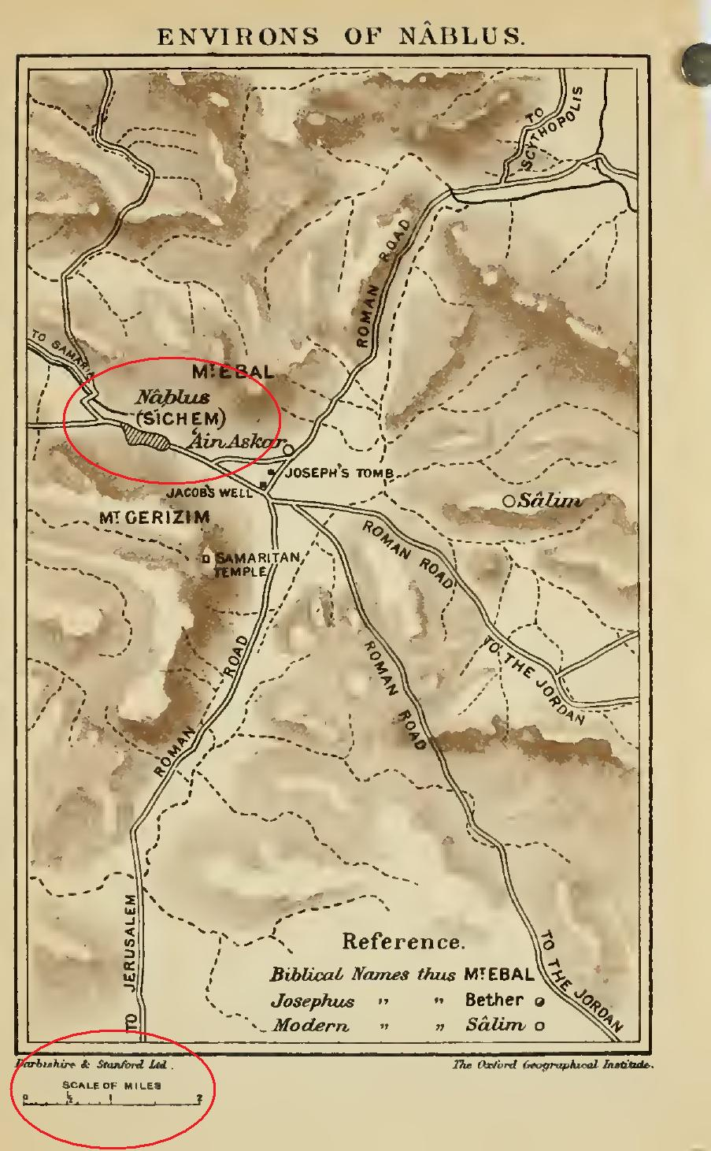

Slide 5
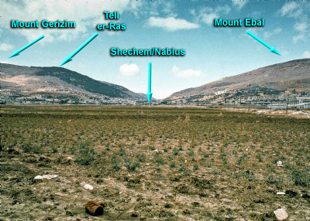

Slide 6
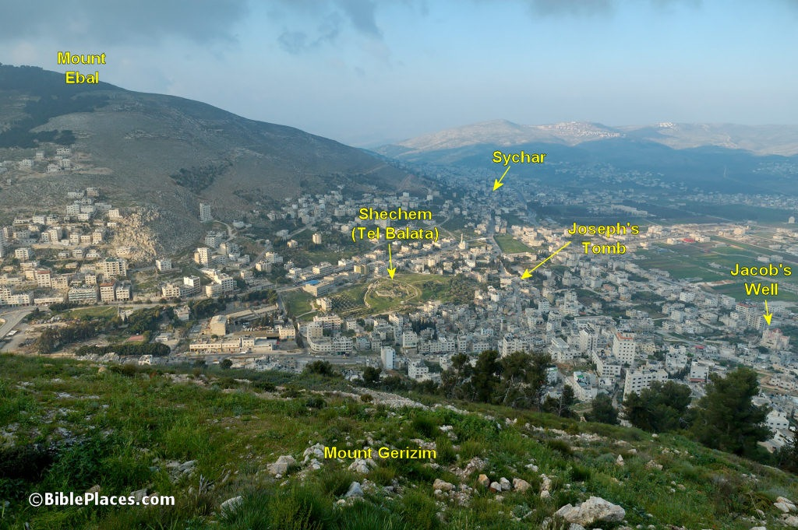

Slide 7
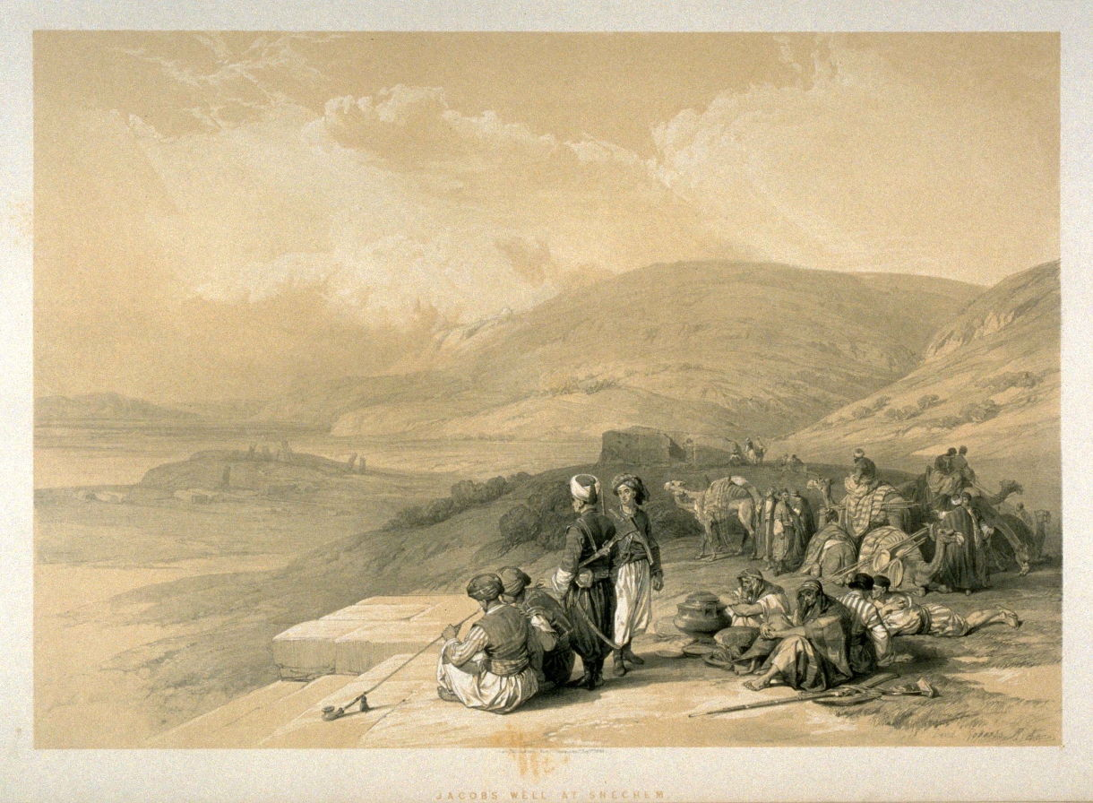

Slide 8
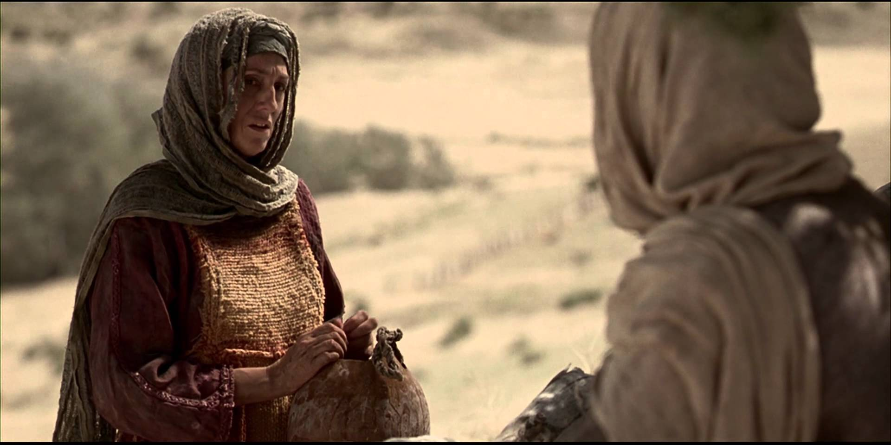

Slide 9
The Conversation Begins
“Give me a drink”
The Woman’s Shock
Living Water
“Go get your husband”
“You are a prophet”

Slide 10
The Spiritual Discussion
Disagreement about place of worship
A new criteria for worship
Things are changing!
“I am He”

Slide 12
What do we learn?
The gospel is truly for all
We earn the right to teach someone
We must speak truth plainly and explicitly
The field is broad and ripe for harvest
Our responsibility is to sow the seed.

Slide 13
