Slide 2
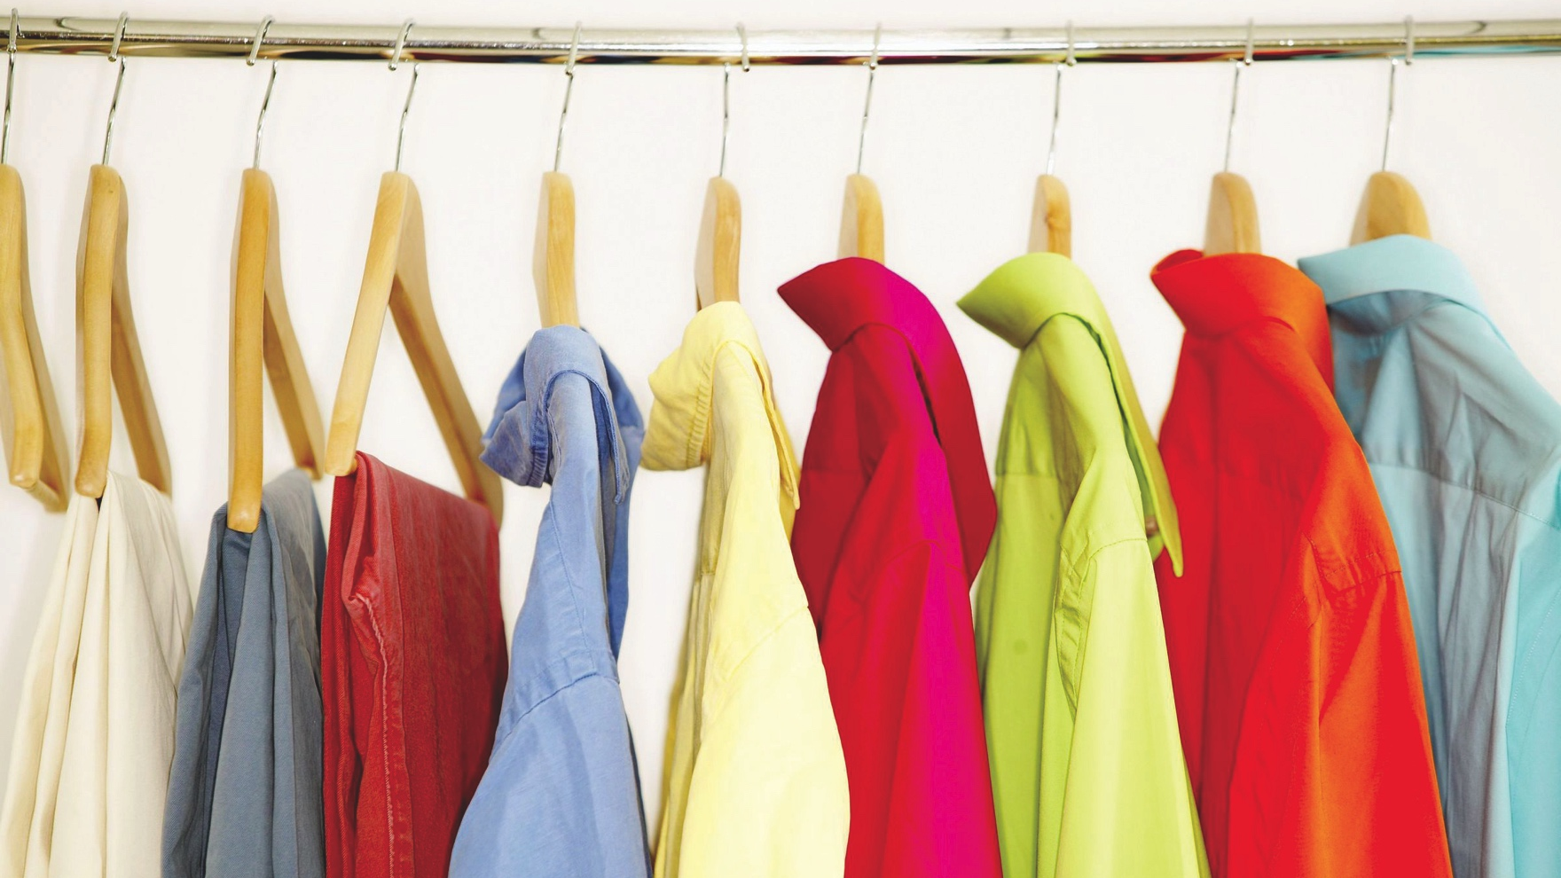
What Do Your Clothes Say?
“You should be attracted to my…”

Slide 3
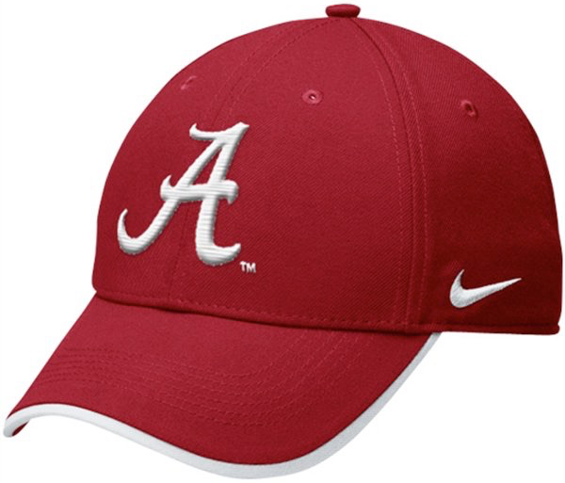
Attractive?
Attract: to draw

Slide 4
What Do Your Clothes Say?
How should we attract? 1 Timothy 2:9-10

Slide 6
Is It That Big Of A Deal?
What kind of person do you want to attract?

Slide 7
Is It That Big Of A Deal?
Who has the right to see your body? Prov. 5:18-19

Slide 8
Is It That Big Of A Deal?
Is that how God wants you to attract? 1Tim 2:10

Slide 9
Is It That Big Of A Deal?
For our kids?

Slide 10
What Do Your Clothes Say?
“I belong to…”

Slide 11
What Do Your Clothes Say?
“I belong to the Lord” Titus 2.10

Slide 12
What Do Your Clothes Say?
“I belong to the world” Rom. 12.2; 1John 2.15

Slide 13
Objections
“You are being judgmental, it is the heart that matters.”

Slide 14
Objections
“It is men who have the problem....”

Slide 15
Objections
“Modest clothing is too hard to find.”

Slide 16
Objections
“Modest clothing is too ugly.”

Slide 17
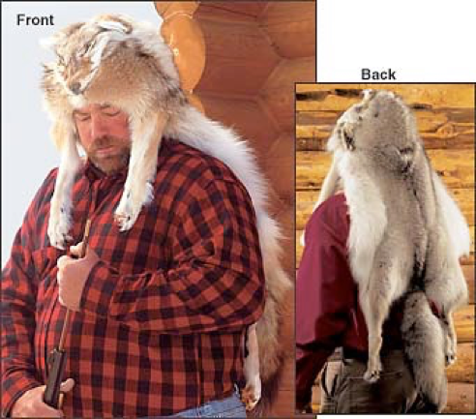
What If God Said…?
All Christians Must Wear This!

Slide 18
Objections
“Modest clothing is too ugly.”

Slide 19
Objections
“I agree in principle, but there are exceptions...”

Slide 20
Objections
“What I wear is nobody else’s business.”

Slide 21
What Do Your Clothes Say?
“I adorn the gospel!” Titus 2:10

