Slide 2
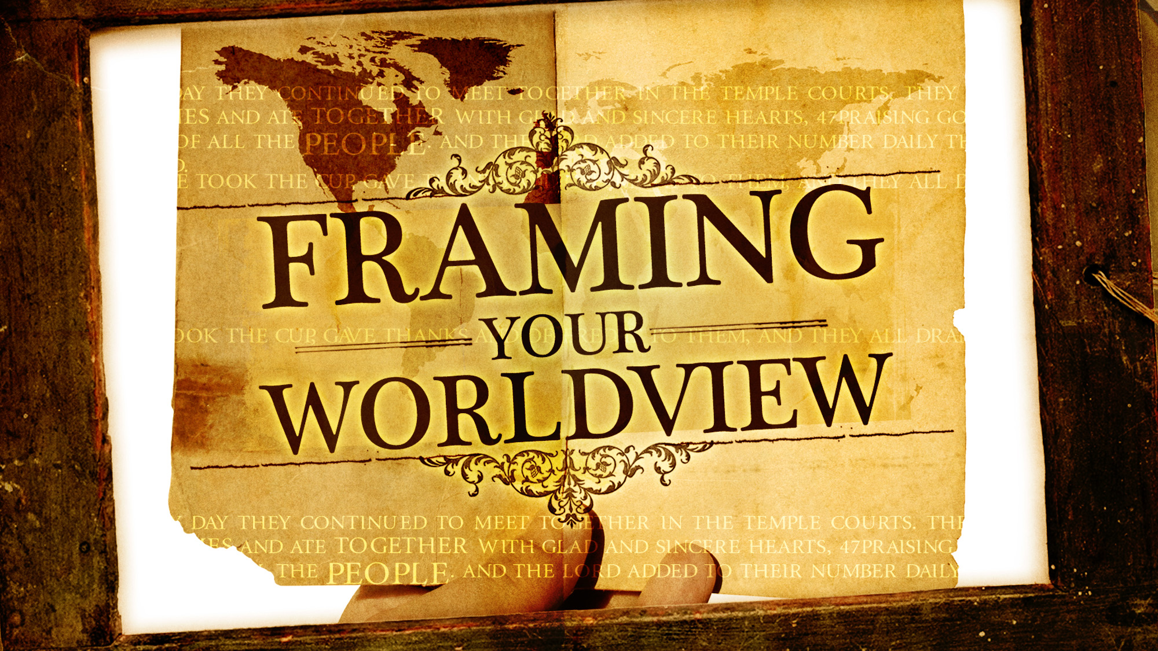

Slide 3
How does God shape
Your
WORLDVIEW?

Slide 4
NEW TESTAMENT CHURCH
WORLDVIEW

Slide 5
What was the New Testament Church About?
SAVED
Lost
The story of the book of Acts
Was it a worldwide org. with a big staff controlling all functions of the church?
Was its mission to transform society by eliminating poverty, educating the masses, providing free medical service?

Slide 6
What is the
church?

Slide 7
Church
The saved

Slide 8
Are you saved or lost?

Slide 9
How did they live out their worldview?

Slide 10
Realized what needed to be done
Conformed their own lives to Jesus
Talked of Jesus to others
They were willing to die for Jesus
Living their Worldview

