Slide 3
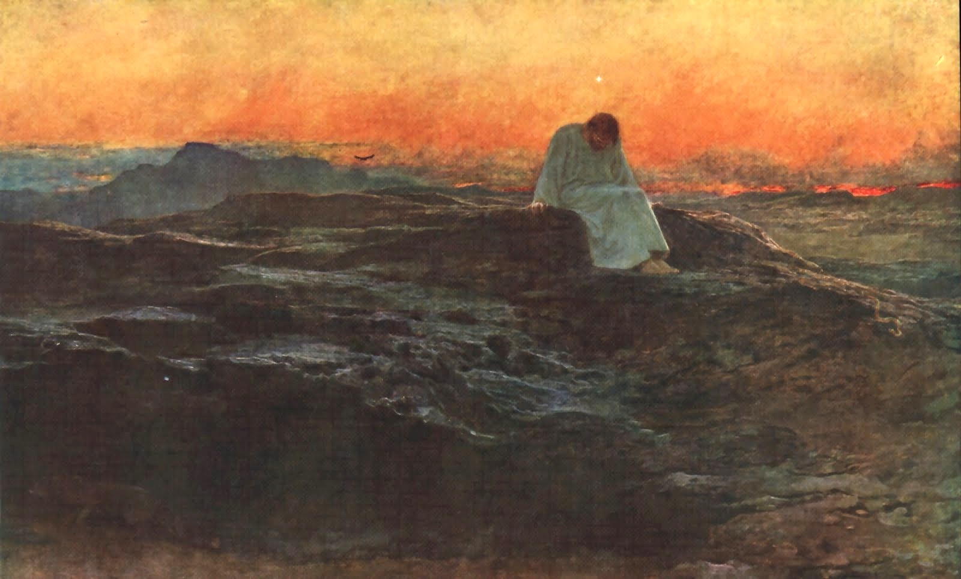

Slide 5
In the Wilderness

Slide 6
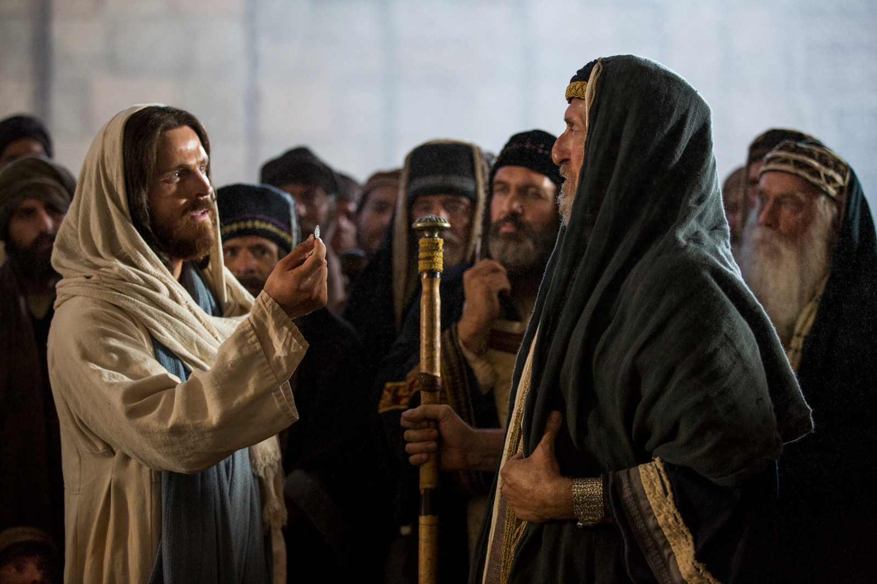
Jesus
vs.
Religious Leaders

Slide 7
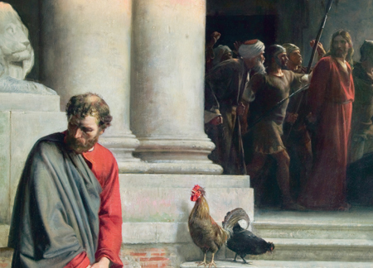
His own friends and disciples

Slide 8
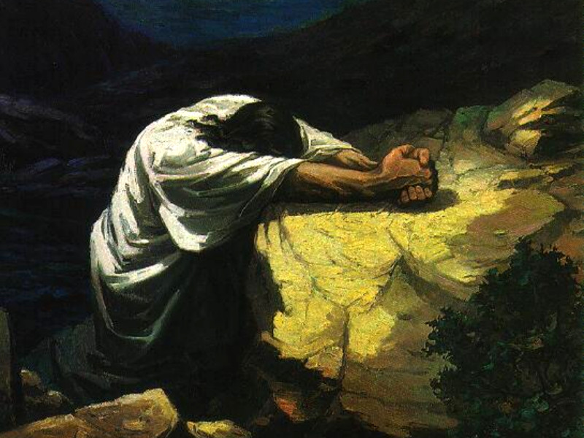
His own desire to escape suffering and death

Slide 9
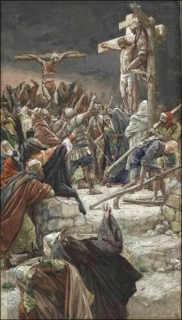
The mockers at the cross

Slide 10
God’s purposes beyond our understanding
Evil often turns on the evildoer
Sometimes friends will forsake us
We can endure lifelong trial and temptation

