Slide 3
Protect & Defend Even When Others Flee

Slide 4
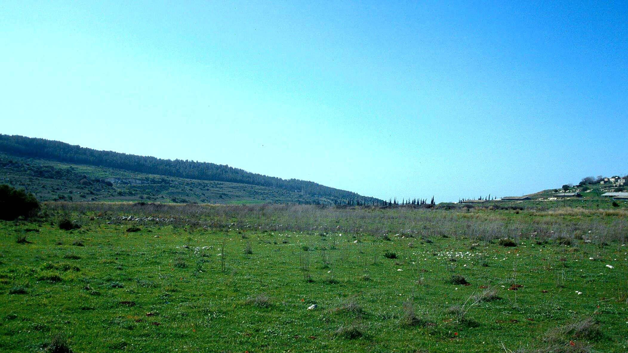
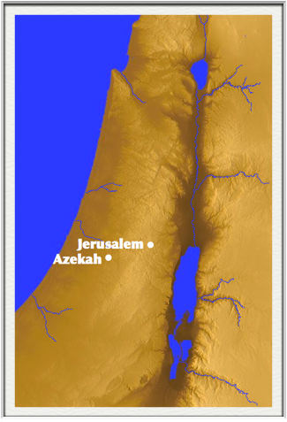

Slide 5
“Be on the alert, stand firm in the faith, act like men, be strong. Let all that you do be done in love.”
(1 Corinthians 16:13–14)
Protect & Defend Even When Others Flee

Slide 6
“He arose and struck the Philistines until his hand was weary and clung to the sword....”
(2 Samuel 23:10)
Keep Up The Fight

Slide 7
“They took their stand in the midst of the plot and defended it, and struck down the Philistines; and the Lord saved them by a great victory.”
(1 Chronicles 11:14)
Know Who Gives The Victory

