Slide 1
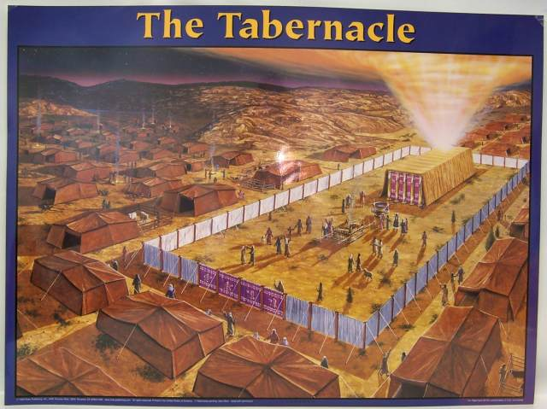

Slide 2
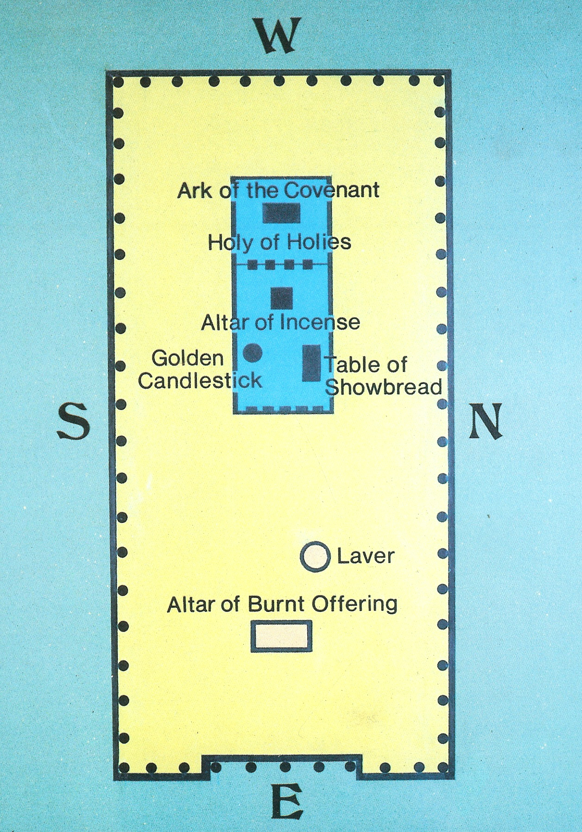

Slide 3
Elements of the Tabernacle
Tent materials and walls
Altar of burnt offering
The Brazen Laver
Holy Place
Candlestick
Table of Showbread
Altar of Incense
Veil
Holy of Holies
Ark of the Covenant with Mercy Seat

Slide 5
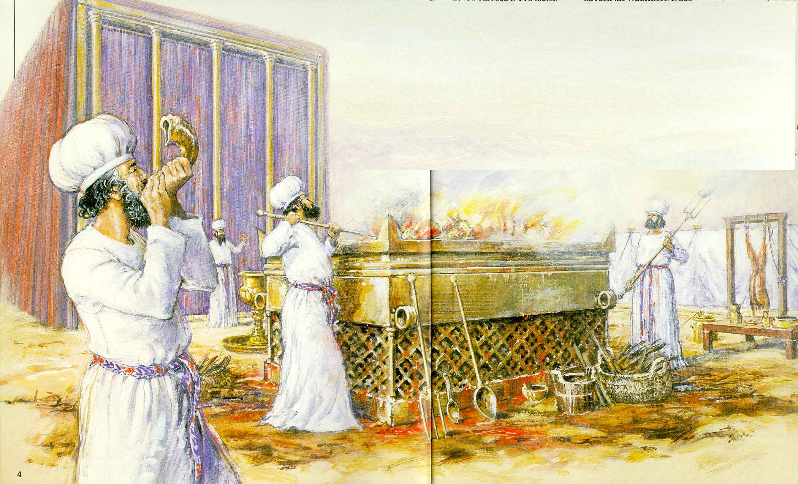

Slide 6
