Slide 1
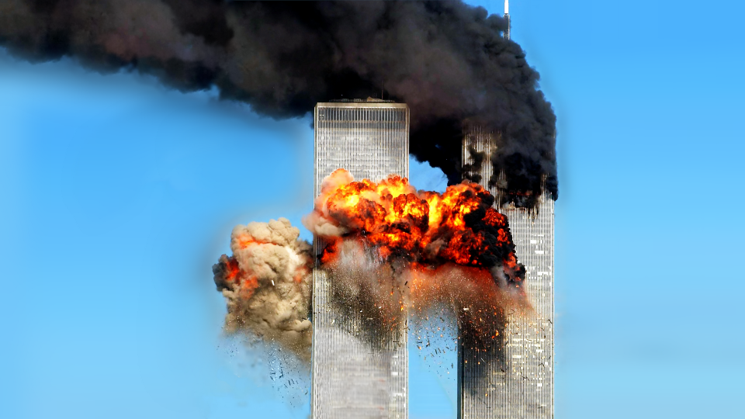
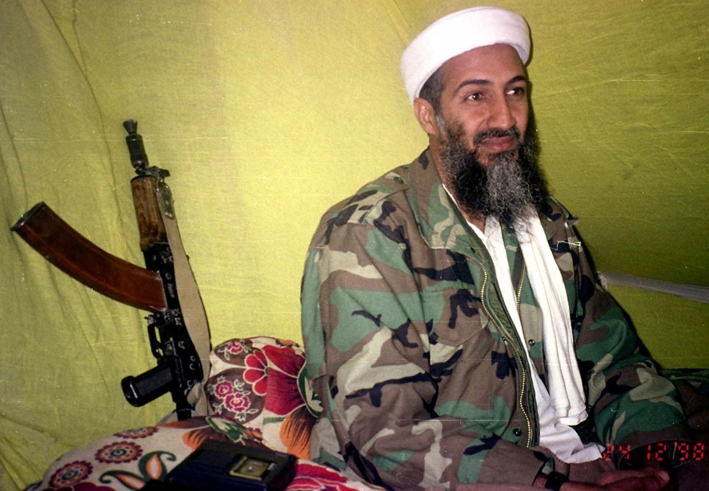

Slide 2
Enemies, Vengeance & The Lord
Psalm 109

Slide 3
The Complaint (vss. 1-5)
The Imprecation (vss. 6-20)
The Prayer (vss. 21-29)
Vow of Praise (vss. 30-31)
Enemies, Vengeance & The Lord
Psalm 109

Slide 4
Don’t be quick to make enemies (vss. 4-5)
Maintain trust in the Lord (vss. 1, 28-31)
Vengeance belongs to the Lord (vss. 21, 26-27)
Responding To Our Enemies

Slide 5
A fitting prophecy of Judas (vs. 8, cf. Acts 1:20)
Psalm 109.6-20 will apply to all who set themselves against the Lord.
Don’t Become God’s Enemy!

