Slide 2
Creation
The Flood
Patriarchs
Exodus from Egypt
Wilderness Wanderings
Conquest of Canaan
Judges
United Kingdom
Divided Kingdom
Judah Alone
Babylonian Captivity
Return from Captivity
STORY of
the OLD
TESTAMENT

Slide 3
Creation
The Flood
Patriarchs
Exodus from Egypt
Wilderness Wanderings
Conquest of Canaan
Judges
United Kingdom
Divided Kingdom
Judah Alone
Babylonian Captivity
Return from Captivity
STORY of
the OLD
TESTAMENT

Slide 4
Hope for Judah? The reign of Hezekiah (2Kings 18-20)
Judah Alone
2Kings 18-25; 2Chron. 30-36; Isaiah; Micah-Zephaniah; Jeremiah

Slide 5
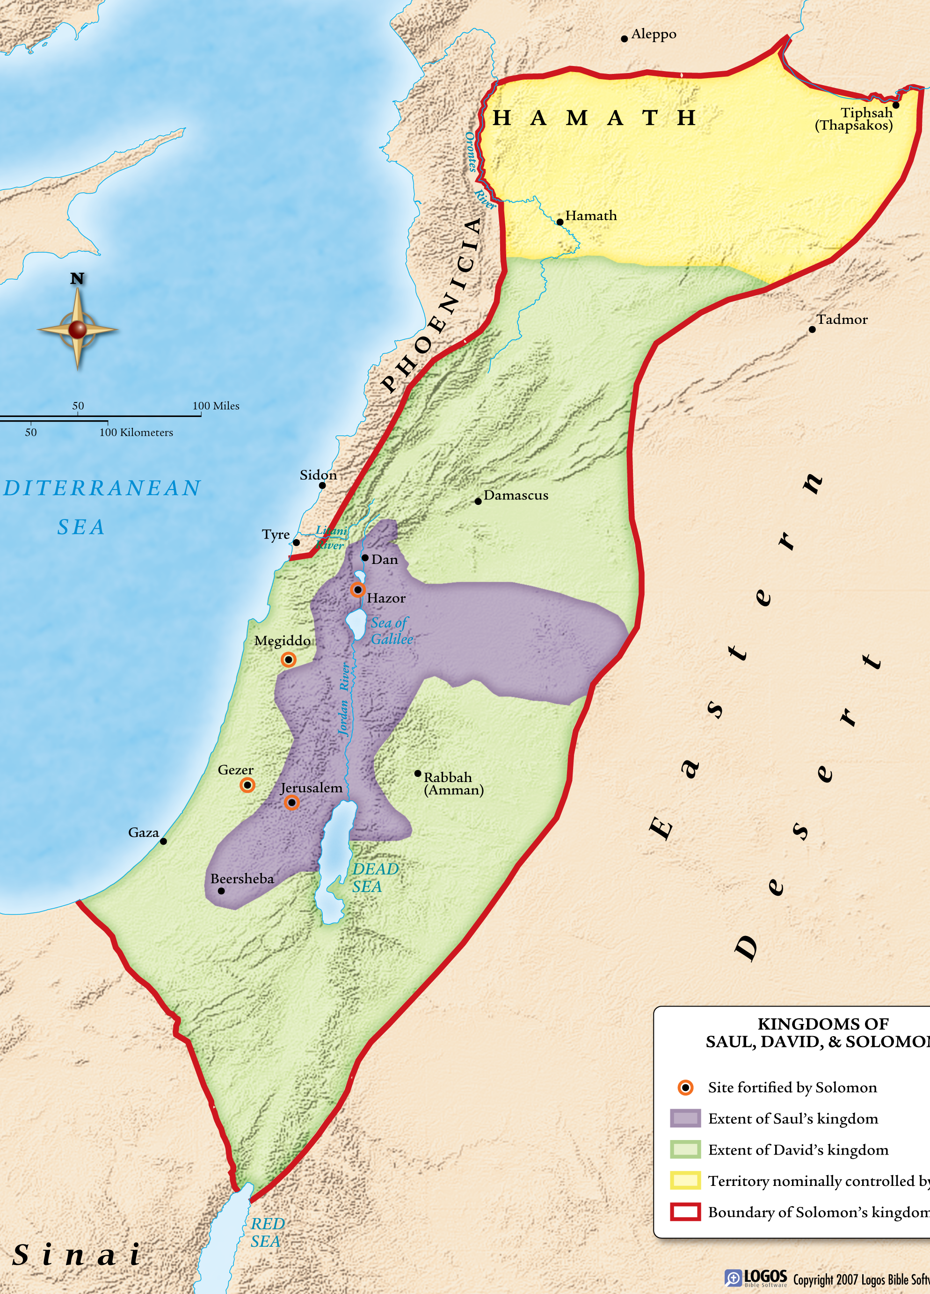
Judah Alone
2Kings 18-25; 2Chron. 30-36; Isaiah; Micah-Zephaniah; Jeremiah

Slide 6
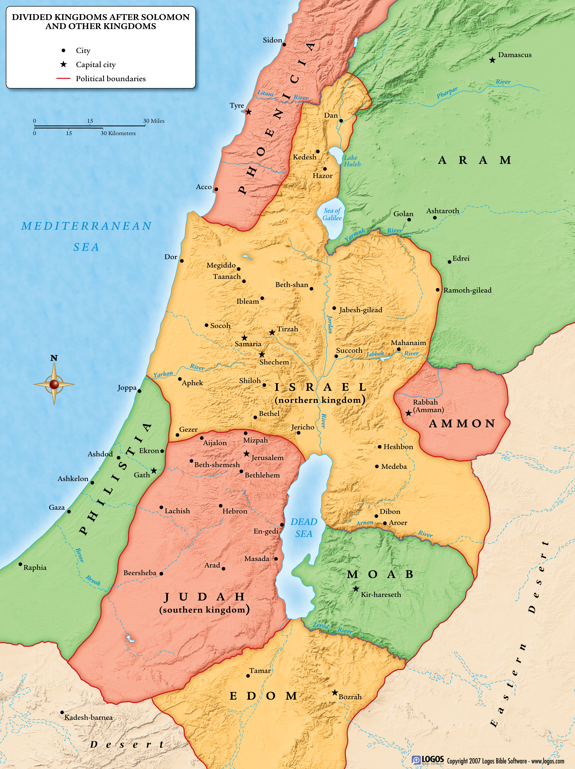
Judah Alone
2Kings 18-25; 2Chron. 30-36; Isaiah; Micah-Zephaniah; Jeremiah

Slide 7
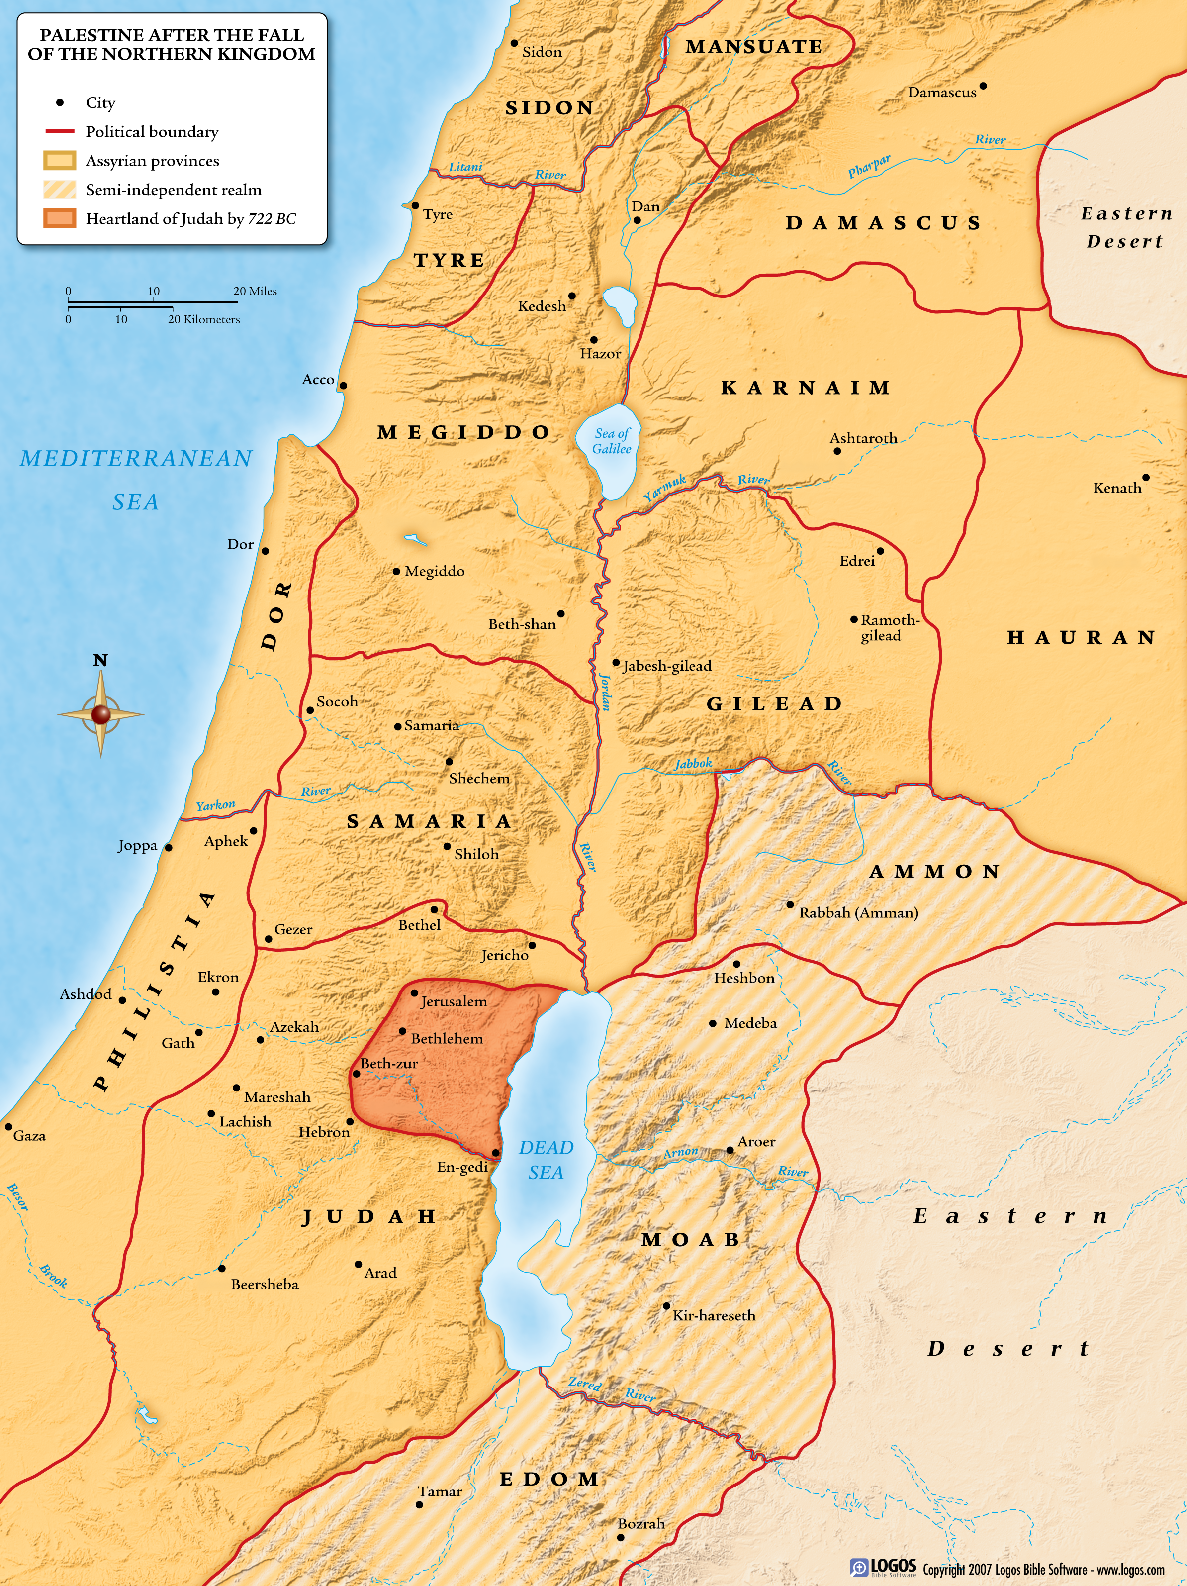
Judah Alone
2Kings 18-25; 2Chron. 30-36; Isaiah; Micah-Zephaniah; Jeremiah

Slide 8
Judah Alone
2Kings 18-25; 2Chron. 30-36; Isaiah; Micah-Zephaniah; Jeremiah

Slide 10
Hope for Judah? The reign of Hezekiah (2Kings 18-20)
Judah will fall. The reigns of Manasseh & Amon (2Kings 21)
Reform, but too late. The reign of Josiah (2Kings 22.1-23.30)
Judah Alone
2Kings 18-25; 2Chron. 30-36; Isaiah; Micah-Zephaniah; Jeremiah

Slide 11
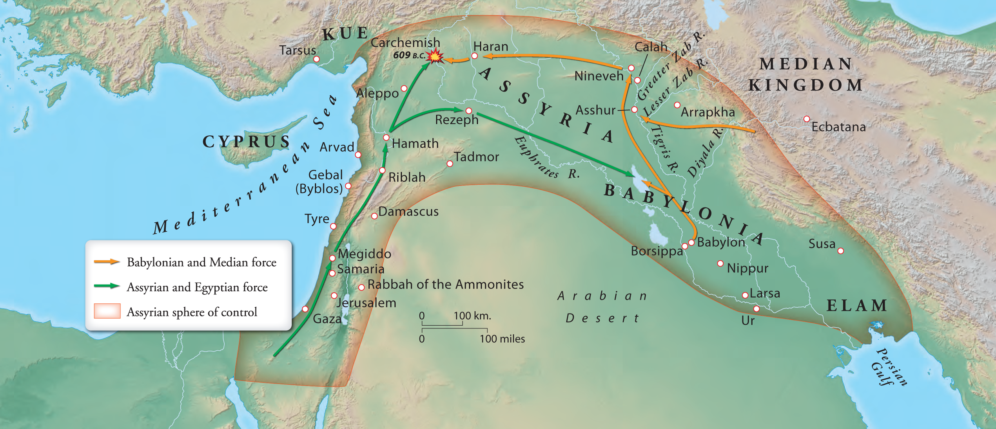

Slide 12
Hope for Judah? The reign of Hezekiah (2Kings 18-20)
Judah will fall. The reigns of Manasseh & Amon (2Kings 21)
Reform, but too late. The reign of Josiah (2Kings 22.1-23.30)
Judah falls. (2Kings 23.31-25.21)
Judah Alone
2Kings 18-25; 2Chron. 30-36; Isaiah; Micah-Zephaniah; Jeremiah

Slide 13
Judah Alone
2Kings 18-25; 2Chron. 30-36; Isaiah; Micah-Zephaniah; Jeremiah

Slide 14
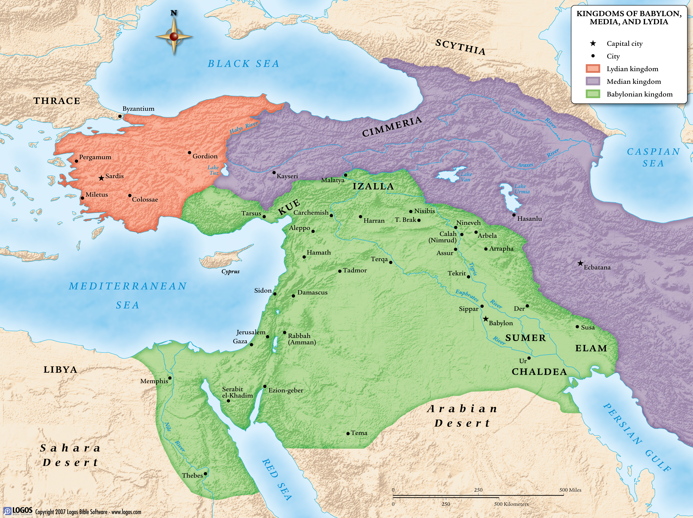
Judah Alone
2Kings 18-25; 2Chron. 30-36; Isaiah; Micah-Zephaniah; Jeremiah

