Slide 2
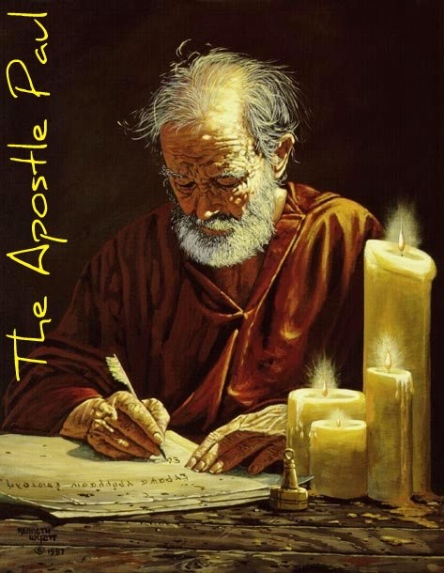
Chapter 11-12
Background
Paul now challenges directly the false apostles in Corinth
Paul’s exposes the heart of his detractors
He engages in what he calls “foolishness” to expose them

Slide 3
Chapter 11-12
Paul
False Teachers
Preaches Spirit revealed Word
“Rude in speech”
Refused their money
A burden on no one
Preach another Jesus
Trained orators
Accepted their money
Received support

Slide 4
Caesar Augustus Tomb Inscription
Twice have I had the lesser Triumph
Three times the [full] curule Triumph
Twenty- one times have I been saluted as“Imperator.”
Fifty-five times has the Senate decreed a thanksgiving unto the Immortal Gods
Nine kings, or children of kings, have been led before my chariot in my Triumphs
Thirteen times had I been consul

Slide 5
2nd Cor. 11:23-28 Paul’s Accomplishments
Are they servants of Christ? I am a better one—I am talking like a madman—with far greater labors, far more imprisonments, with countless beatings, and often near death. Five times I received at the hands of the Jews the forty lashes less one. Three times I was beaten with rods. Once I was stoned. Three times I was shipwrecked; a night and a day I was adrift at sea; on frequent journeys, in danger from rivers, danger from robbers, danger from my own people, danger from Gentiles, danger in the city, danger in the wilderness, danger at sea, danger from false brothers; in toil and hardship, through many a sleepless night, in hunger and thirst, often without food, in cold and exposure. And, apart from other things, there is the daily pressure on me of my anxiety for all the churches.

Slide 6
Paul’s Glorying Chpt 11-12
More abundant labors
In prisons more abundantly
Jewish whippings (5)
Roman beatings (3)
Stoned
Shipwrecks (3)
Many kinds of peril
Often and hungry, thirsty, cold, naked
Anxiety for the brethren

